Slide 1
Emerging risk workshop
Making a difference
IPRRG Nairobi 2023

Slide 2
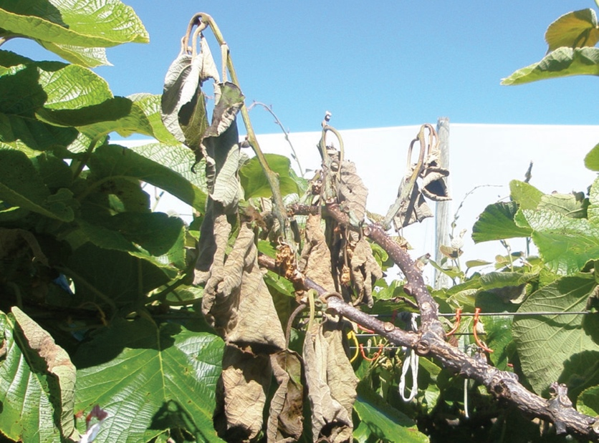
Kiwifruit vine disease Psa
Pseudomonas syringae pv. actinidiae
Affects kiwfruit (Actinidia deliciosa)
Detected in New Zealand 2010
lots of information about the pathogen, but it still entered New Zealand
image: Kiwifruit vine health

Slide 3
Critical information...
Not change in distribution or host range
Became a more serious problem because a new variety of kiwifruit was more susceptible
Change in a pathway meant it was more likely to come in – this change not detected
image: Kiwifruit vine health

Slide 4
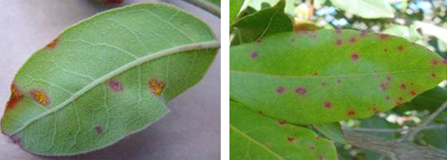
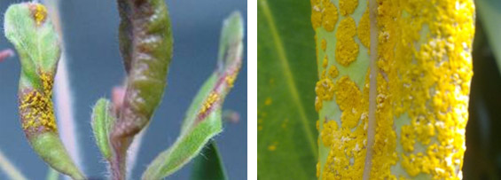
Myrtle rust
Austropuccinia psidii
Affects Myrtaceae
Detected in New Zealand 2017
lots of information about the pathogen, but New Zealand still unprepared when it arrived.
image: Department of Conservation

Slide 5
Critical information
Arrival in Hawai’i – new distribution and new host genera
Arrival in Australia – new distribution and new host genera
Rust which arrive in Australia typically detected in New Zealand within 1-5 years – wind transport
image: Department of Conservation

Slide 6
The challenge may not be finding information about new pests...
but in getting the information to the right people...
and getting the right actions to happen.

Slide 7
Purpose of this workshop
Better understand what makes an emerging risk important
Better understand what can be done
Better understand who needs to know
Better understand how to screen emerging risk information and focus on what is important

Slide 8
Group activity 1 (30 minutes)
Think of two examples from your country or which you are aware of
either new pests or pathogens which have arrived
or new pests or pathogens which you are concerned about
Share with your group
what they are
what they affect (e.g. host plants, likely impacts)
where they come from
how they are transported (e.g. plants for planting, fruit, seeds)

Slide 9
Options to consider for emerging risks...
actions to prevent arrival
actions to prepare for arrival
surveillance
contingency planning
communication
do nothing

Slide 10
Group activity 2 (30 minutes)
For your examples
what could have been done, for pests which have already established
what could be done, for pests which haven’t established
would these actions be (or have been) a priority?
What information would (or would have) made a difference?
where could you find this information?
who needs to know about it?

Slide 11
What makes an emerging risk important?
Affects important hosts
Causes large impacts
Likely to arrive
Information needed for action

Slide 12
Group activity 3 (30 minutes)
For your examples:
are they important?
what makes them important?
What are some general criteria you could use when you get new information about pests?

Slide 13
Report back on criteria

