Slide 1

Analytical Parallels Between Quantitative Risk Modelling and Regional Forest Disturbance Monitoring
Frank H. Koch
USDA Forest Service, Southern Research Station

Slide 2
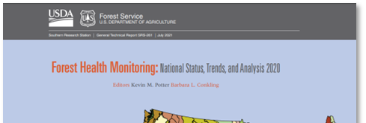


What I do (other than IPRRG Chair)
My unit: Eastern Forest Environmental Threat Assessment Center (EFETAC)
Within EFETAC, Team Leader for Forest Health Monitoring Research
Forest health lead for National Report on Sustainable Forests
UNECE/FAO Forestry Team of Specialists for Monitoring Sustainable Forest Management
IUFRO Working Group 7.03.15 – Social Dimensions of Forest Health

Slide 3

Special project: Monitoring and assessment of forest damage and disturbance in the UNECE region
UNECE = UN Economic Commission for Europe
  Europe, USA, Canada, Russia
Motivation: lack of harmonized reporting and assessment across UNECE region
  Different…
    Agents of emphasis
    Reporting thresholds
    Reporting intervals
    Data sources
    Etc.

Slide 4
Special project: Monitoring and assessment of forest damage and disturbance in the UNECE region
My task within project:
  Identify and describe innovative methods and tools
  Outline possible template for applying these innovations
  A few concepts brought up repeatedly
    Satellite remote sensing
    AI / machine learning algorithms
    Cloud computing platforms
Pretty easy, right?

Slide 5
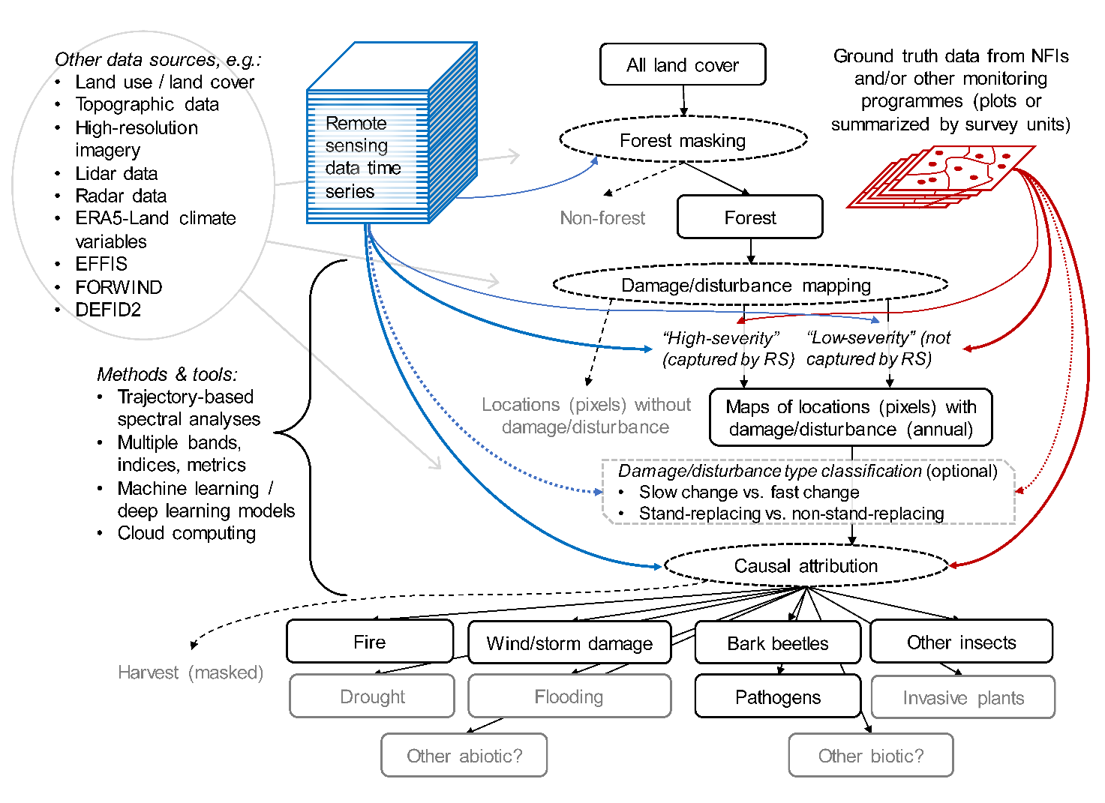
After 2 ½ years…
The more arrows I add, the more the project team loves this!

Slide 6
Then, I started thinking…
This is my current reality
I’ve already spent years working in “forest health”
  Risk modelling and analysis of non-native forest pests
Focus of my prior work was different…but how different, really?

Slide 7
Fundamental differences
Forest disturbance monitoring
  Deals with numerous agents, biotic and abiotic
  “Most important” insects and diseases are usually native
  Typically focused on recent history and current conditions
Pest risk modelling
  Typically deals with a single pest
  Commonly non-native (in some sense)
  Pest isn’t usually at equilibrium
    Isn’t found in all potentially suitable locations (yet)

Slide 8
Fundamental similarities
Both concerned about where and when particular phenomena happen (or are expected to happen)
  Under what conditions?
  With what likelihood?
Importantly, forest disturbance monitoring isn’t just retrospective
  Looks at baseline patterns and trends to enable forecasts
  Like pest risk modeling, intended to inform future decision-making
Human activity plays a major role
  Trade and transportation (pest risk models) vs. harvest (forest disturbance monitoring)

Slide 9
Similar key questions
Forest disturbance monitoring
Pest risk modelling
Causal agent?
  Biotic? Abiotic? Both?
  Frequently dictates
Level of disturbance
  For example, is it likely to be stand-replacing?
  Are there important thresholds in extent and/or severity?
  What forests are most vulnerable?
How (and when) to address disturbance?
Type of pest?
  Insect? Pathogen? Complex?
  Frequently dictates
Level of risk
  For example, what is the rate of host loss?
  Are there important thresholds in extent and/or severity?
  What hosts are most vulnerable?
How (and when) to address risk?

Slide 10
Both operate under uncertainty
Uncertainty of inputs
Scale-related
  Spatial
  Temporal
Attribution-related
  Do inputs represent what they’re thought to represent?
Uncertainty of methods
Models are imperfect
Impose their own uncertainties
Uncertainty of outputs
Unavoidable for future projections
  Climate change
  Socioeconomic change
  Unforeseen interactions

Slide 11
Both struggle with integrating climate change
Climatic conditions influence (or define) pest risk models
But climatic factors can be direct agents of forest disturbance
  Drought and extreme heat in particular
Future conditions may not have good historical analogues
  Certain thresholds may never have been exceeded
  Certain interactions may never have occurred

Slide 12
Back to the UNECE special project
So, there are parallels
But has my work in forest disturbance monitoring provided any ideas for pest risk modelling?

Slide 13
1) Embrace disparate data streams
Tasked with convincing people that remote sensing data are useful for forest disturbance monitoring
  Remote sensing data have pluses and minuses
  Won’t (can’t) replace field inventory
  Solution is figuring out how to use them together
Field reports, systematic inventory, multispectral imagery, lidar, synthetic aperture radar (SAR) – ALL have information value
Similar can be said about inputs for pest risk modelling
  Don’t throw things out because they’re messy
  Find a way to extract information content

Slide 14
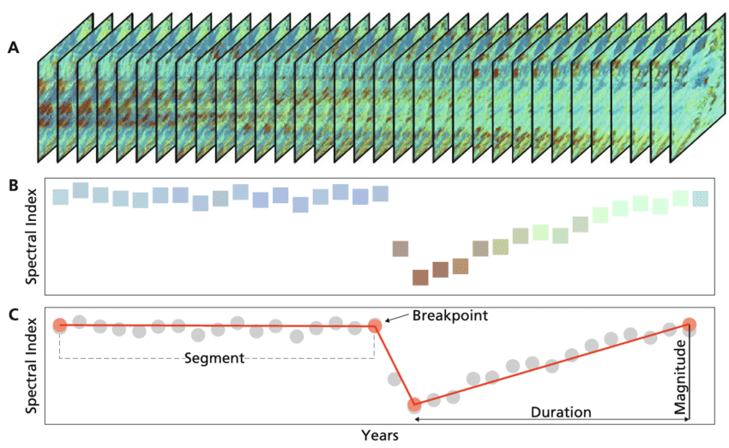
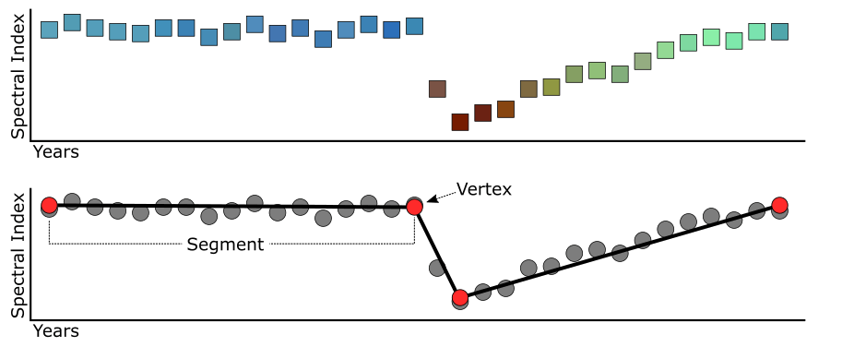
2) Think in terms of trajectories
Natural outgrowth of focus on remote sensing for forest disturbance monitoring
Looking at a trajectory through time can reveal the eventual outcome after disturbance
  i.e., long-term impact
Why not apply this for risk modelling?
  Don’t we want to know what happens after a pest establishes?

Slide 15
3) Know your forests (or your hosts)
Most forest disturbances don’t lead to permanent loss
Rather, they cause forest change – sometimes short-term, sometimes long-term
Forest composition, structure & landscape context influence the meaningfulness of these change events
Factors like these influence pest risk, too, even for pests of “monoculture” crops
  Worthwhile to get as much data on these factors as possible

Slide 16

4) Cloud computing can be your friend…
How to manage these disparate data streams and multitude of relevant factors?
Cloud computing platforms like Google Earth Engine have enabled a “big data” environment for everyone
The term “artificial intelligence” is currently trendy
Regardless of computing platform, AI algorithms do not solve all problems
Any model should be developed with a critical eye
…or your enemy

Slide 17
Final points
This was meant as food for thought
There are MANY things I didn’t address
Hopefully, an idea or two piqued your interest
Happy to discuss further
Thank you!
frank.h.koch@usda.gov

