Slide 1



Climate change project
Prof. Darren Kriticos
22 Sept 2023 Nairobi

Slide 2
Contributors
Alyssa Lowry
Catherine Bradshaw
Alan MacLeod
Darren Kriticos
Ciro Gardi
Sara Tramontini
Anca Hanea
Andrea Maiorano
Antigoni Akrivou
Chiara Rosace
Anna Szyniszewska
Chris Baker
Christine Li
Dmitrii Musolin
Eleni Verykouki
Evgenia Sarakatsani
Jessica Kriticos
Johanna Boberg
Juha Tuomola
Martin Damus
Melanie Newfield
Muriel Suffert
Niklas Björklund
Ramona Maggini
Tim Beale

Slide 3
Challenge from EFSA and EPPO
EFSA and EPPO were (really) concerned with climate change
To apply IPRRG effort to advise on how to deal with the emerging challenges from climate change
We negotiated a set of themes that they were interested in
Potential for inclusion of material in ISPMs

Slide 4
Challenge from EFSA and EPPO
Trends, magnitude and uncertainties in climate change
The interpretation of climate change scenarios. Appropriate framing of the risk assessment problems and communicating PRA scenarios
The sensitivity of pests to climate change. How important are the effects of climate change on PRA?
Evidence for changes in pest ranges and impacts in response to climatic changes, including case studies
The strengths and weaknesses of different models for estimating species ranges under climate change
Can current PRA tools include emerging threats due to climate change accurately and adequately, considering establishment, host crop exposure, and the distribution of impacts, etc.?
How should future climate scenarios be incorporated into PRA?
Understanding the appropriate time horizon for PRA
Monitoring and horizon scanning for emerging pest threats
Managing emerging pest threats under substantial climate uncertainty

Slide 5
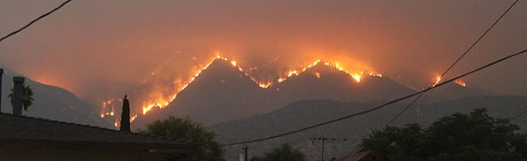
Distillation process
Interpretation and uncertainty
Importance
Modelling tools
Climate change and PRA
Time Horizon
Horizon scanning
Editorial

Slide 6
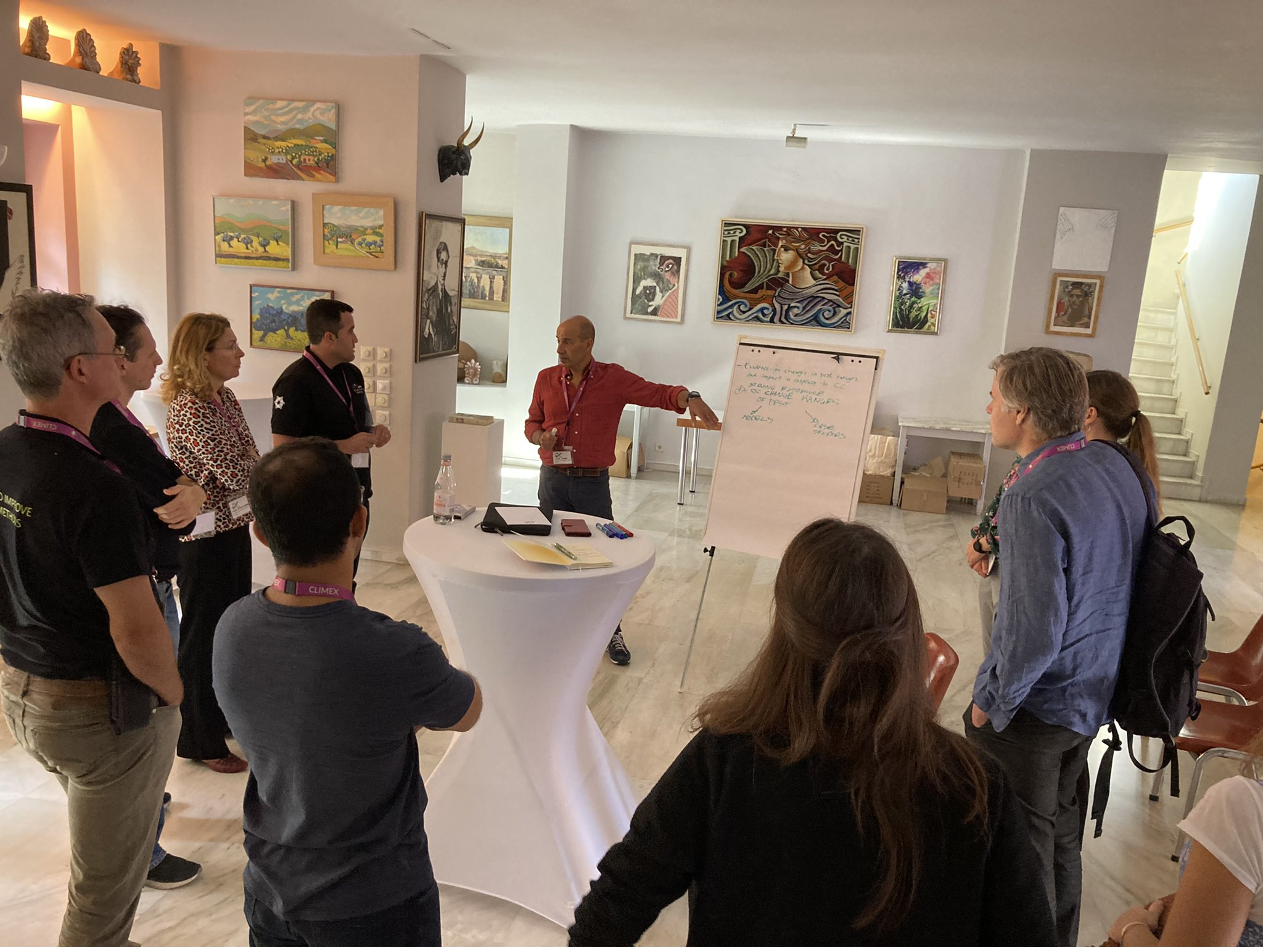
World Café
Topics distilled
Small groups moving to each theme station
Brainstorming topics that should be addressed
Capture a list of potential contributors and lead author
Editorial team appointed

Slide 7
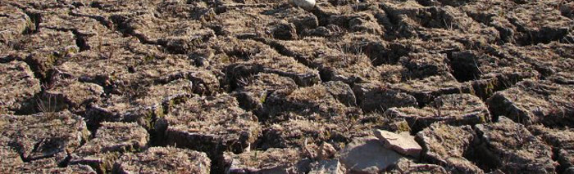
The writing process
MSs shared on Google drive
Lead authors contacted participants and arranged regular/semi-regular meetings
MSs evolved

Slide 8
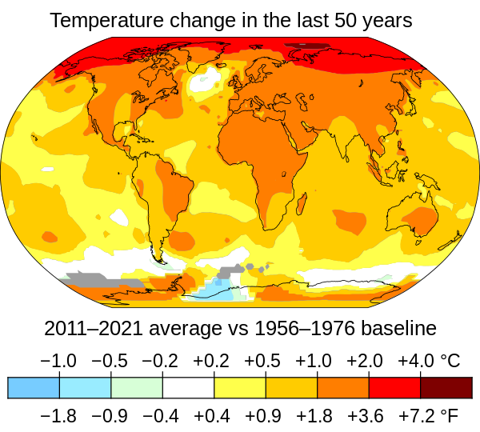
Aim
To have six manuscripts submitted to EPPO Bulletin by May
Editorial written and submitted
Special edition published prior to this meeting

Slide 9
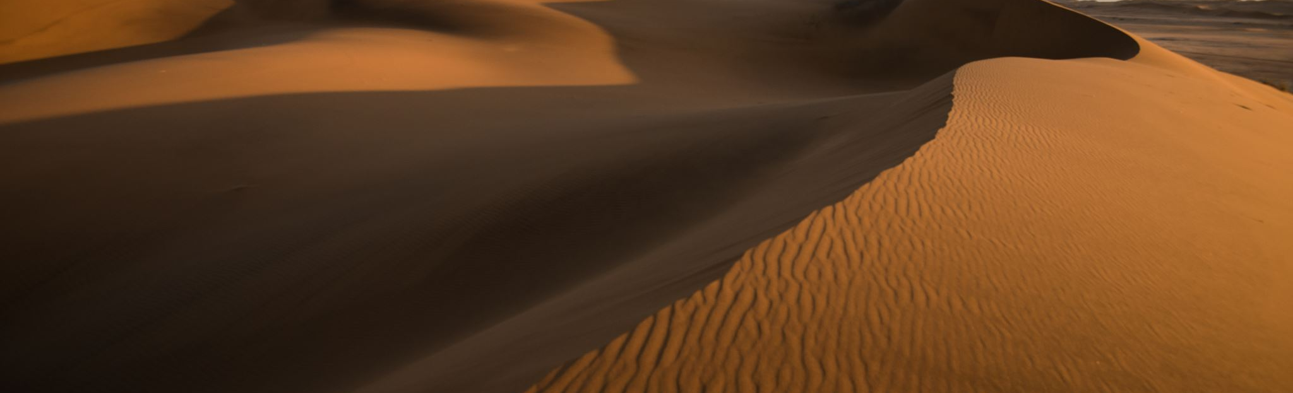
Progress
Could not find a lead author for MS 5, Time Horizon
Interpretation and uncertainty
Importance
Modelling tools
Climate change and PRA
Time Horizon
Horizon scanning
Editorial

Slide 10
Lessons
Bit off too much
Manuscript development forced conversations
Need to use technology

Slide 11
Time Horizon
How far into the future should we consider climate change scenarios?
Commented on in other MSs
Not adequate
Needs an economist/risk statistician to lead this topic

Slide 12
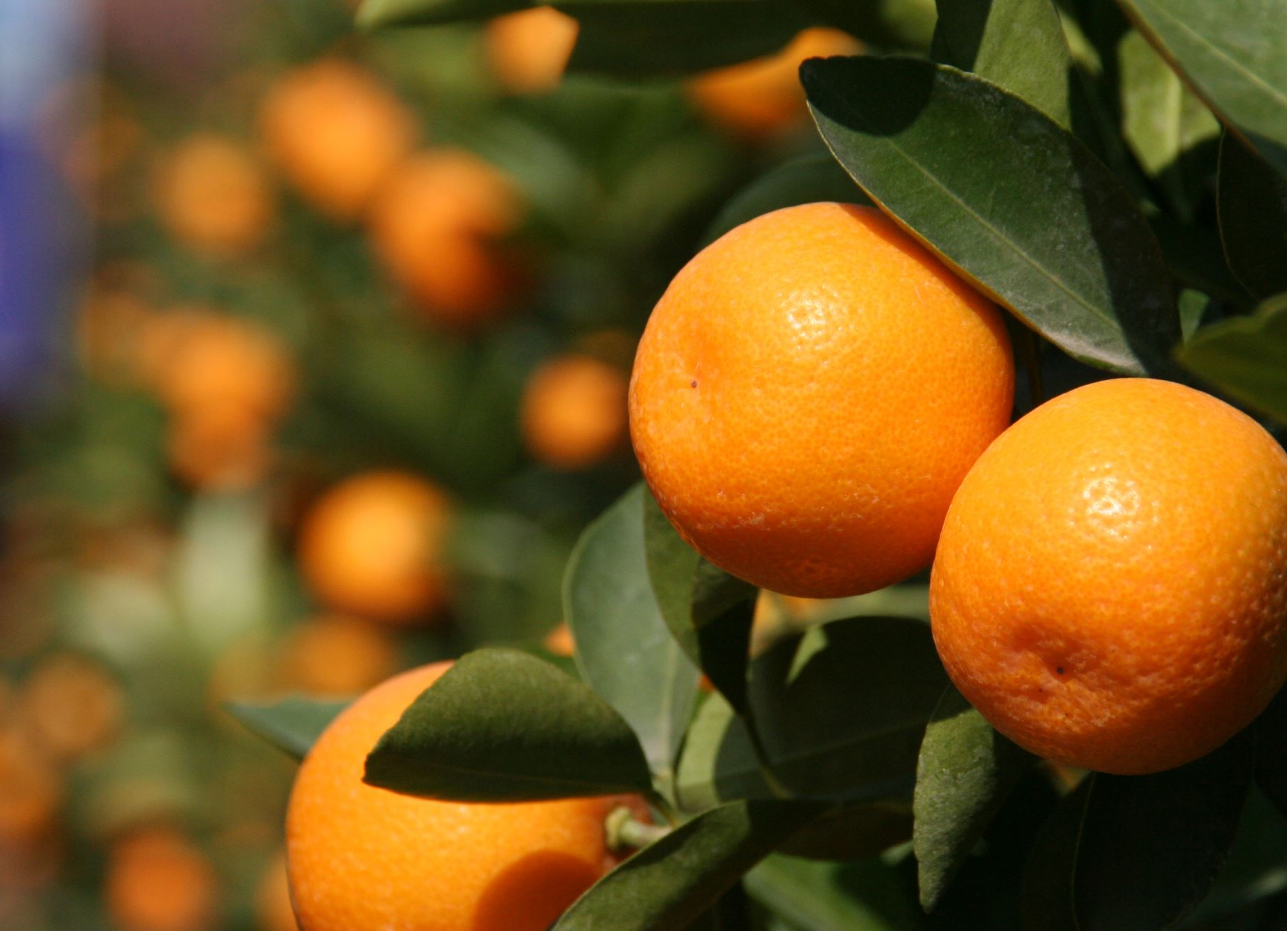
Asante Sana
Prof. Darren Kriticos
E: darren@cervantesagritech.com

