Slide 1
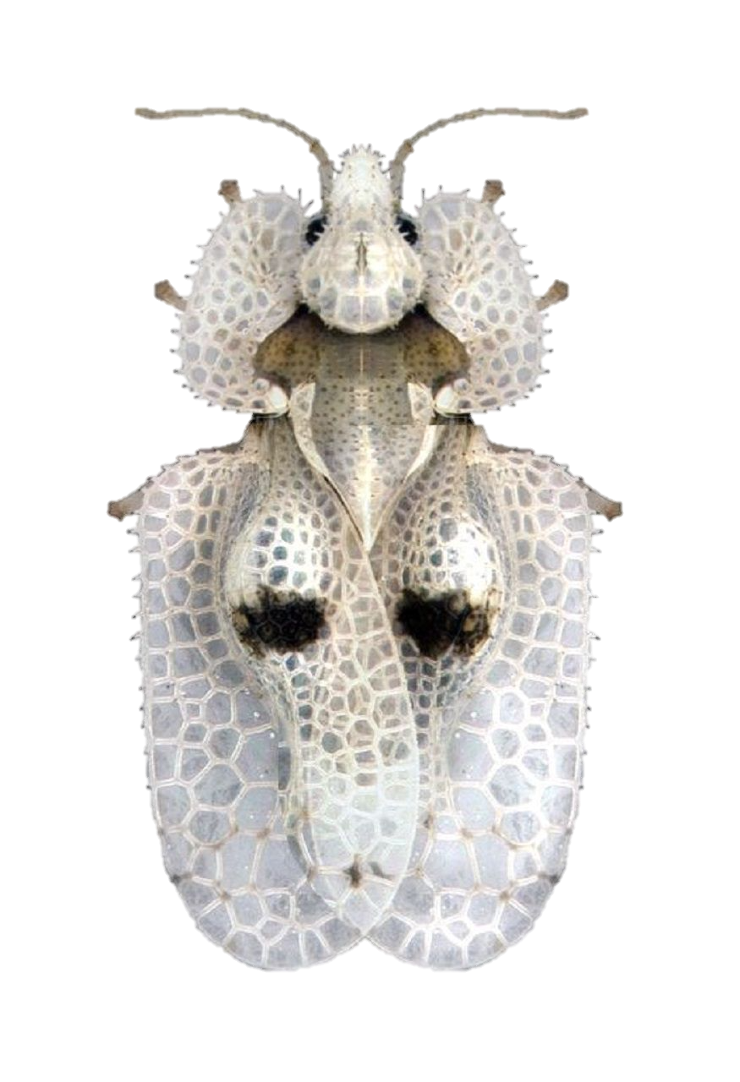
The potential global distribution of Corythucha ciliata under current and future climates
Jessica Kriticos

Slide 2
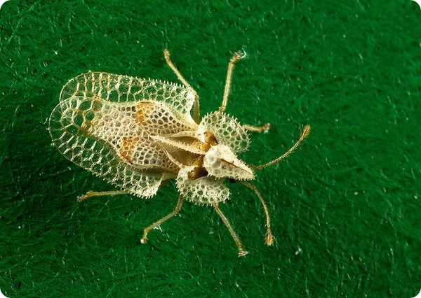
Impacts of Corythucha ciliata
Adults and nymphs feed on the leaves of Platanus spp., causing foliar damage
Severe infestations combined with drought or fungi can kill hosts
Global spread via human activity
Rapid natural spread across borders once established

Slide 3
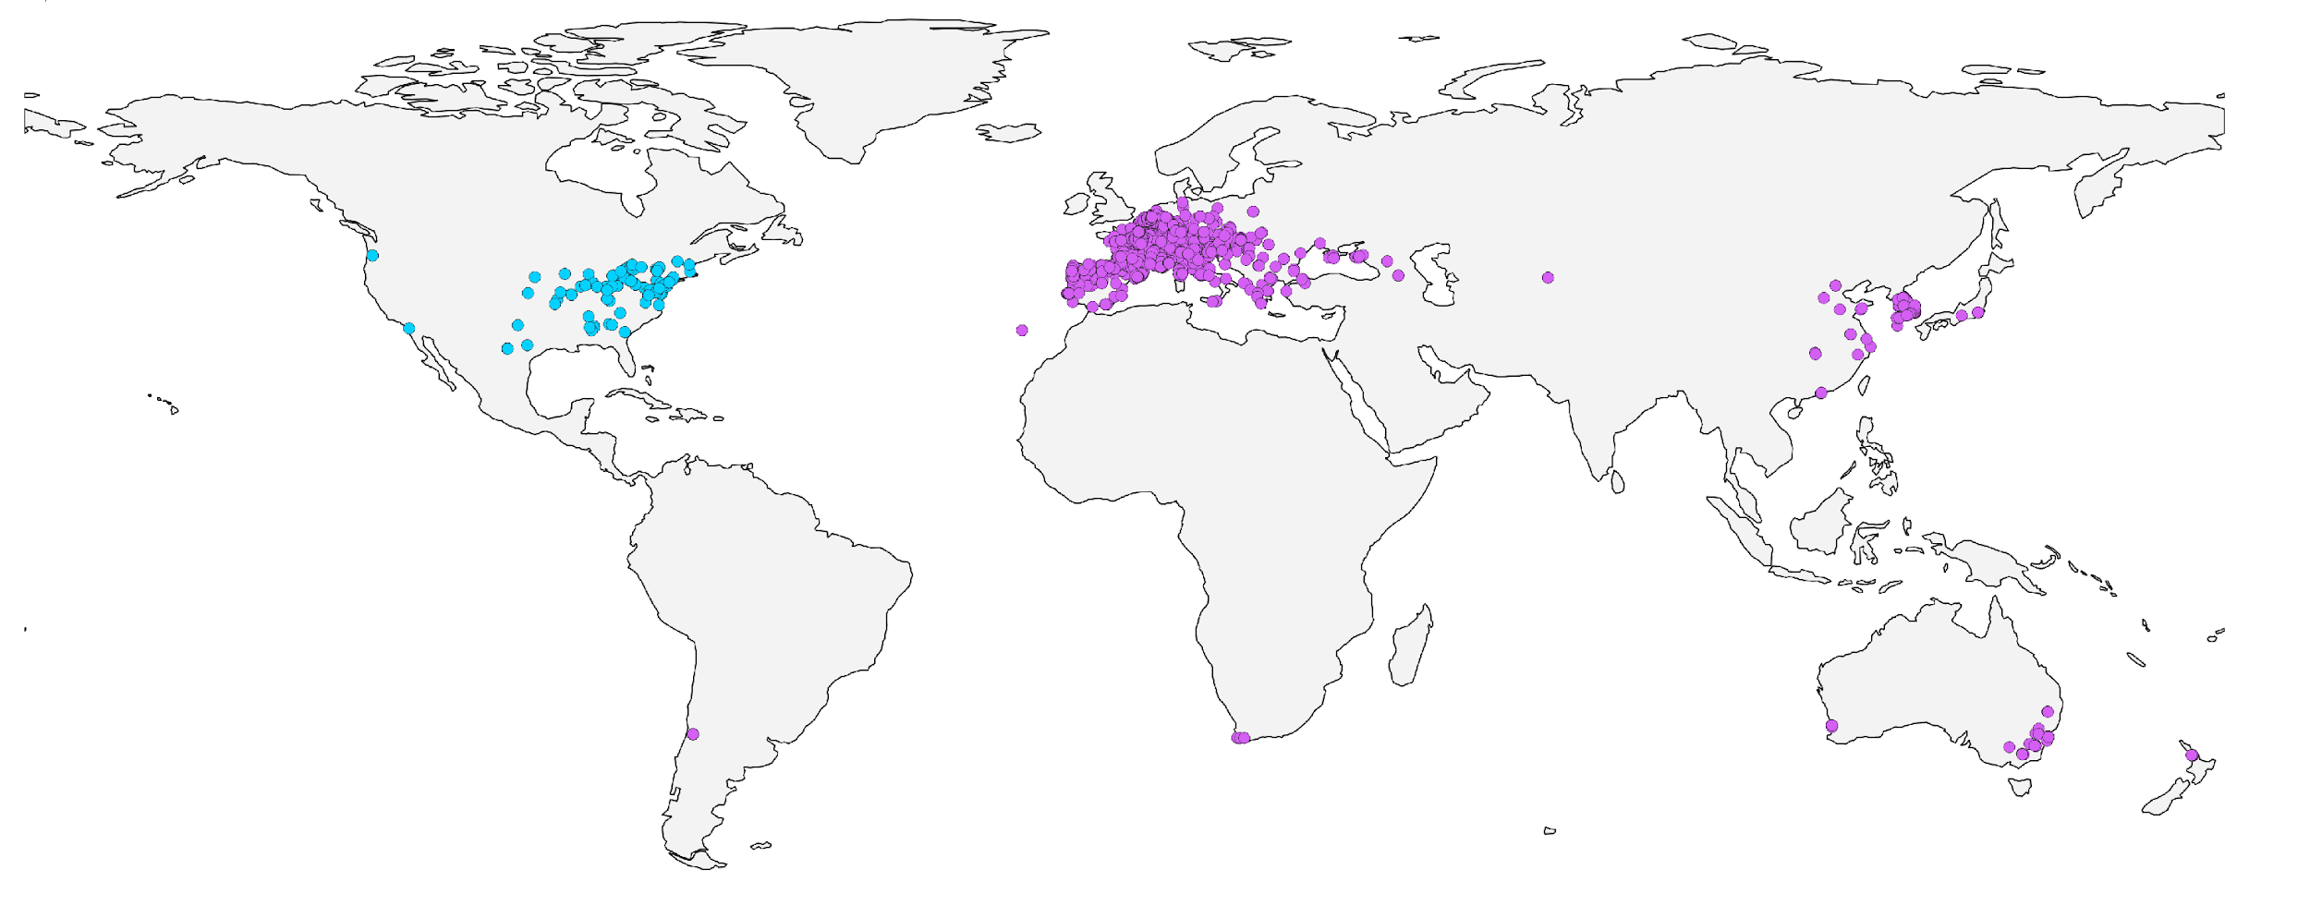
Current global distribution of Corythucha ciliata

Slide 4
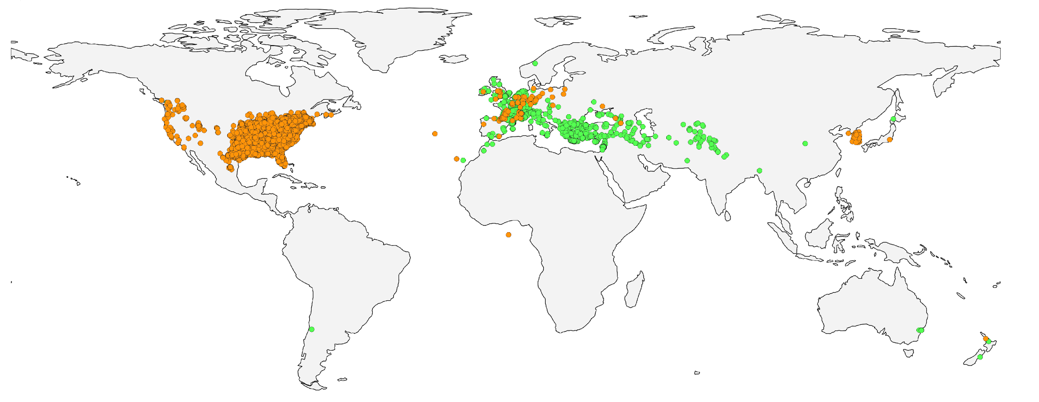
Global host distribution
Platanus occidentalis
Platanus orientalis
Notes:
Ideally would have included x hispanica / x acerifolia, but the GBIF dataset is very large and Google Sheets refused to play ball.

Slide 5
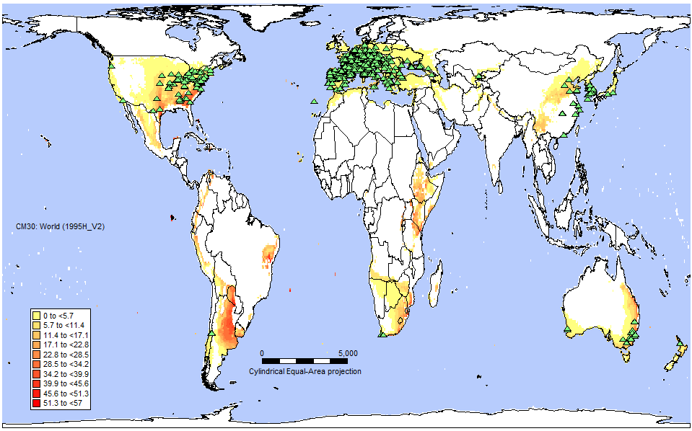
EI of CLIMEX model fitted to native range
Notes:
Only using N. American dataset in its native temperate range

Slide 6
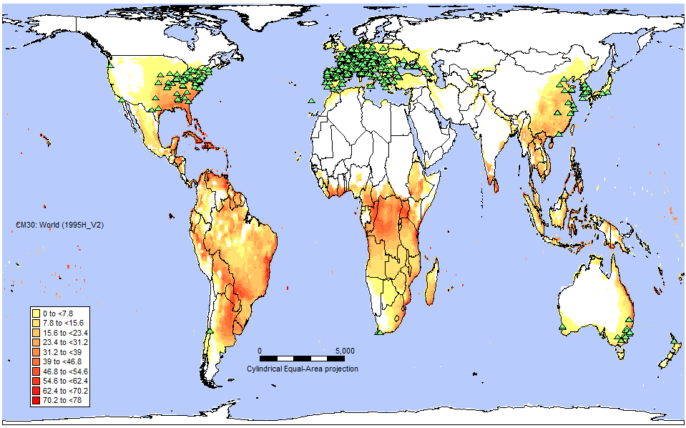
EI of CLIMEX model fitted to global range
Notes:
Relaxed Hot-Wet Stress parameter to fit to records in China where it has invaded subtropical areas, which also ensures that the northernmost Australian records fit.

Slide 7
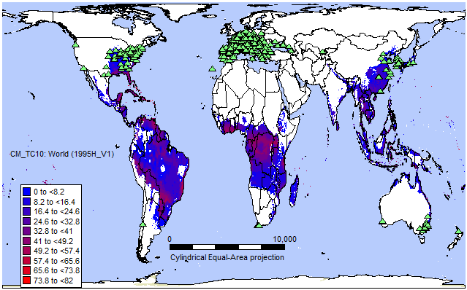
EI difference map
Notes:
Difference map between the model fit to the native range versus the global range. Relaxing the HW stress parameter allows subtropical and tropical regions to be modelled as suitable (S. America, SS Africa, South-Eastern Asia and Oceania ).

Slide 8
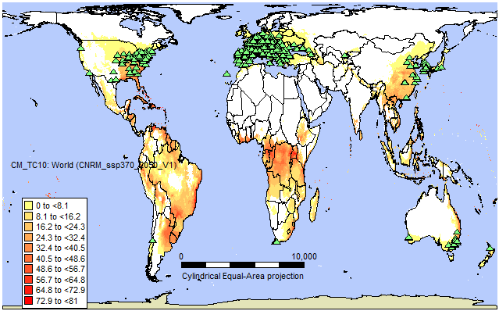
2050 projection under CNRM model
Notes:
Slight decrease in S. America, practically identical for SSA and S-E Asia

Slide 9
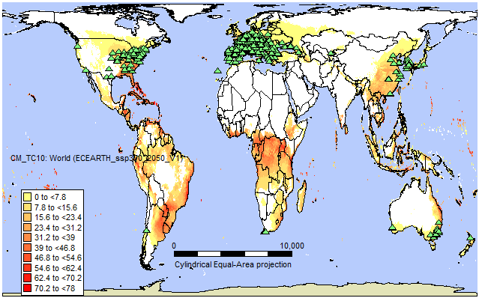
2050 projection under EC-Earth model
Notes:
Main trend is a sharply decreased suitability in central Southern America … DS? Other subtropical regions show little to no variation between the two climate scenarios. Increase in range across Eastern Eurasia into Russia

Slide 10
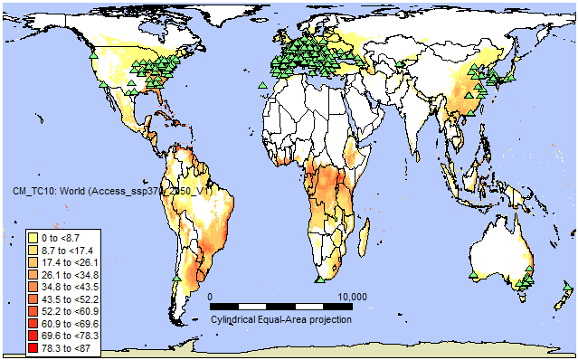
2050 projection under Access model
Notes:
Least favourable climate change scenario for Corythuca ciliata, similarly modelled decrease in S. America but reduction of EI (although not range) in Central and N. America. Very little change globally compared to current climate.

Slide 11
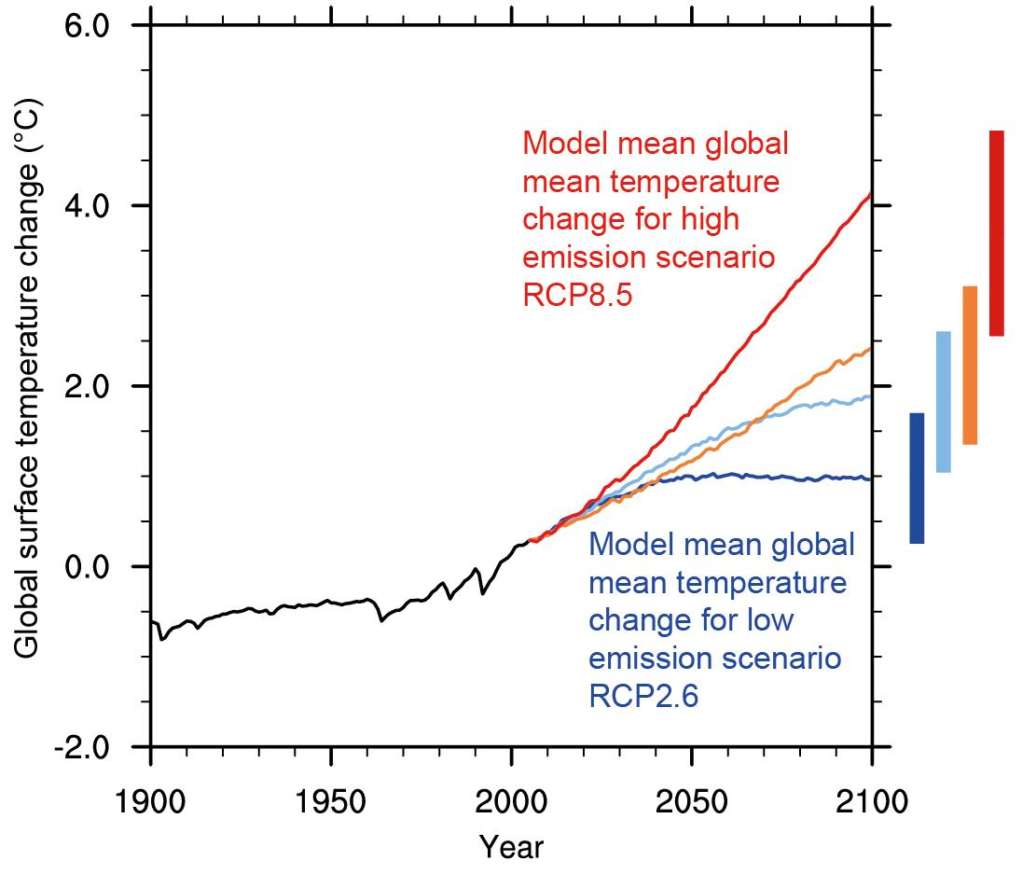
Uncertainties of climate projections
Based on estimates of projected GHG emissions
Future geopolitical impacts are inherently uncertain
Focus on broad-scale patterns of invasion potential
Notes:
Invasion potential in s. hemisphere

Slide 12
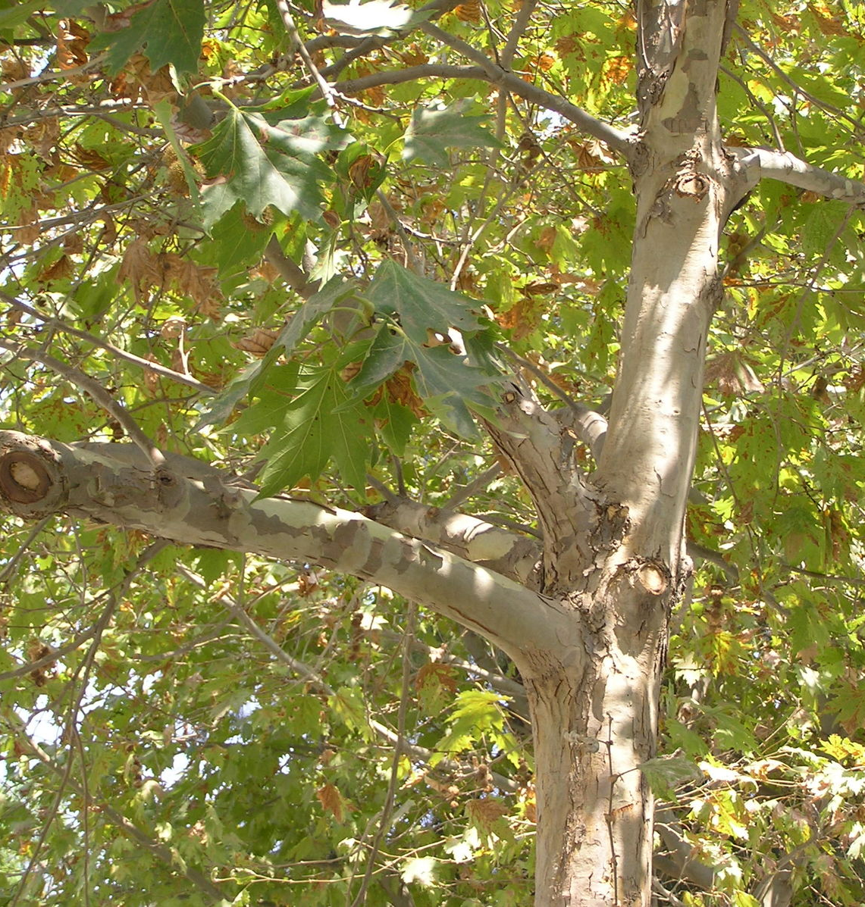
Discussion
Natural enemies likely reduce range in south-eastern USA where we initially modelled HW stress
Expansion into subtropical areas of Australia and China
Largely restricted by the distribution of Platanus spp. as urban ornamentals
Notes:
HW stress is generally an indication of biotic competitive factors rather than direct abiotic stress

Slide 13
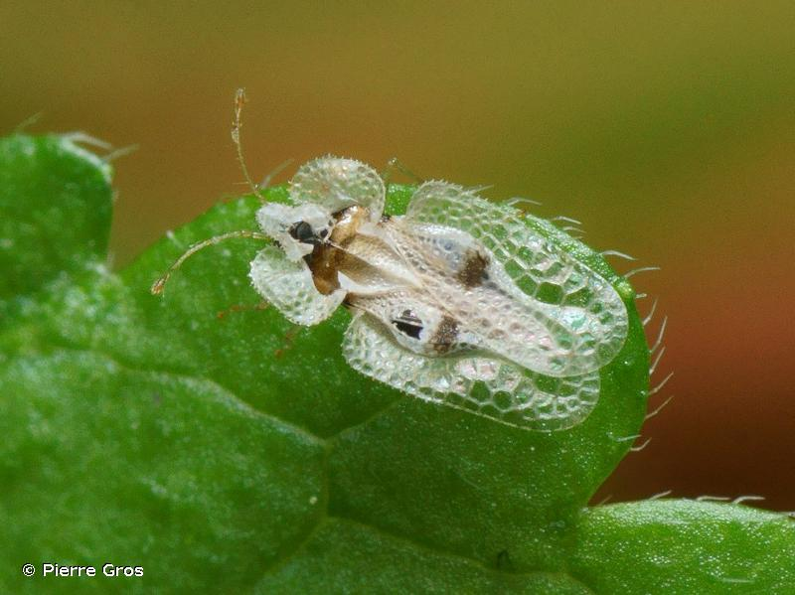
Thank you!
Email: jmkriticos@gmail.com

