Slide 1
Horizon scanning dashboard
Sara Tramontini, Sybren Vos
EFSA Plant Health Monitoring team
European Food Safety Authority, Parma Italy

Slide 2
Plant Health in EFSA
Plant Health Monitoring Team
Pest Surveillance
UQ pest prioritisation
Emerging risks: Media & Literature monitoring
Plant Health
Risk Assessment Team
Pest categorisation
Commodity Risk assessments
Pest risk assessment

Slide 3
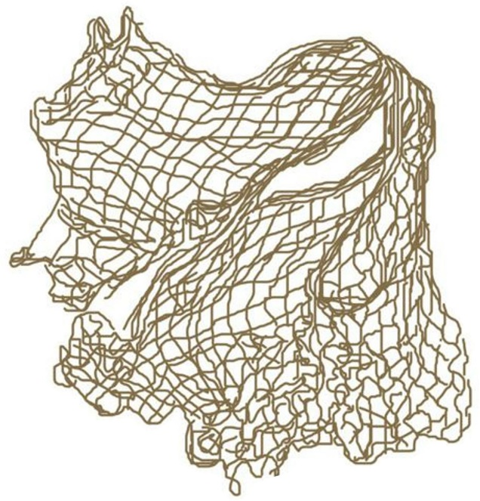
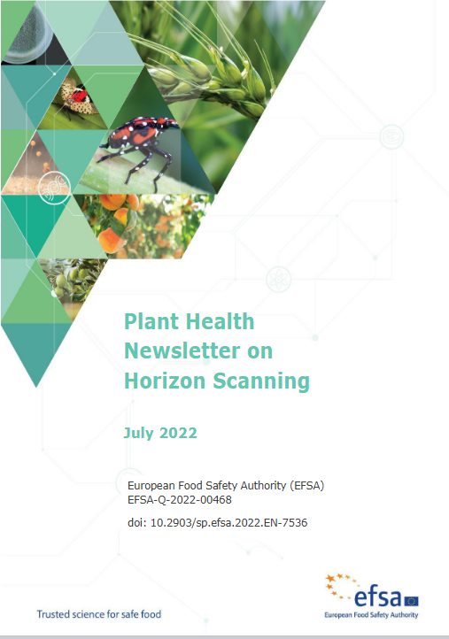
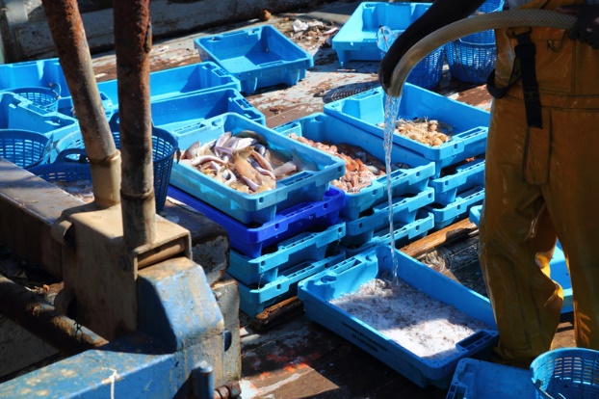
Horizon scanning in a glance
Media and
scientific literature monitoring
Newsletter composition
Articles screening and selection
MediSys platform
>22,000 sources (1,706 scientific journals)
>2,500 pests
> 13,000 keywords
204 countries
79 languages
PeMo+
PeMo-

Slide 4
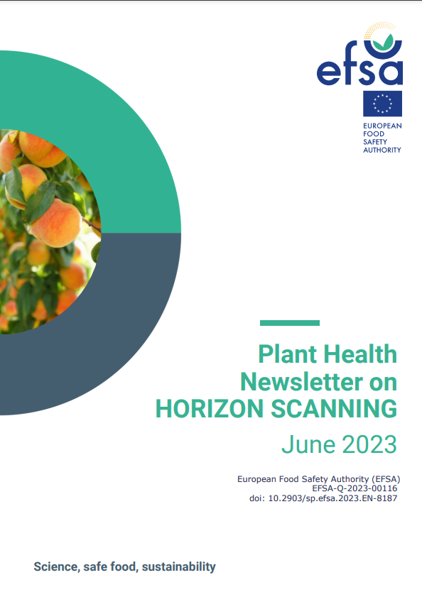
Newsletter workflow
Monthly meeting with scientific experts
Validation of the articles content
PeMoScoring with experts
Draft finalisation
30-40 items
3-7 PeMo pests
Newsletter to EU Commission and PAFF
Publication on EFSA journal Virtual Issue
Tweets
4

Slide 5
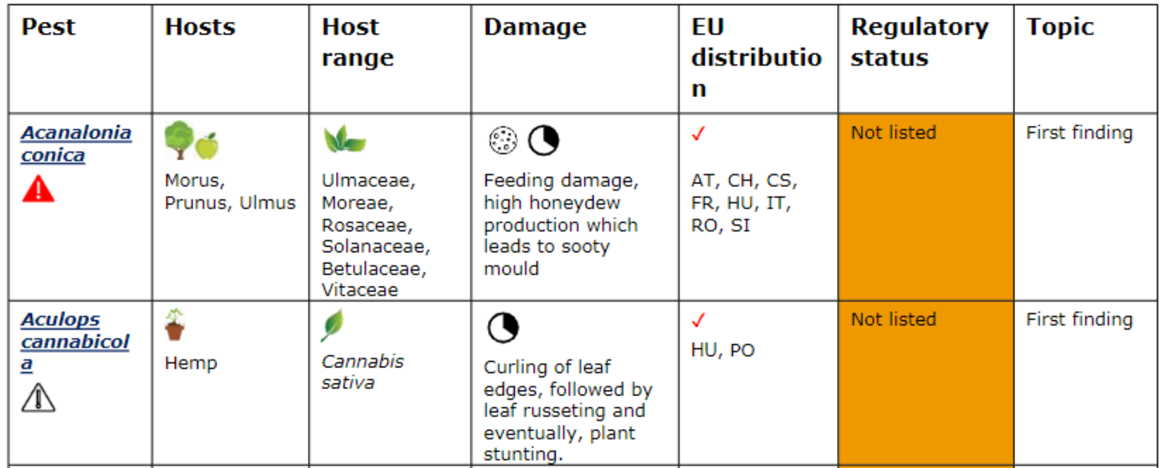
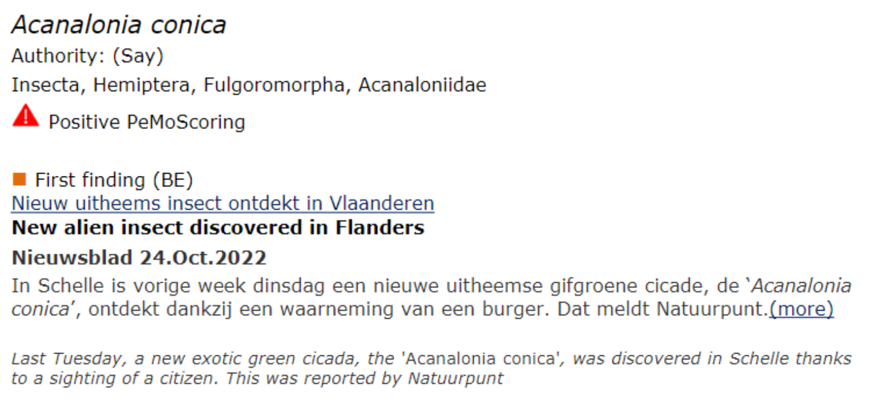
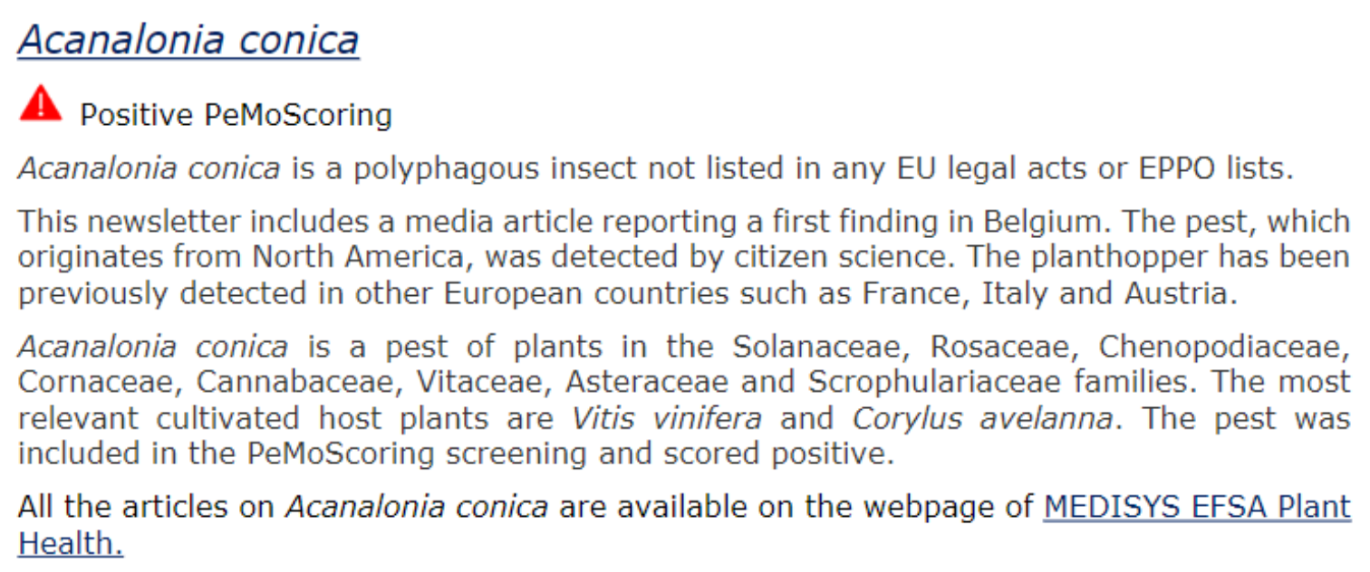
Newsletter structure
Table of content
Introduction
Summary table
Main issues
Selected items with links
3.
5.
4.
5

Slide 6
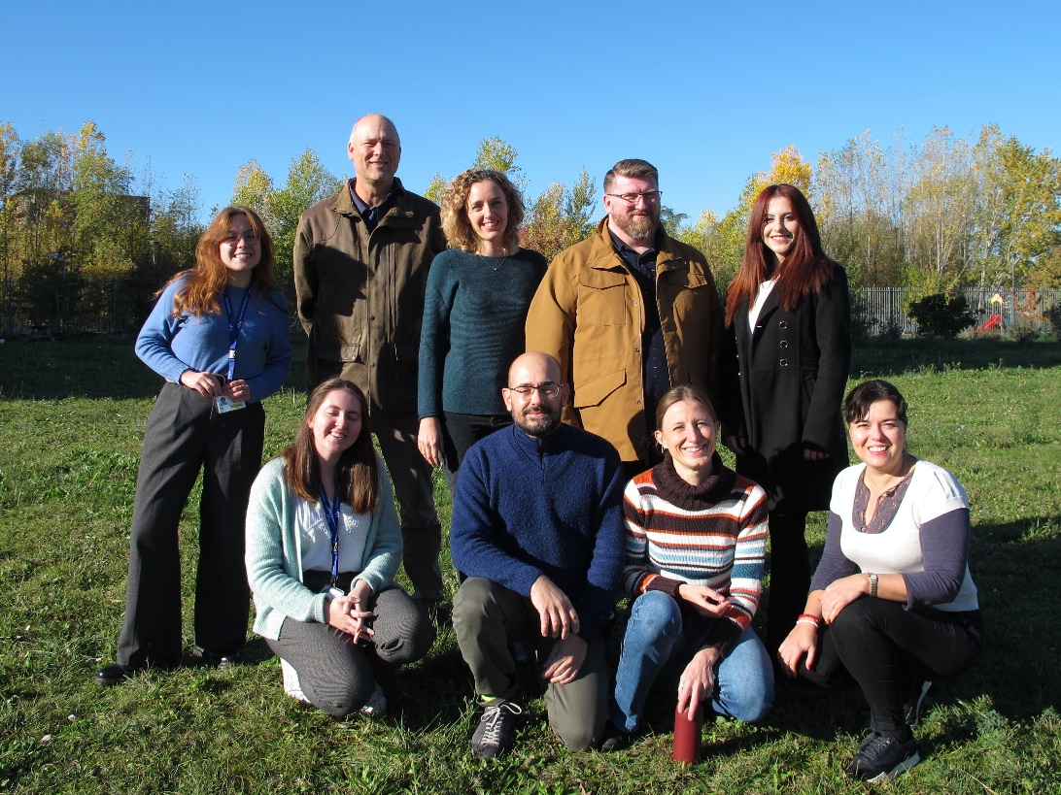
The team
Horizon Scanning Team
EFSA Staff
Sara, Alexia, Marina,
Jose, Sybren
Grant with ANSES
Magalie , Giulia
WG of experts:
Newsletter 5 experts
PeMO Scoring 3 experts

Slide 7
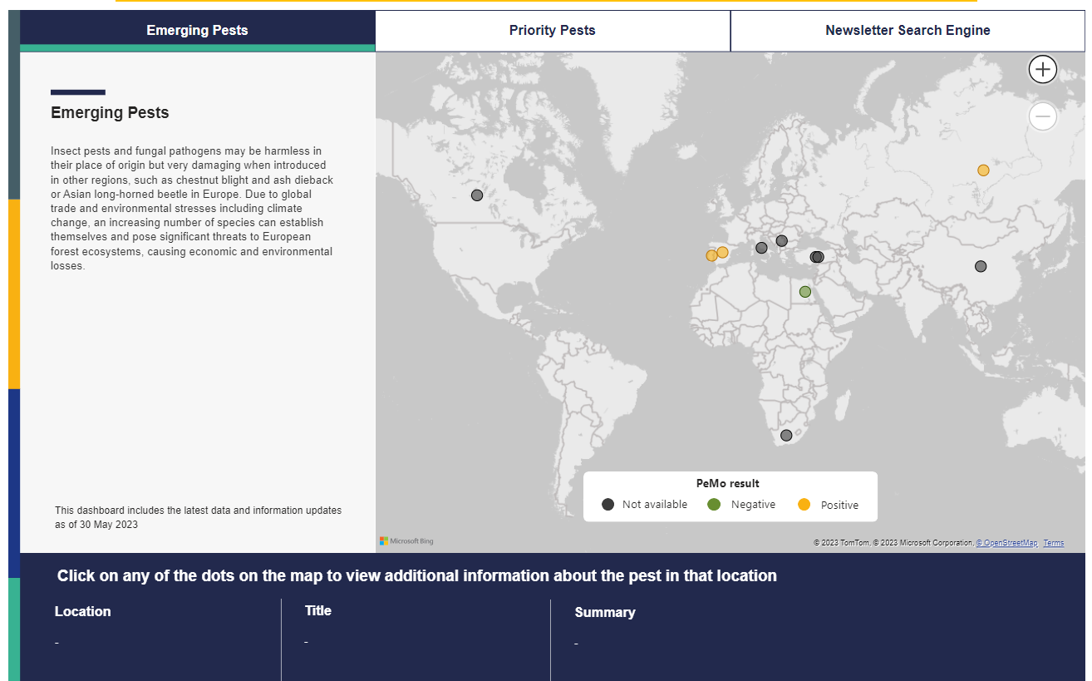
How to inform about HS?
NEW DASHBOARD!
Interactive
Self-explanatory
Regularly updated
Focused on a limited number of aspects
3 sections
https://digit-efsa.acc.fpfis.tech.ec.europa.eu/en/powerbi/horizon-scanning

Slide 8
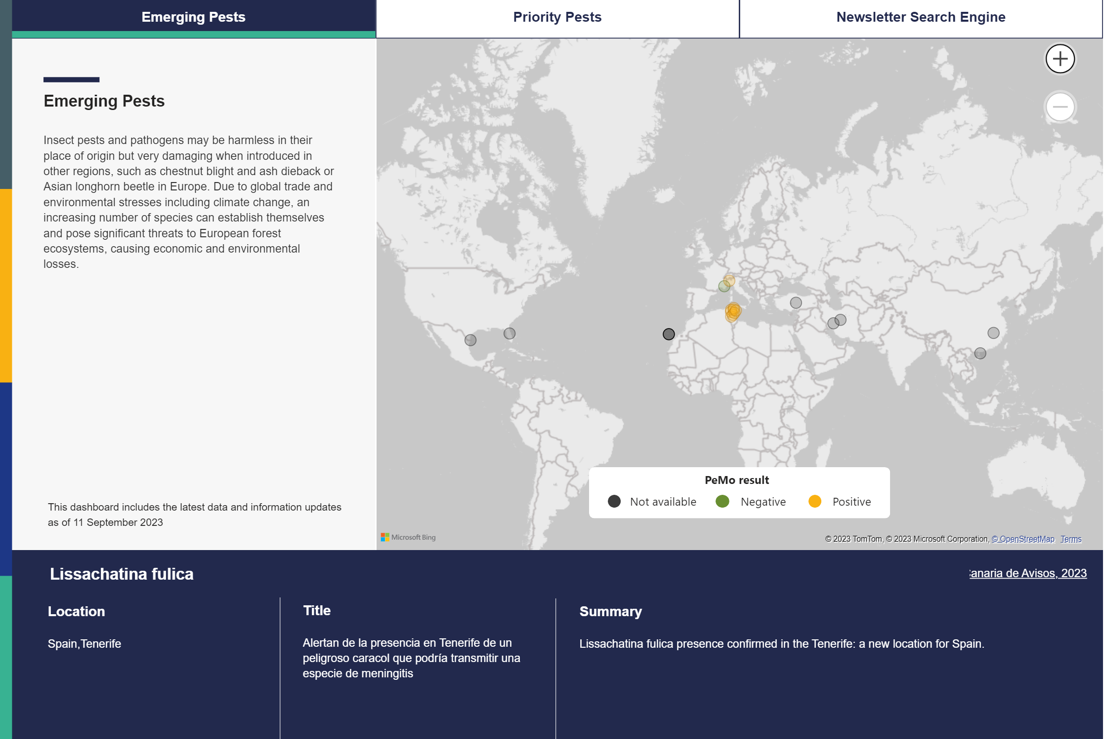
Emerging pests
Pest not regulated neither suggested for regulation in the EU
Selection triggered by
Outbreaks
New hosts
New type/level of damages
New taxa
Manual feeding of the page (at least once/month)
In the dashboard:
Identity of the pest
Location(s) of the event(s)
Title of the item triggering the news
Short summary on the relevance of the news
Active link to the original source
Result of PeMo (when available)

Slide 9
Priority pests
20 EU Priority Pests
Amount of traffic of items identified on Medisys
Authomatic continuous feeding from the tool
In the dashboard:
Select pest
Select time period

Slide 10
Search engine
All mentions of each single pest since the begininning of the project
Selection triggered by
Taxonomic category according to legislation
Family and species
Results of PeMo
Updated each time a new newsletter is published (once/month)
In the dashboard:
Active link to the corresponding newsletter

Slide 11
Lets go live!!
https://www.efsa.europa.eu/en

