Slide 1


History of IPRRG
Darren Kriticos
Immediate Past Chair IPRRG
22 Sept 2023 Nairobi

Slide 2
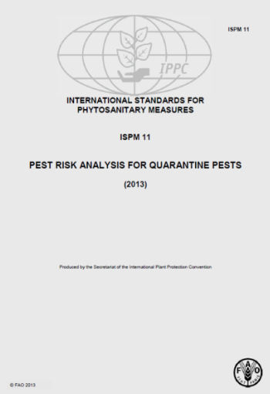
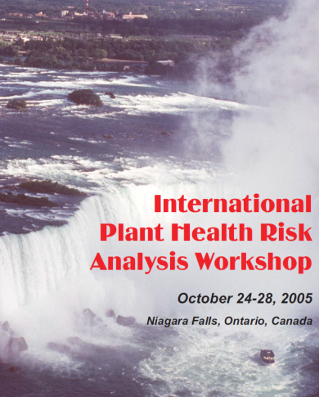
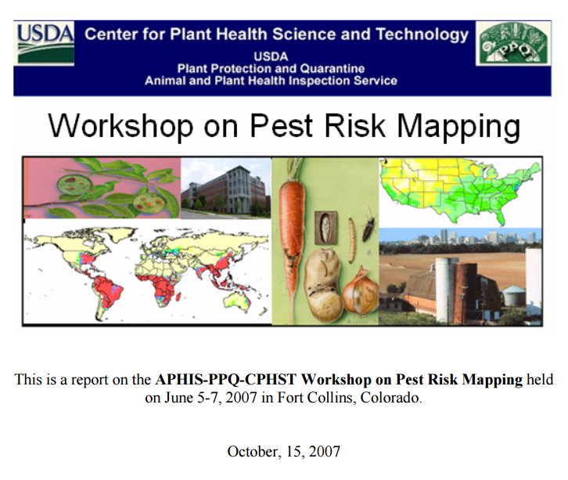
Why was IPPRG formed?
Formal Pest Risk Analysis (PRA) started in 1990
International Standard for Phytosanitary Measures on PRA (ISPM 11) published in 2004 gives little detail on methods
Plant Health Risk Analysis Workshop (Niagara Falls, Canada) in 2005 identified no forum for pest risk analysts to share best practice and enhance methods for analysing and communicating risk.
  A particular need was identified in relation to pest risk modelling and mapping
In 2007 USDA-APHIS hosted the first International Pest Risk Mapping Workshop (Fort Collins, Colorado, USA)
  26 attendees from six countries and 3 continents
Notes:
Formal Pest Risk Analysis (PRA) started in 1990 with the development of national and regional schemes, e.g. at EPPO.
International Standard for Phytosanitary Measures on PRA (ISPM 11) published in 2004 gives little detail on methods, e.g. “Climatic modelling systems may be used to compare climatic data on the known distribution of a pest with that in the PRA area.”
Plant Health Risk Analysis Workshop (Niagara Falls, Canada) in 2005 identified no forum for pest risk analysts to share best practice and enhance methods for analysing and communicating risk.
A particular need was identified in relation to pest risk modelling and mapping and convinced USDA-APHIS to host the first International Pest Risk Mapping Workshop (Fort Collins, Colorado, USA) in 2007 with 26 attendees from six countries and 3 continents

Slide 3

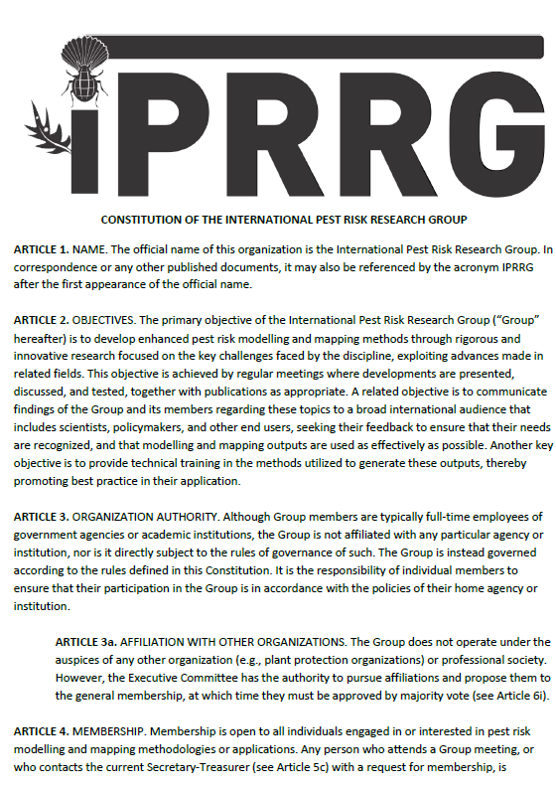
How was IPRRG created?
Initially called the International Pest Risk Mapping Workgroup (IPRMW)
  Informal network of pest risk analysts
By meeting 7 (2013), it was agreed that we needed a professional body with a constitution to:
  Give us a clear identity when promoting our work and engaging with external bodies
  Provide funds to support the website, the annual meetings and other activities
At meeting 9 (2015):
  Constitution was agreed
  Registered as an unincorporated not-for-profit association in Australia
  Executive Committee elected
  Changed the name to the International Pest Risk Research Group (IPRRG) to reflect the fact that all pest risk related research is covered by the group.
Notes:
An informal network of pest risk analysts that met annually to share developments in pest risk mapping and modelling, to address the key challenges and to provide guidance in using the most appropriate techniques.

Slide 4
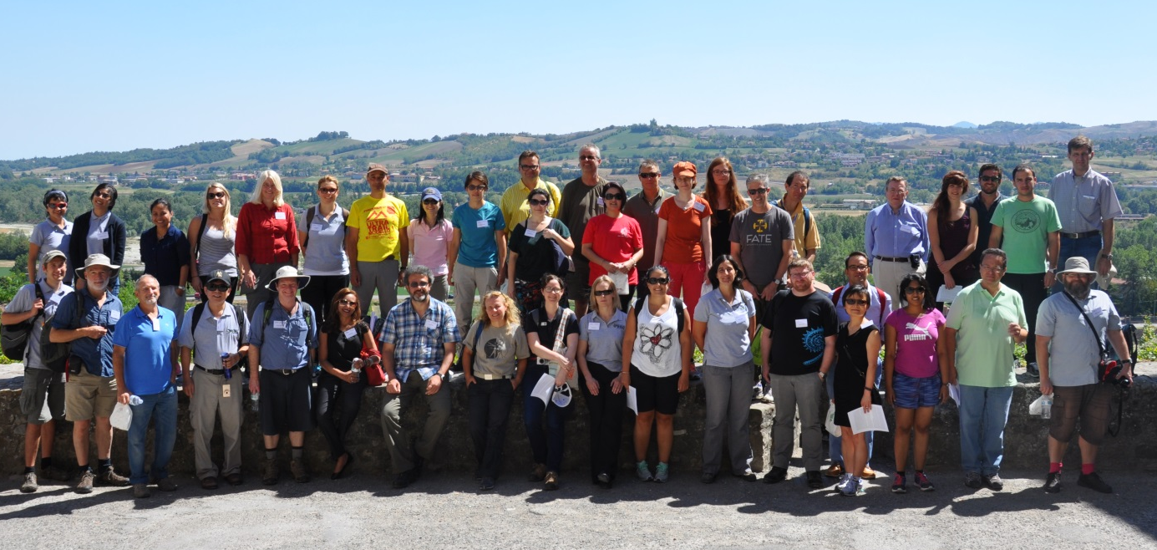
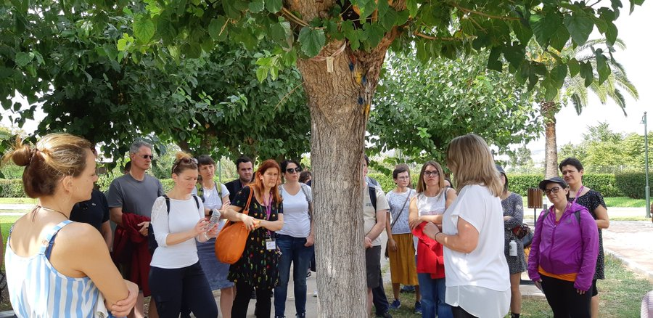
Who are we?
Members:
  >450 members
  >56 countries
Affiliations:
  Students and professionals from academic institutions, national and international agencies
  Interdisciplinary background e.g. pest risk analysts, modellers, entomologists, plant pathologists , ecologists, economists, risk managers, etc
Executive Committee:
  Frank Koch (Communications Officer
  Melanie Newfield (Secretary-Treasurer)
  Jessica Kriticos (Student Rep.)
  Rose Souza Richards (Vice-Chair)
  Darren Kriticos (immediate past chair)
Scientific Committee:
  Exec Committee & local organisers
Parma
2022 Athens

Slide 5
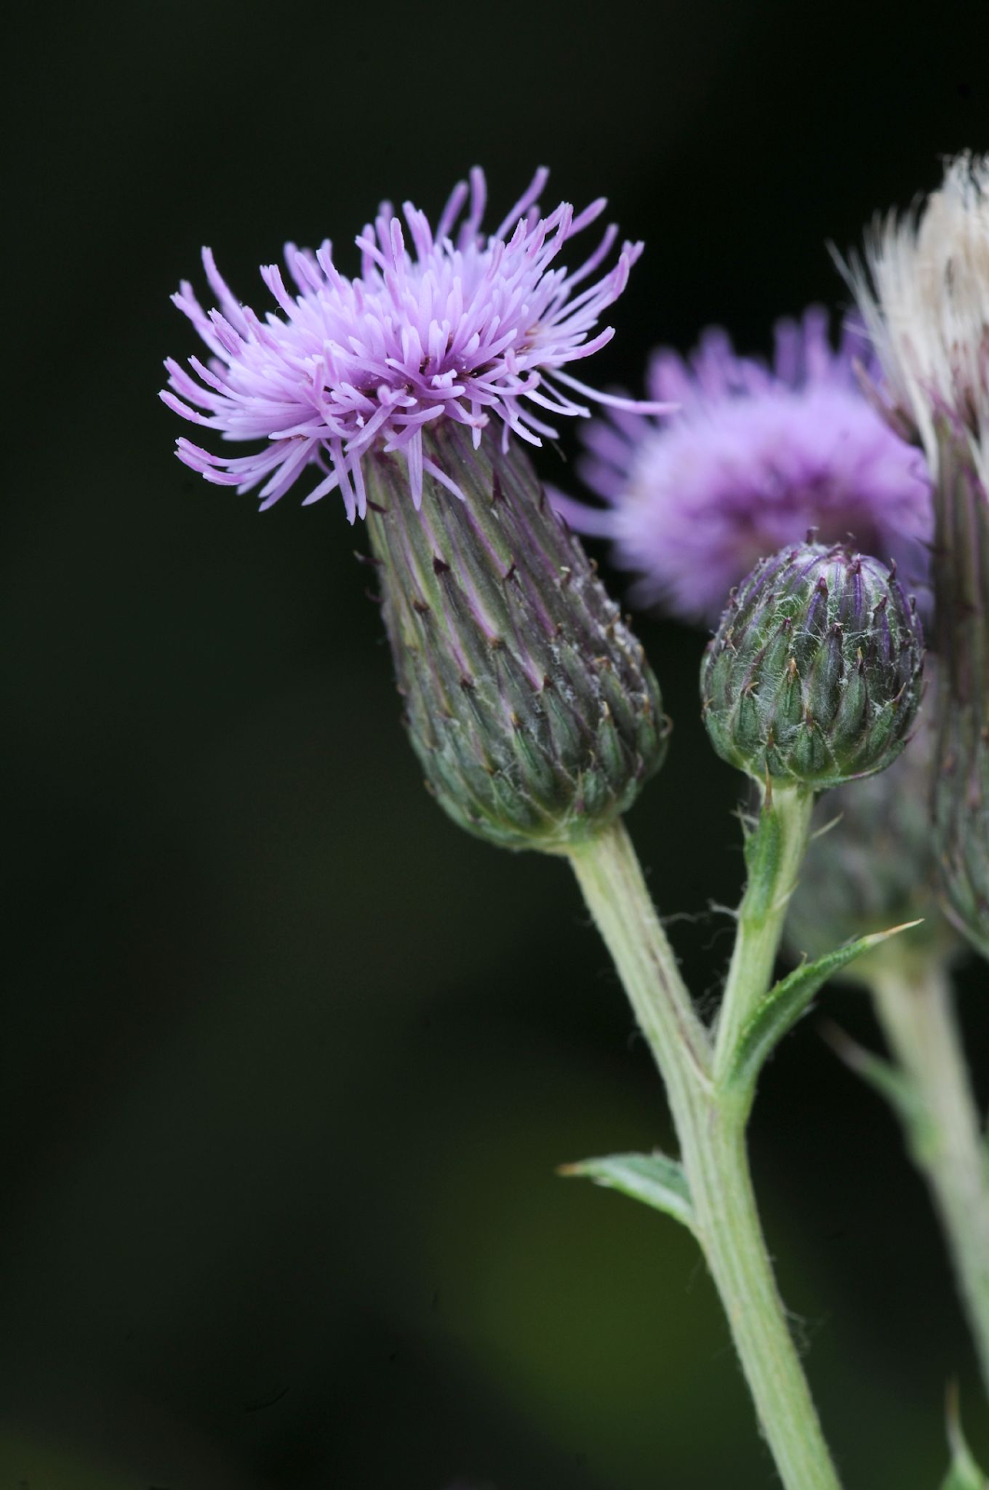
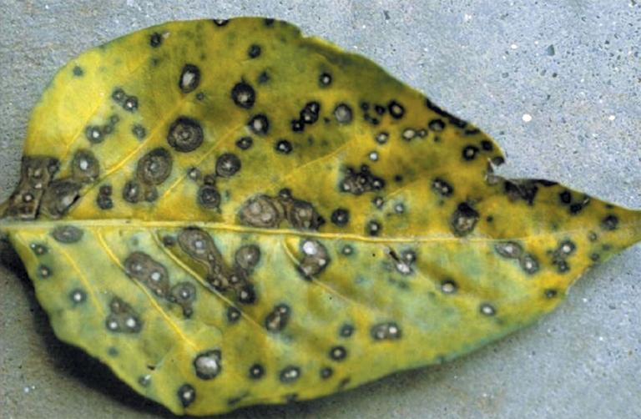
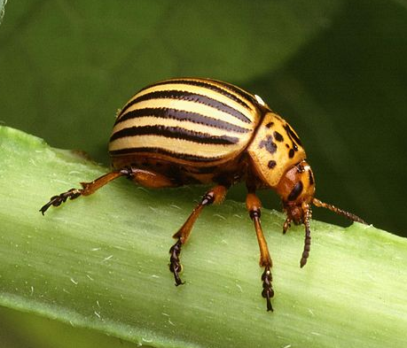
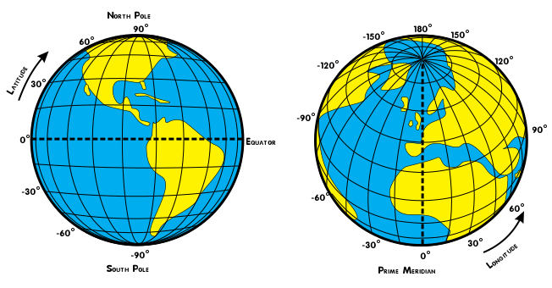
The Logo
Ian Clarke, VicFlora 2022
David B. Langston, University of Georgia,
Bugwood.org
Scott Bauer, USDA

Slide 6
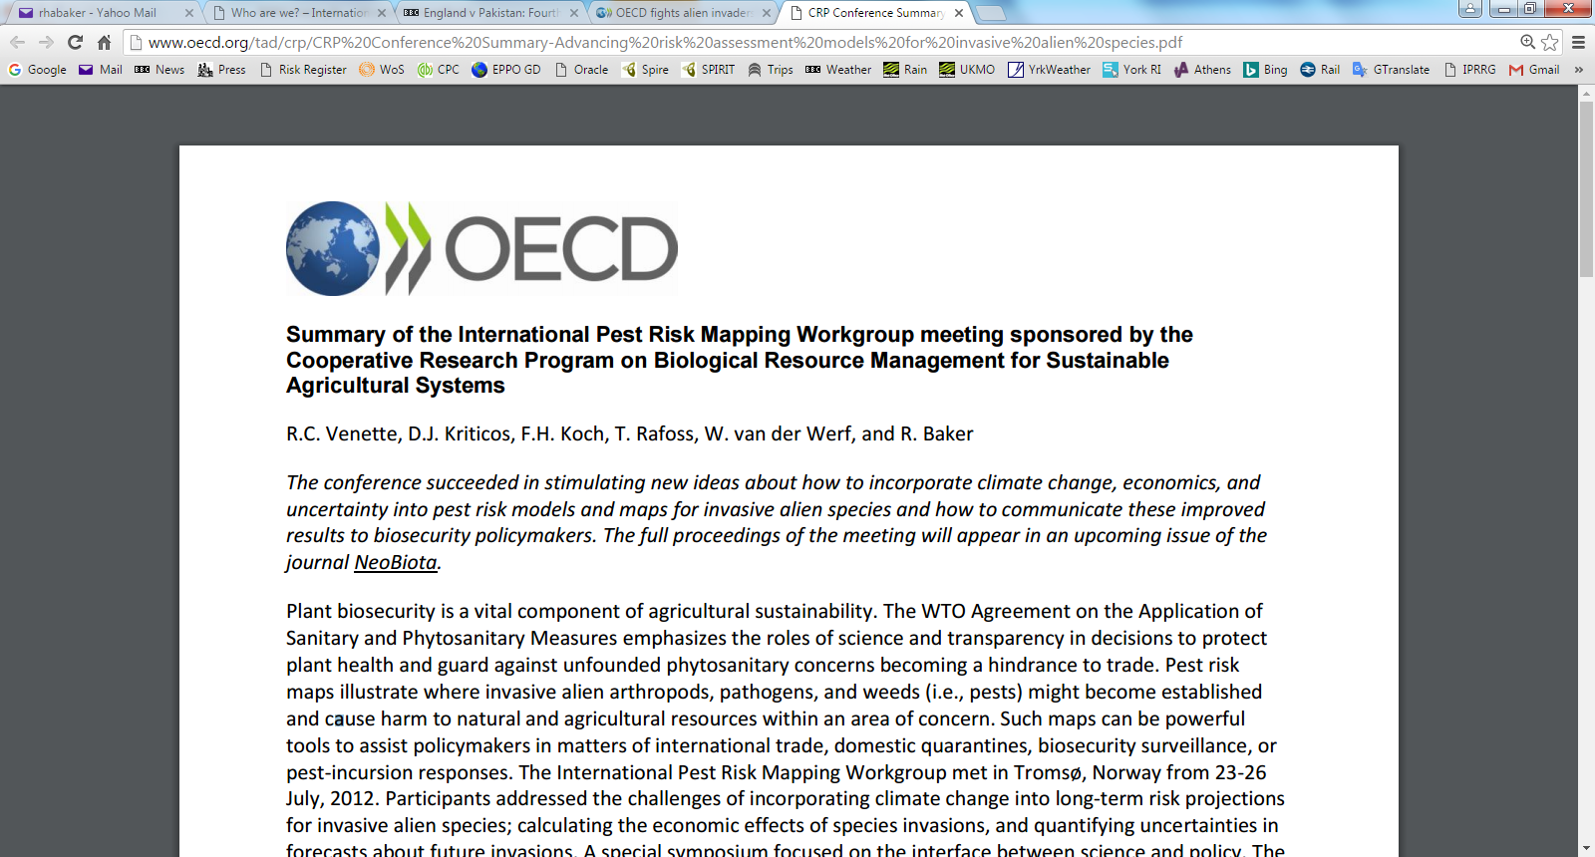
Achievements
No | Year | Location | Papers presented
1 | 2007 | Fort Collins, Colorado, USA | 18
2 | 2008 | St. Paul, Minnesota, USA | 14
3 | 2009 | Pescadero, California, USA | 26
4 | 2010 | Port Douglas, Queensland, Australia | 32
5 | 2011 | Fort Collins, Colorado, USA | 30
6 | 2012 | Tromsø, Norway | 29
7 | 2013 | Raleigh, North Carolina, USA | 17
8 | 2014 | Canberra, Australia | 19
9 | 2015 | Fort Collins, Colorado, USA | 17
10 | 2016 | Parma, Italy | 32
11 | 2017 | Ottawa, Canada | 27
12 | 2018 | Taichung, Taiwan | 26
13 | 2019 | Poznan, Poland | 32
 | 2020 | Webinar series | -
14 | 2022 | Athens | 45
 |  | TOTAL | 364
14 annual meetings on four continents
319 papers presented
Sponsorship of the 2012 meeting by the OECD and 2018 Meeting by Taiwanese Ministry of Science and Technology
Webinar series
319

Slide 7
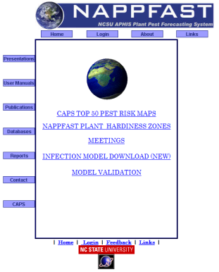

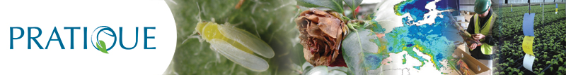
Achievements - Work group activities
Pathways
Uncertainty
Model Comparison
Work Group activities have:
Led to publications
Provided invaluable feedback on new endeavours, e.g NAPPFAST (NCSU-APHIS Plant Pest Forecasting System), the PRATIQUE EU Project and CLIMEX pest risk modelling software v. 4
Enabled comparisons to be made between different approaches and models
Provided a general forum for discussion on particularly challenging topics
IPRRG
Economic Modelling
Establishment & Spread
Project Stinky

Slide 8
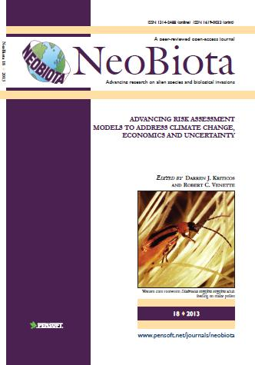
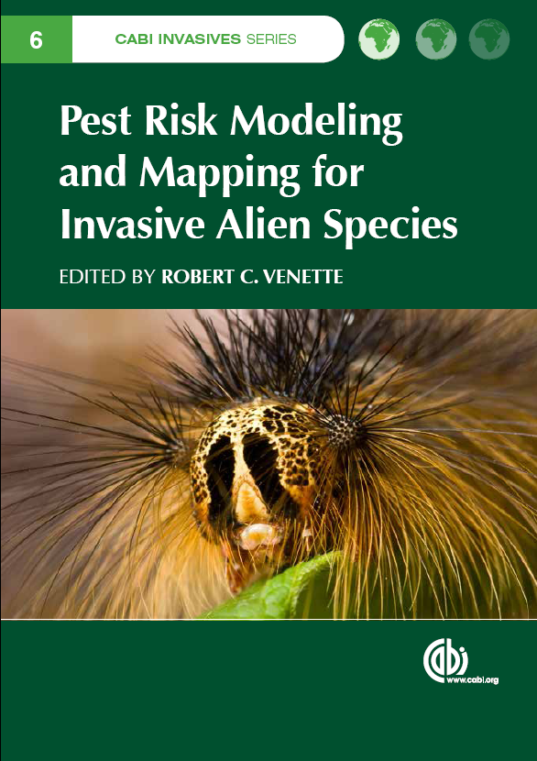
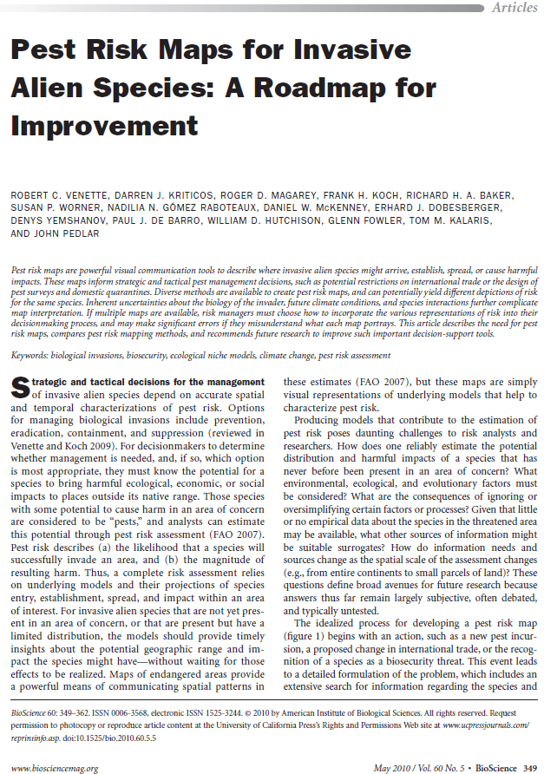
Achievements - Publications
Pest risk maps for invasive alien species: a roadmap for improvement (Venette RC et al; 2010; Bioscience)
Advancing risk assessment models to address climate change, economics and uncertainty (Kriticos DJ et al; Neobiota Special Issue; 2013)
Pest Risk Modelling and Mapping for Invasive Alien Species. (Venette RC (Ed); 2015. CAB International)

Slide 9
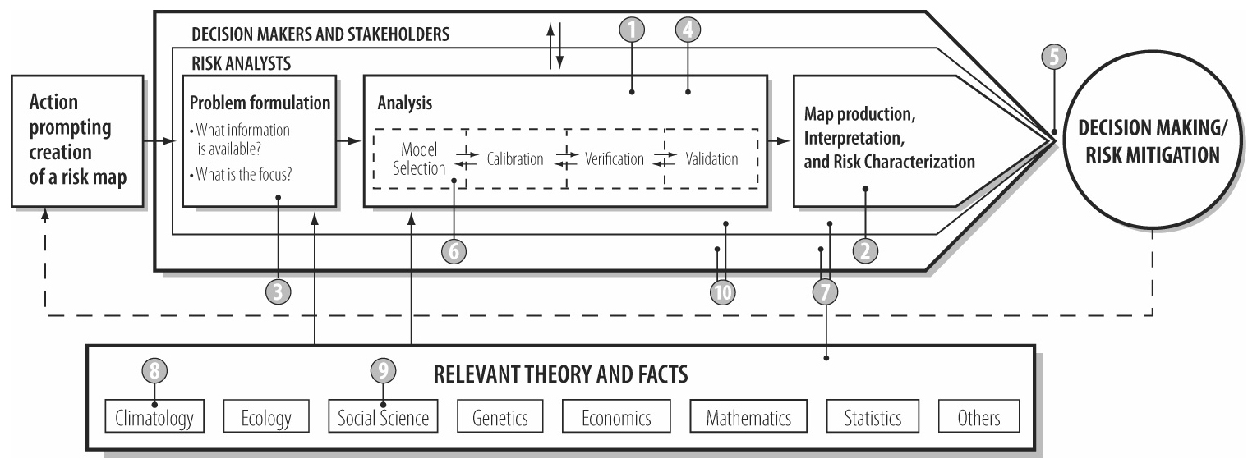
What have we achieved – The roadmap
Provide greater documentation of model development and assessment.
Improve representation of uncertainty.
Expand availability and accessibility of primary data.
Develop a best practice guide and toolkit for modeling.
Expand communications with decision-makers on the interpretation and use of risk maps.
Work towards impact mapping.
Increase international collaboration.
Incorporate climate change.
Study how human and biological dimensions interact.
Provide training in pest risk modelling practice.

Slide 10
IAGPRA
Merged a working group from IPPC
Alan McLeod appointed as the Policy Liaison Officer
Recognized IPRRG as a significant organization

Slide 11
Incorporation
Sep 2023 Application made to incorporate the association in Canberra, Australia

Slide 12
Current and emerging goals
To develop enhanced pest risk modelling and mapping methods through rigorous and innovative research
To communicate findings of the Group
Provide technical training, build capacity
Engagement with developing nations

Slide 13
COVID-19
Applied for STDF funding to support a meeting in Nairobi
Lost two annual meetings
International Year of Plant Health was a fizzer
Instituted a very popular webinar series

Slide 14

Asante Sana
Prof. Darren Kriticos
E: darren@cervantesagritech.com

