Slide 1
CABI introduction for IPRRG 2023
IPRRG 2023, Nairobi, Kenya, 20-24 Sep. 2023
Lucinda Charles CABI UK and MaryLucy CABI Kenya

Slide 2
CABI at a Glance
Not-for-profit intergovernmental organization, established by a United Nations treaty-level agreement
Owned by 49 Member Countries which have an equal role in the organization’s governance, policies and strategic direction
Global reach – 450+ staff across more than 20 locations worldwide
Addresses issues of global concern such as food security and climate change through research and international development cooperation
Major publisher of scientific information – books, ebooks, digital learning, compendia and online information resources

Slide 5
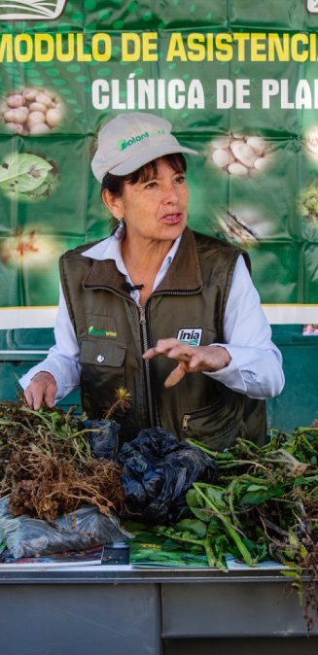
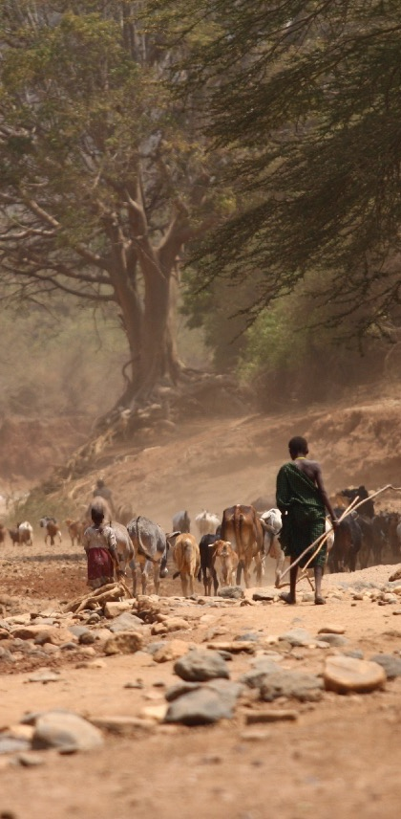
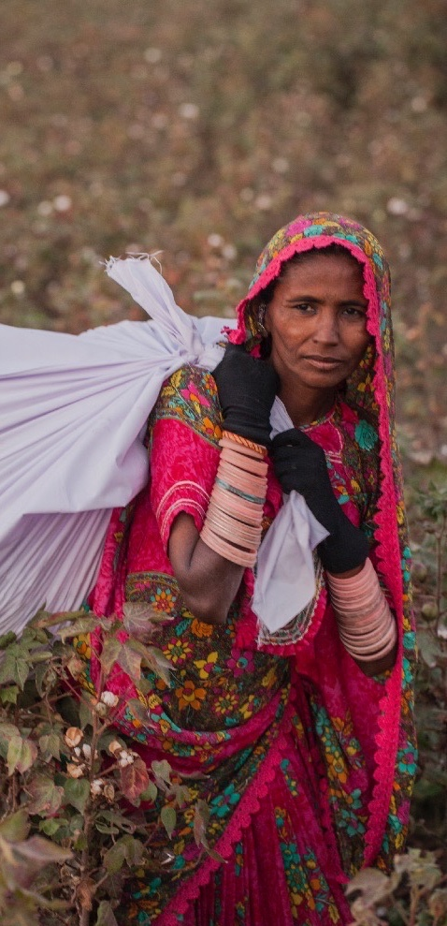
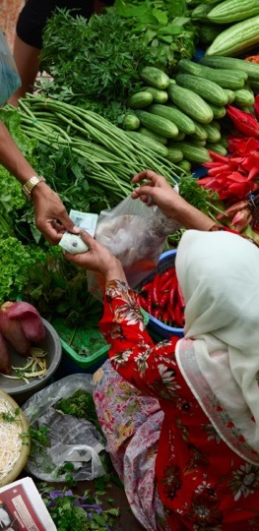
Our areas of focus
Food & nutrition security
Climate change & biodiversity
Gender & youth
Economic development

Slide 6
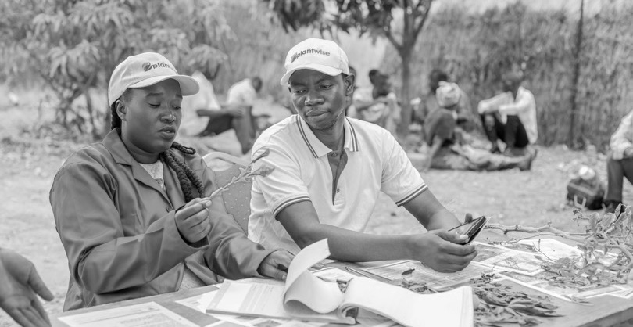
Our areas of expertise
Crop health
Development communication and extension
Digital development
Invasive species
Publishing
Value chains and trade
Notes:
Crop health CABI helps smallholder farmers to grow more and lose less, increase their incomes and improve their livelihoods.
Dev ICT CABI’s unique expertise and global presence around the world allows us to communicate the agricultural knowledge that smallholders need
Digital development Through the creation and application of digital technologies, CABI brings science-based agricultural knowledge to millions of smallholder farmers helping to increase their yields.
Invasive species: Through our work with donors and partners, we are helping to manage the spread of invasive species
Publishing: As an academic publisher in the life sciences, CABI helps people discover validated, evidence-based information to help them overcome the world’s biggest challenges.
Value chains By helping farmers improve the quality and safety of what they grow, process and sell, CABI helps create sustainable value chains and breaks down barriers to trade.

Slide 7
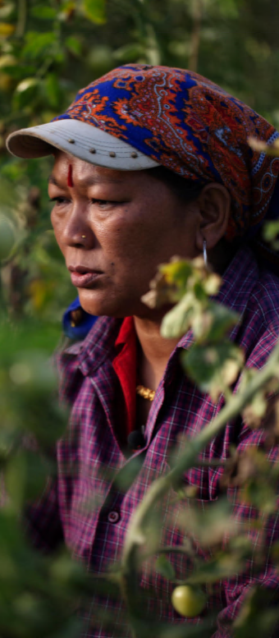
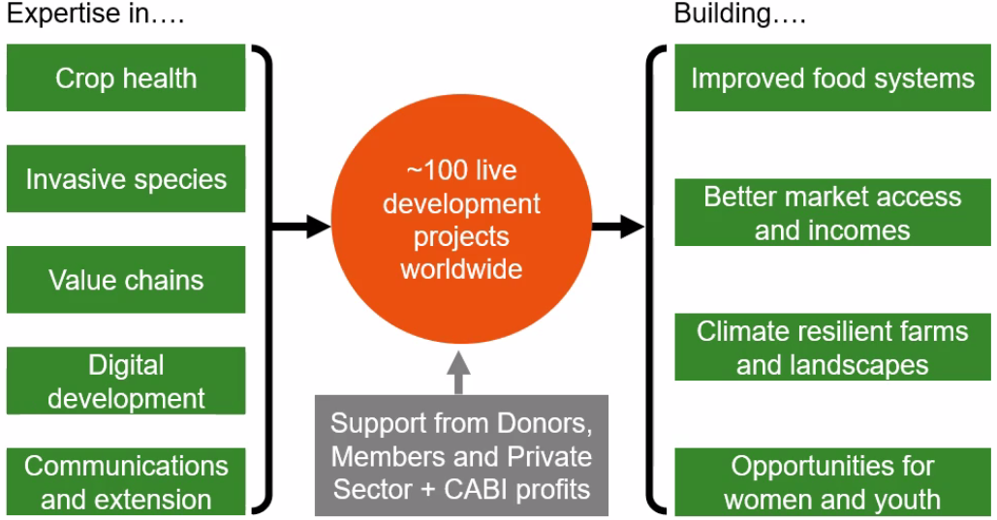
International development

Slide 8
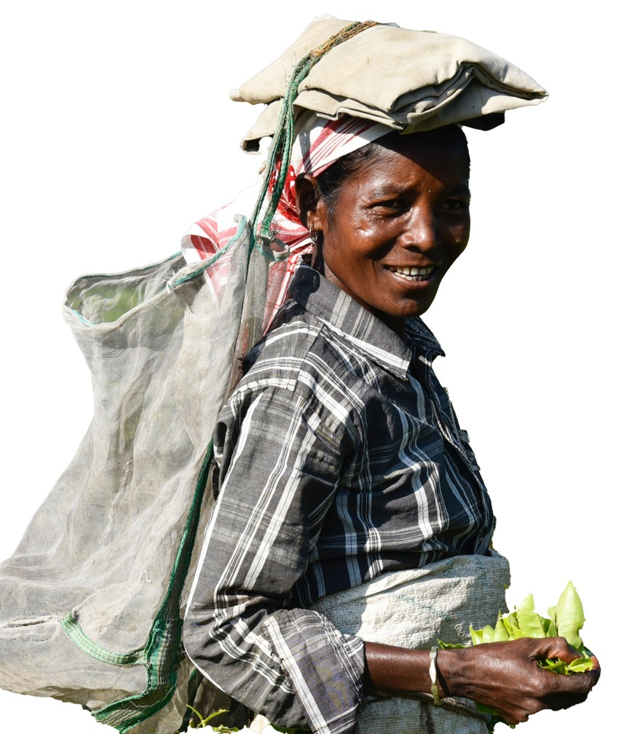
Who does CABI work for and with?
member country governments
ministries of agriculture; NPPOs
farmers
extension workers
non-governmental organizations
charities and foundations
research agencies
development agencies
universities
corporate organizations

Slide 9
Donors
Our project work is funded by a wide range of donors including:
Ministry of Agriculture and Rural Affairs (MARA)
People’s Republic of China

Slide 10
PlantwisePlus
CABI’s flagship food security programme (2021-2030)

Slide 11
PlantwisePlus : Approach
Taking the Plantwise and Action on Invasives programmes forward
Reaching 50 million women and men farmers
The programme targets 20 countries
A 10-year programme:
Inception phase (2020)
Proof-of-concept phase (2021 - 2023)
Scale-up phase (2024 - 2030)
Notes:
We envisage that during the 10-year programme (2021-2030), 20 countries will join us as part of an ambition to make 50 million women and men farmers more resilient to climate change impacts and more able to access higher value domestic markets for their produce
Plantwise+ will commence with an inception phase in 2020, followed by a 3-year proof-of-concept phase (2021-2023)
Specific interventions will be tested in 6-7 selected countries in Africa, Asia and the Americas, particularly those that have already successfully strengthened plant health systems and are keen to evolve to the proposed climate-smart approaches
Additional countries will be brought into the programme during the scale-up phase (2024-2030)

Slide 12
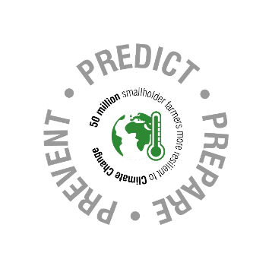
Pest preparedness:
Strengthen systems for detection and response to pest outbreaks
SAFER & MORE NUTRITIOUS FOOD
consumers have access to safer and more nutritious food, farmers earn more by responding to market demand for safer production, women and youth benefit from value-addition employment opportunities
Farmer advisory:
Enhance advisory tools to boost climate-smart plant health practices
Pesticide risk reduction:
Enhance availability of safer plant protection products
Pesticide risk reduction:
Increase supply of and demand for safer and higher quality food
SAFER PLANT PROTECTION PRODUCTS
women and youth employment opportunities in rural communities, safer plant protection products available, accessible and affordable, and protection of human health and natural resources
DETECTING & RESPONDING
more efficient national pest surveillance and response systems and reduced losses to crops through improved coordination, which improves food and economic security
Notes:
Four components, interrelated but can be adopted individually subject to what countries want most support for
All are huge challenges requiring partnerships and innovation

Slide 13
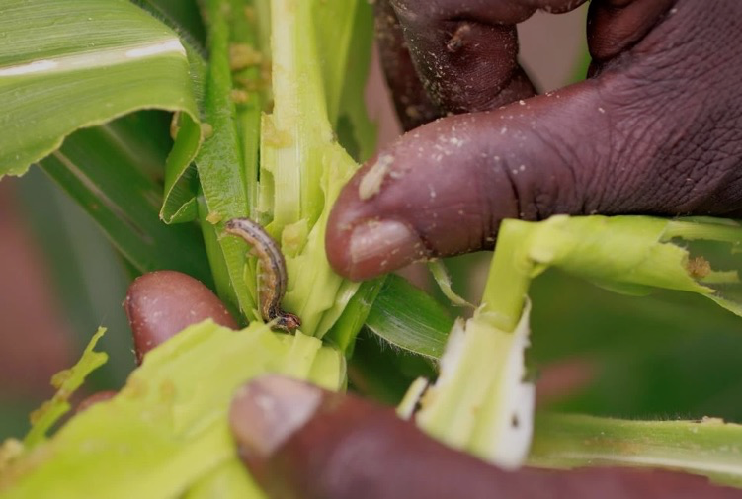
Pest preparedness
key outputs
Tools and processes to characterize and prioritize pest threats effectively (horizon scanning, pest risk analysis, insight reporting, pest risk register).
Evidence of the impacts of identified pest threats
Contingency and response planning
Work with partners to explore nature-based solutions to manage invasive species
SAFER PLANT PROTECTION PRODUCTS
women and youth employment opportunities in rural communities, safer plant protection products available, accessible and affordable, and protection of human health and natural resources
Notes:
Of particular relevance is the work we are doing national and regional level on PRA, Horizon scanning, and developing pest lists. I will talk a bit more about these in my presentation tomorrow.

Slide 14
2023 Annual Meeting International Pest Risk Research Group: Collaboration and capacity building in pest risk analysis
We are all here to learn from others and contribute to pest risk best practices
IPRRG provides an important network of experts and forum for collaboration and innovation

