Slide 1
IPRRG Awards
Frank Koch
Chair, IPRRG Executive Committee

Slide 2
Award Types
Fellowships
Honorary Fellowships
Medals
Early Career Research Excellence
Meeting awards: best presentation / poster

Slide 3
Fellowships
‘Exceptional, sustained dedication to promoting the aims of the Group and for significant contributions to pest risk research’
Member in good standing
Attendance at 6 or more of last 10 IPRRG meetings
At least 2 years of service as Executive Committee officer or designated special officer
Local Arrangements Organiser or other planning roles also count
Nominees must have made outstanding contributions in 1 or more of the following areas: Research, Training, Extension and Outreach, or Administration

Slide 4
Honorary Fellowships
Honour retired members who have provided significant meritorious contributions to IPRRG and to pest risk research
Guidelines are mostly the same as for Fellowships
Active current engagement is not required

Slide 5
IPRRG Medal
‘Exceptional contributions to pest risk research, and for promoting the aims of the Group’
An exceptional and sustained research contribution to the advancement of pest risk research for the solution of scientific and technological problems as evidenced by global recognition and publication record
Published extensively in the most respected outlets
Web of Science Researcher ID H‐index > 25 and Google Scholar lifetime citations > 5000
An outstanding proven record as a key influencer and leader
Public profile as an advocate for the role and importance of pest risk research
Attendance at 6 or more of the past 10 IPRRG meetings, or an active member of an IPRRG Meeting Organising Committee

Slide 6
Early Career Research Excellence (ECRE)
‘Early career excellence in pest risk research’
If nominee has a PhD, the time limit since obtaining the PhD is 5 years, which can be extended to 7 (parenting, illness, caring for family, etc.)
If nominee has equivalent competencies to a PhD, the time limit is 7 years in the industry, which can be extended to 10 (parenting, illness, caring for family, etc.)
Impressive research contribution to the advancement of pest risk research. Nominees would be expected to meet the following minimum guidelines:
5 or more publications in Web of Science or Scopus journals in the past 3 years
Web of Science Research ID H‐index > 5 and Google Scholar Citations > 100
Emerging profile in their industry or discipline
Member in good standing (participation in at least 3 IPRRG Meetings in the past 5 years)

Slide 7
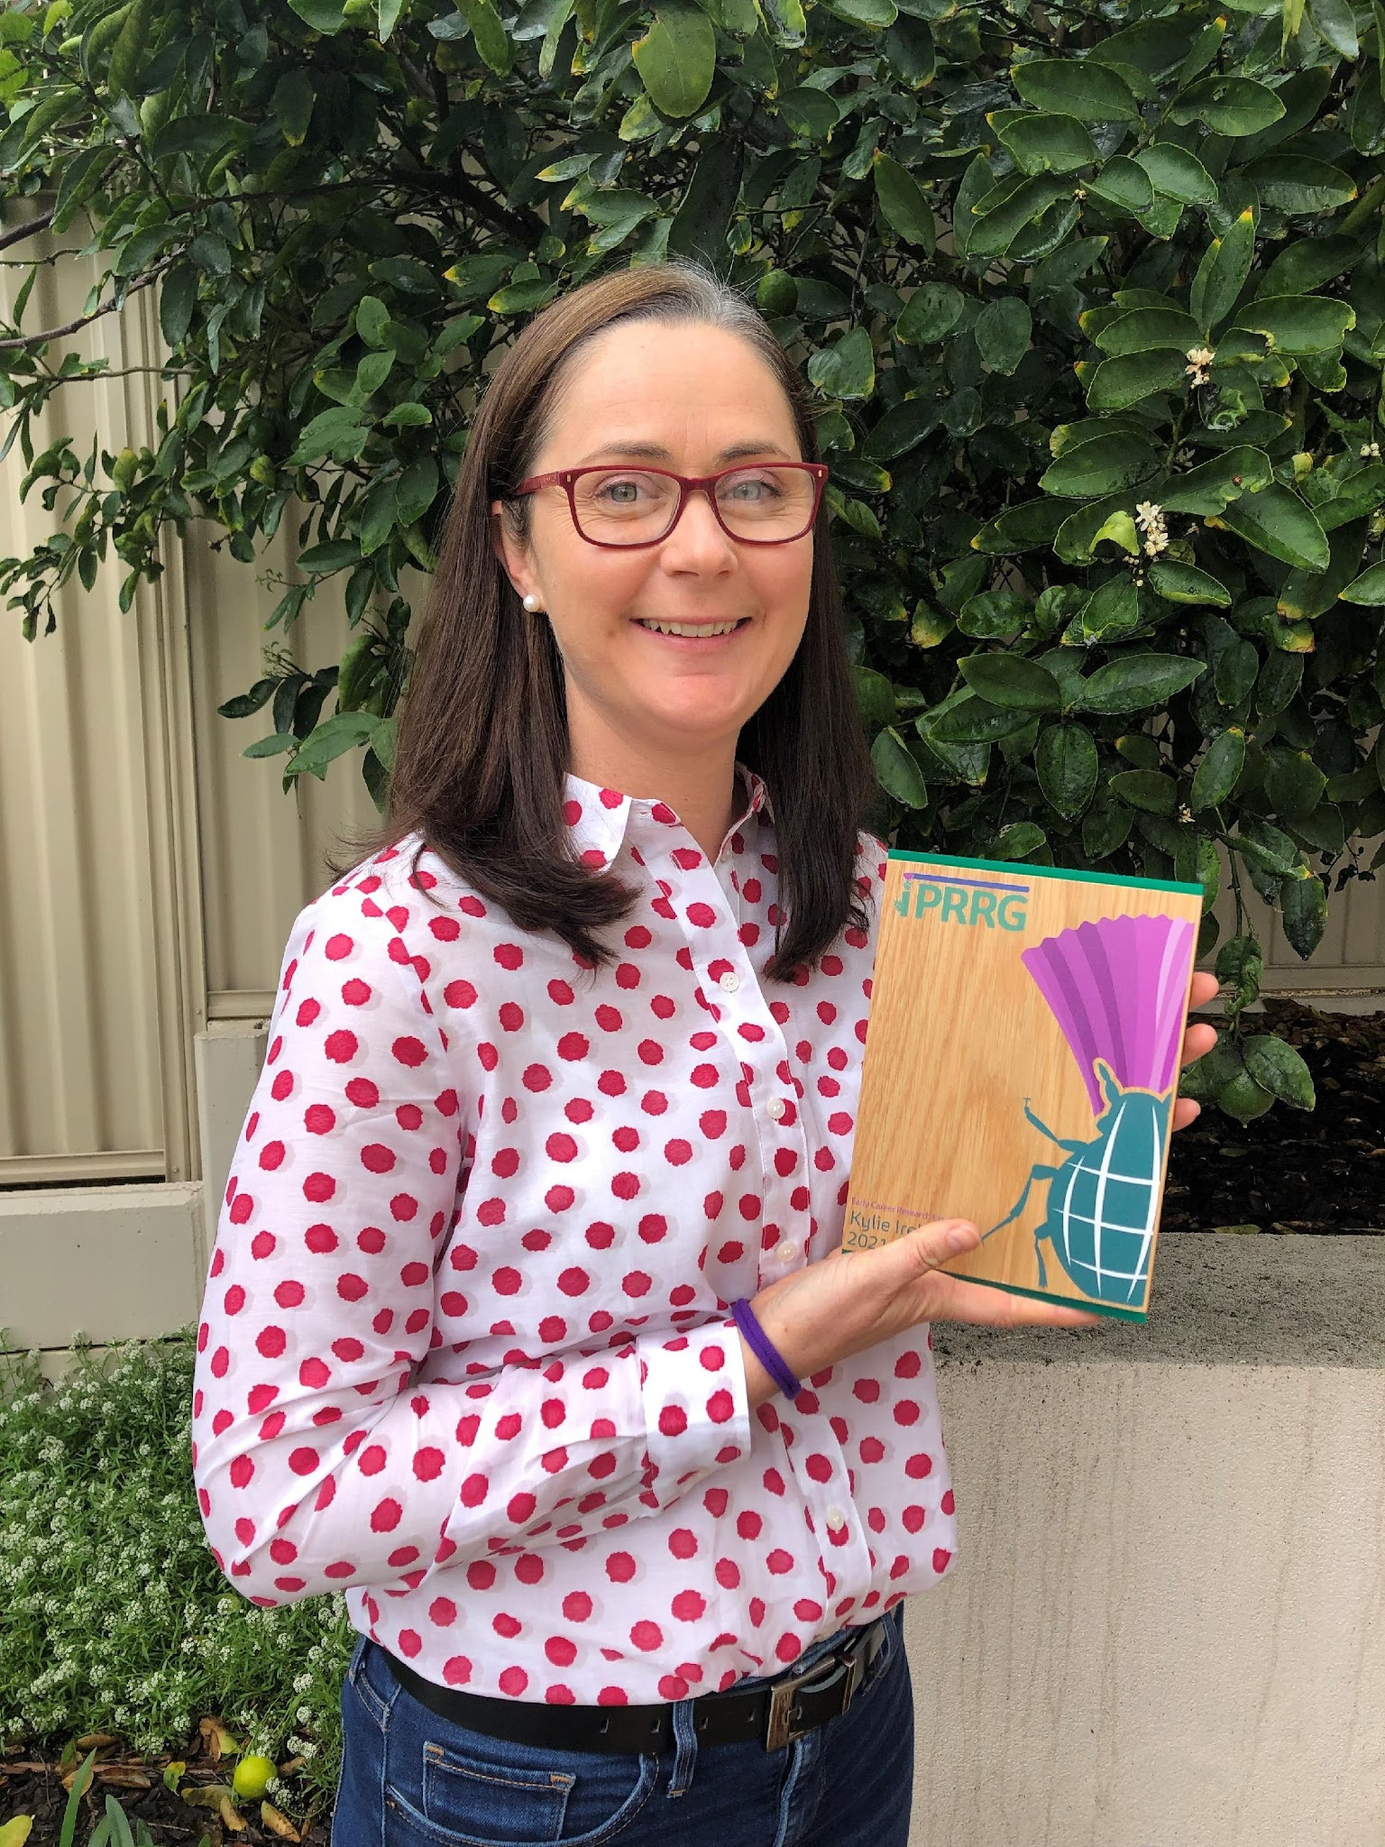
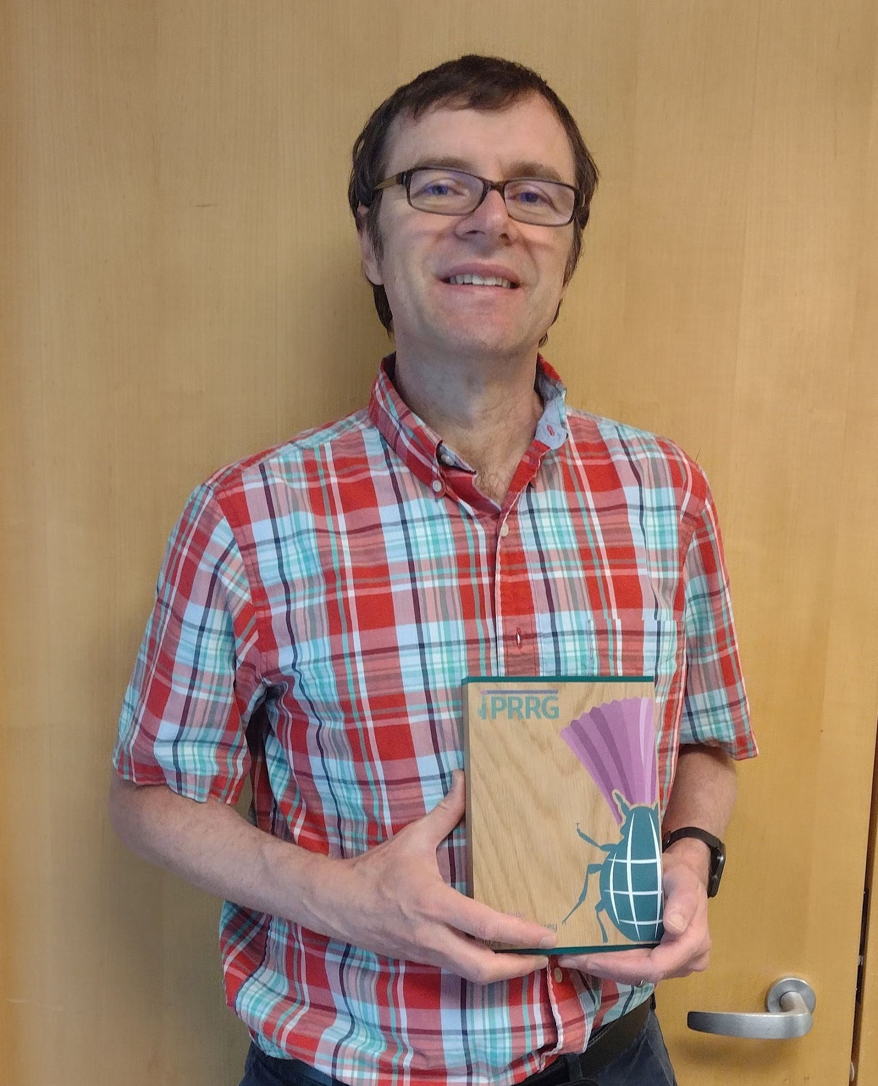
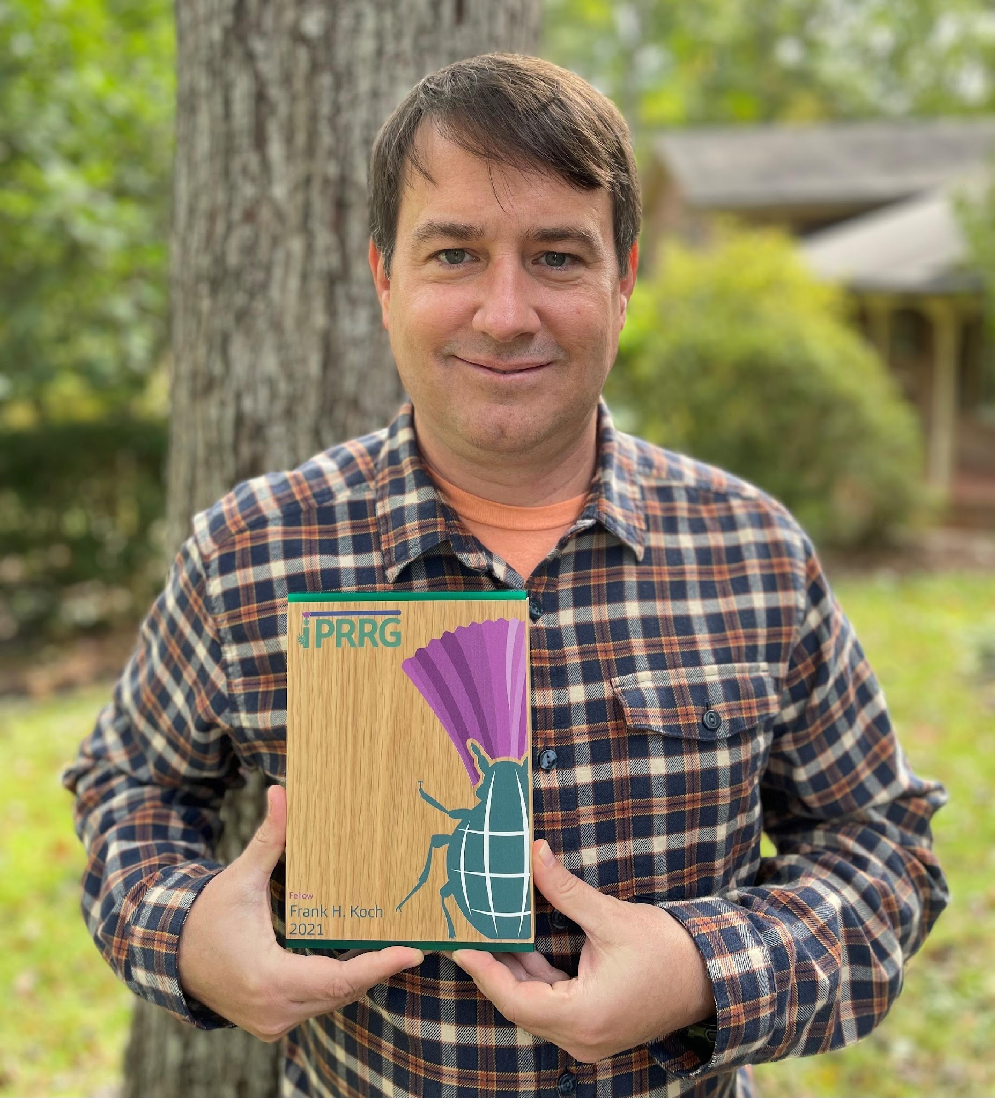
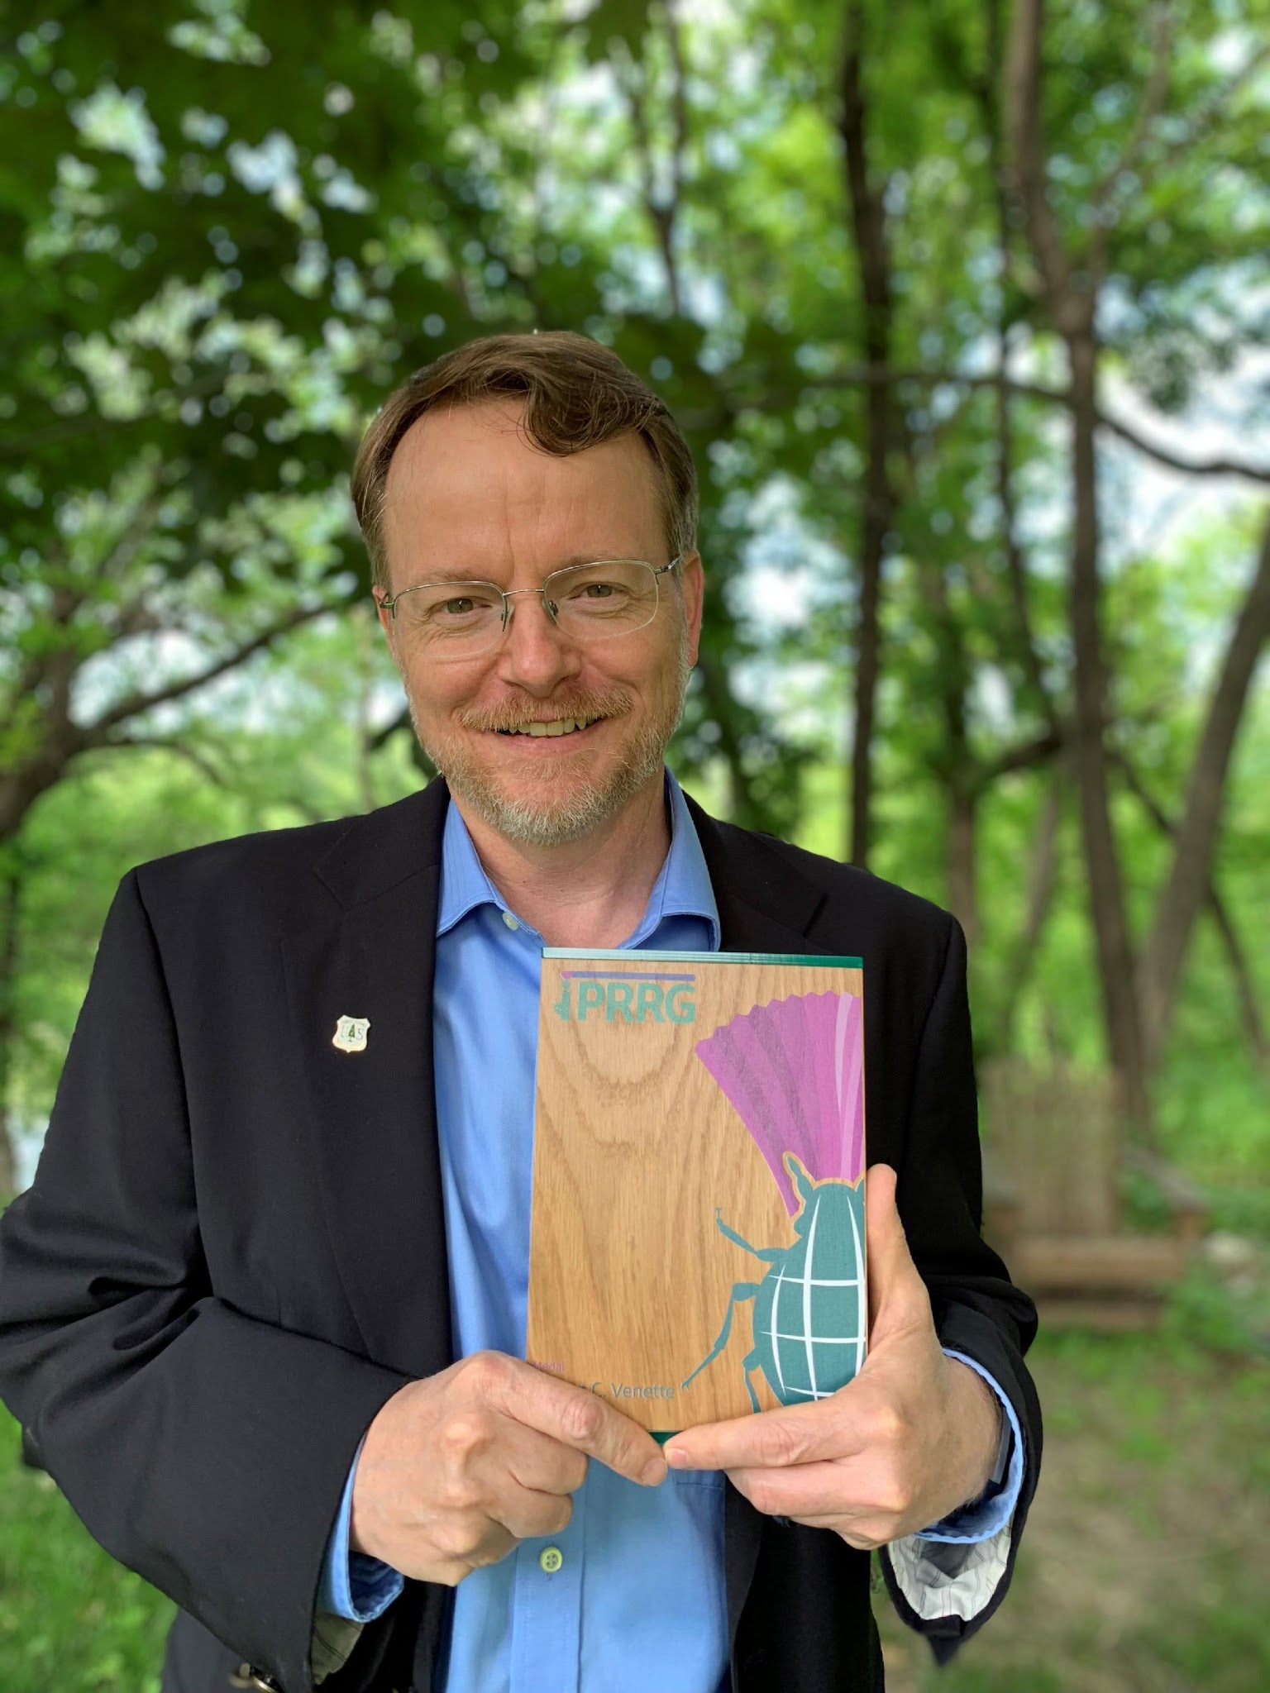
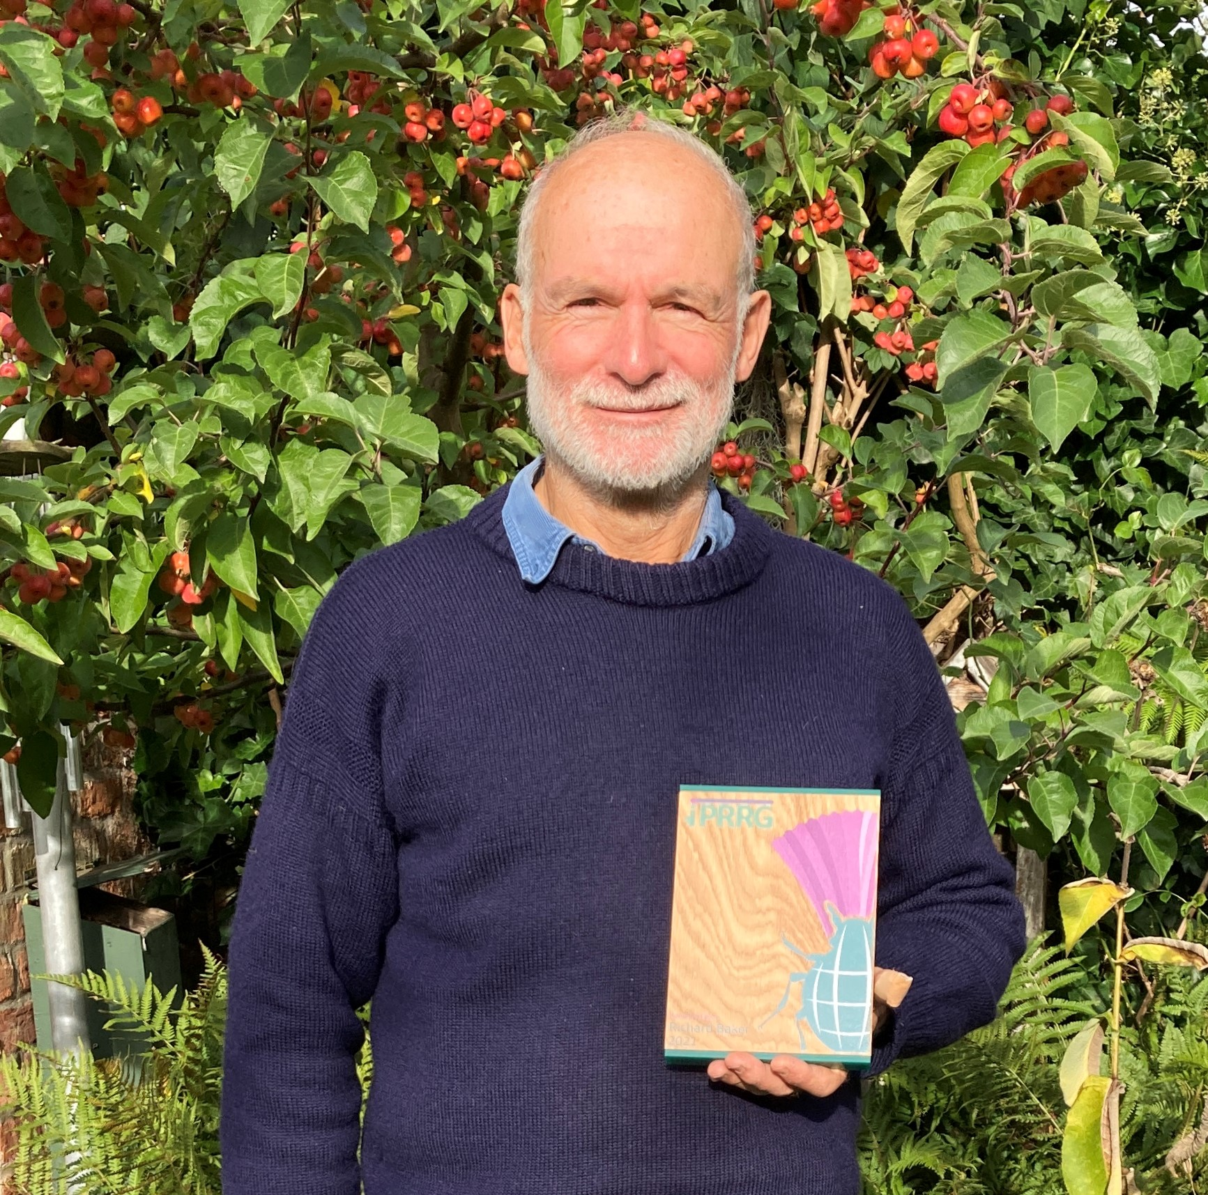
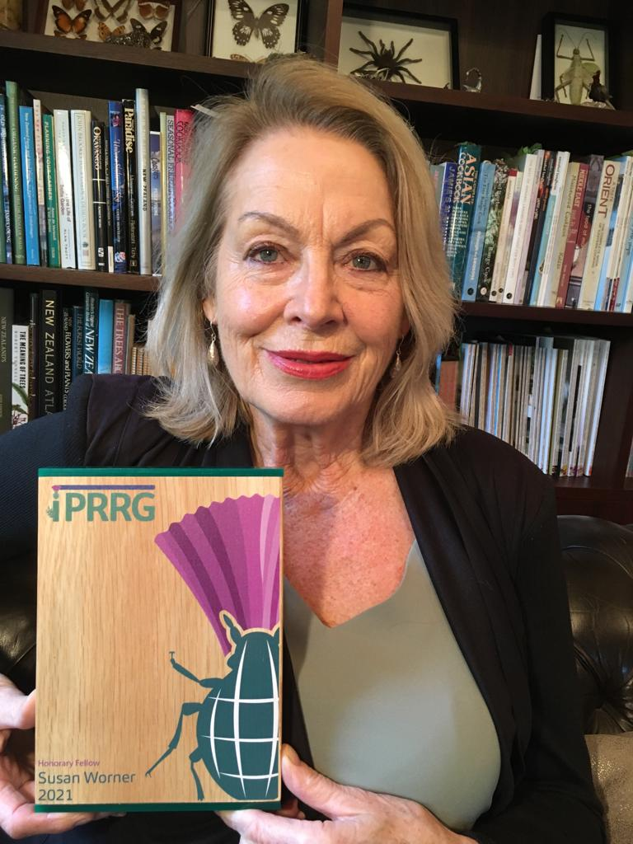
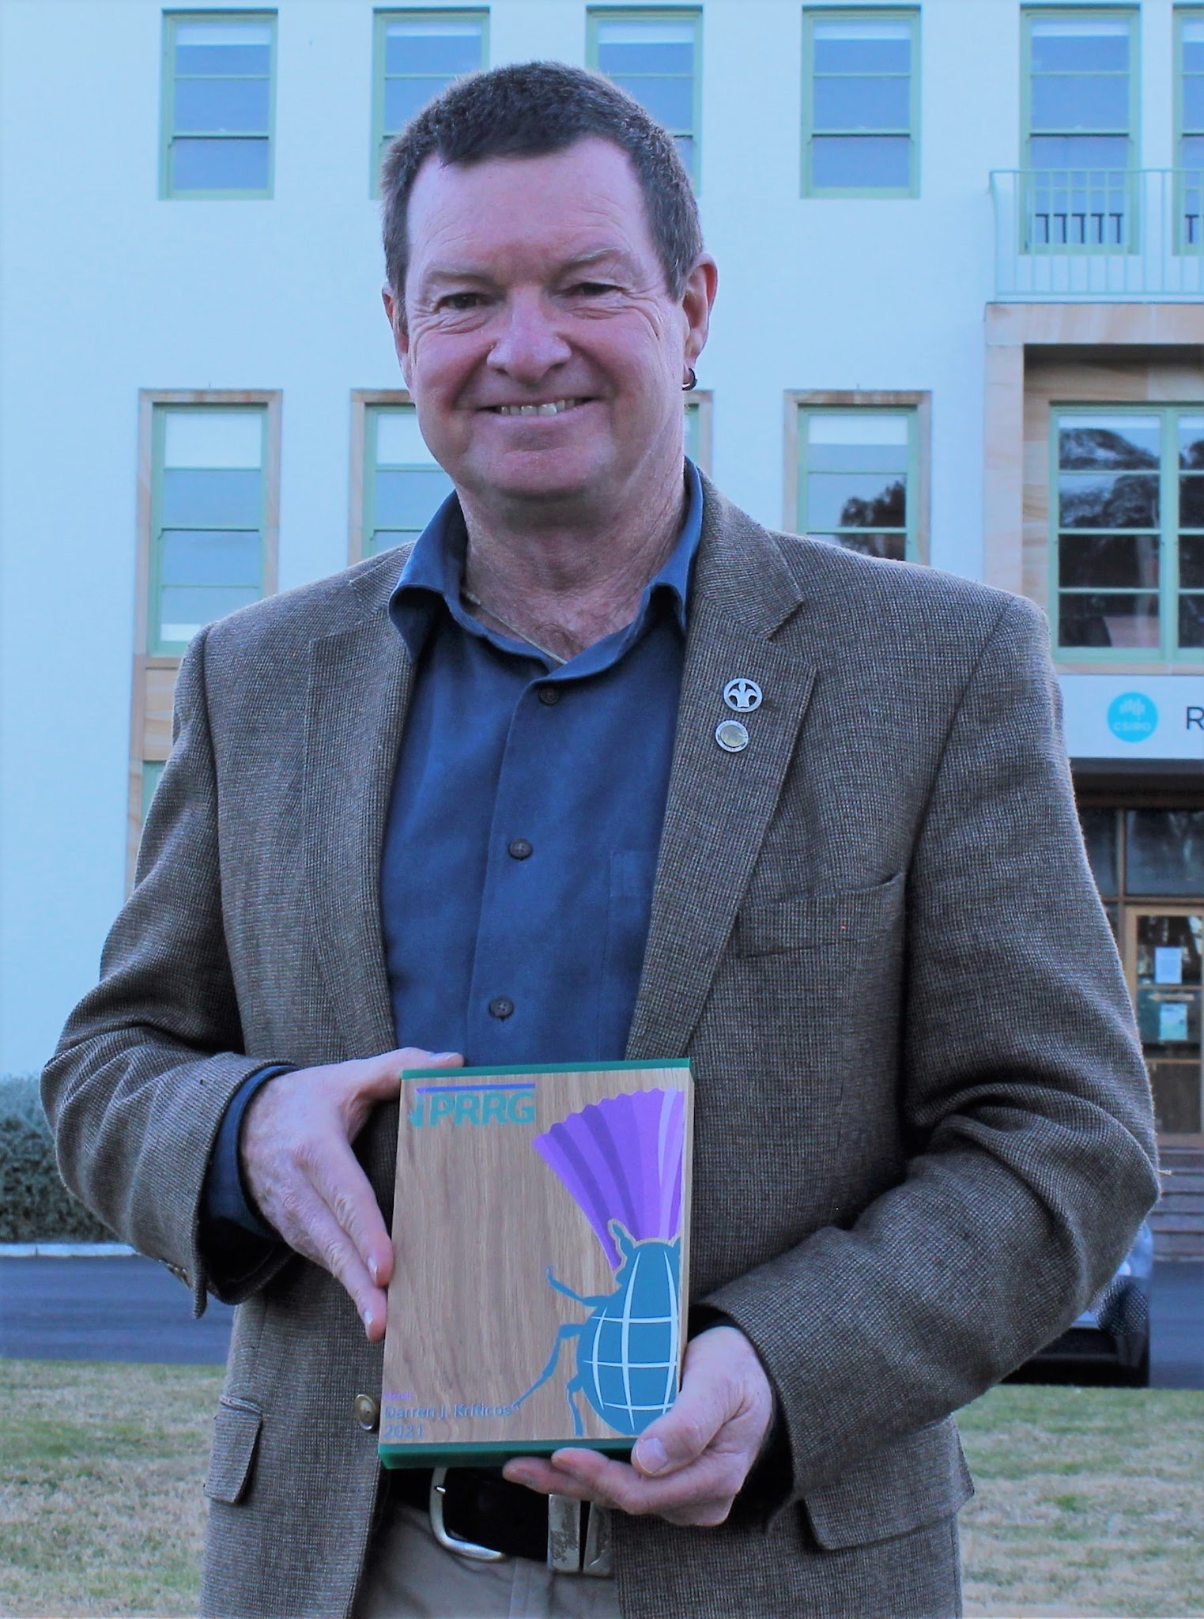
First class of IPRRG award recipients
Early Career Research Excellence
Kylie Ireland
Fellow
Roger Magarey, Frank Koch
Honorary Fellow
Richard Baker, Sue Worner
IPRRG Medal, Fellow
Darren Kriticos, Rob Venette

Slide 8
Now it’s time for a new class!
https://pestrisk.org/resources/iprrg-awards/
Download and complete nomination form(s)
Contact Awards Administrator (awards@pestrisk.org)
Nomination packages due 3 months prior to next IPRRG Meeting
Letters of support from 3 IPRRG members are required
Nominator should work in consultation with nominee

Slide 9
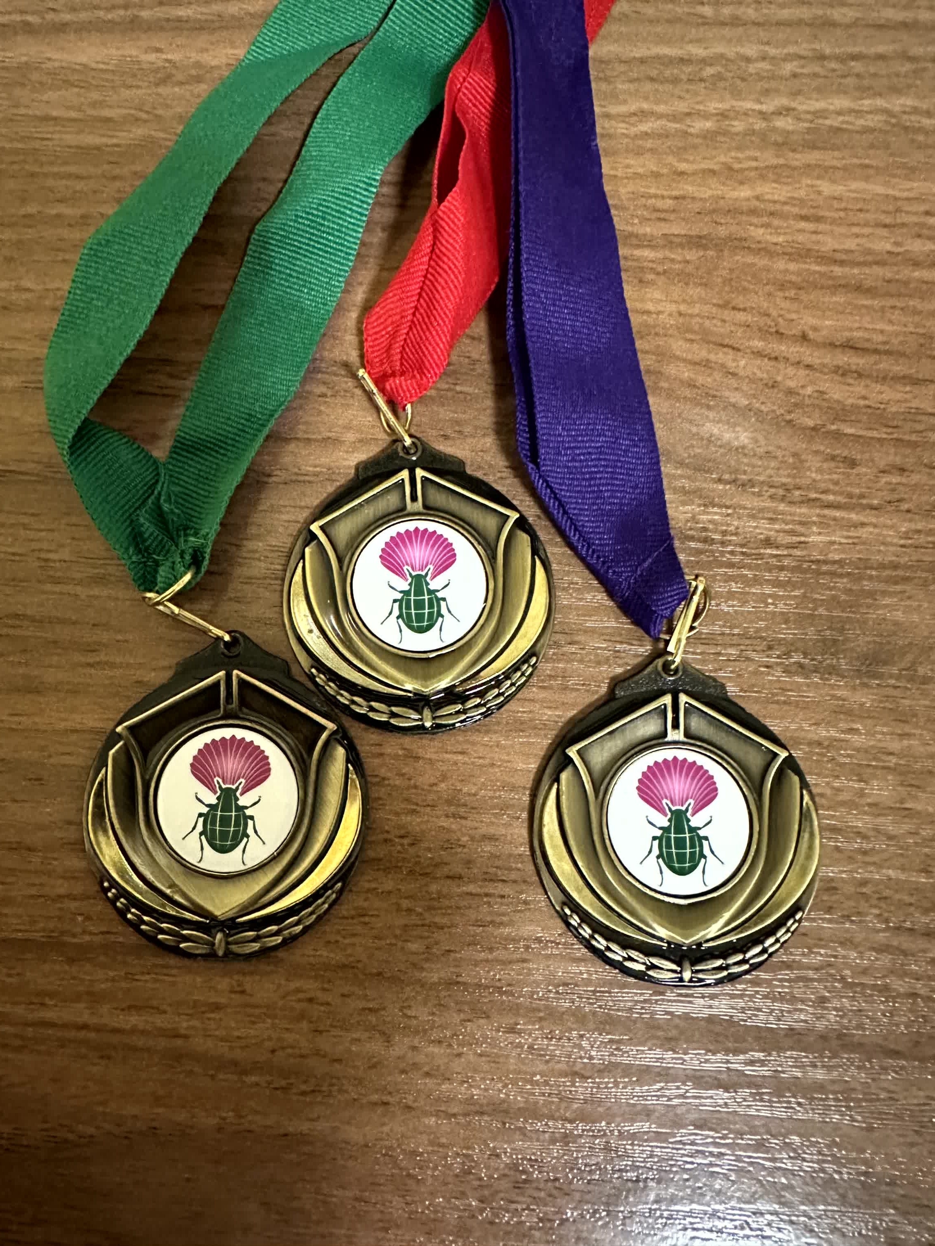
Meeting awards
At each Annual Meeting, may confer multiple Awards for Excellent Presentation or Poster, including one or more Awards specifically for students
This year, we’ll have a vote on Day 4 prior to business meeting
If a presentation really resonated with you, make a note so you don’t forget!

