Slide 1
IPRRG’s relationship with the IPPC Dr Alan MacLeod Defra York United Kingdom IPRRG Meeting, Kenya, September 21st -24th 2023

Slide 2
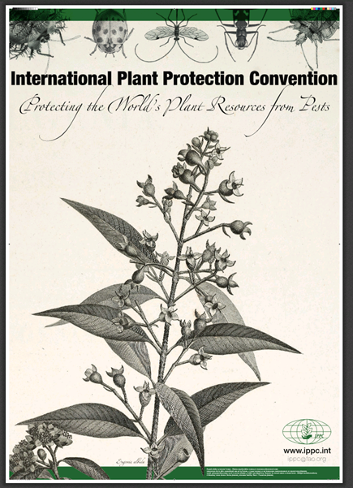
What is the IPPC?
International Plant Protection Convention
Multilateral treaty for international cooperation in plant protection
Signed 1951
Started with 75 signatories now has 184 contracting parties
countries, territories, EU
A standard setting organization
Recognised by World Trade Organization (WTO)
Aims
Protect plant life
Promote fair & safe trade
Prevent introduction & spread of pests
https://www.ippc.int

Slide 3
Basic principles of the IPPC
ISPM 1: Phytosanitary principles for the protection of plants and the application of phytosanitary measures in international trade
Sovereignty
Necessity
Managed risk
Minimal impact
Transparency
Harmonization
Non-discrimination
Technical justification
Cooperation
Equivalence of phytosanitary measures
Modification
All but 5 and 9 explicitly refer to phytosanitary measures
Phytosanitary measures technically justified by pest risk analysis (PRA)
PRA fundamental to IPPC
ISPM 1 at https://www.fao.org/3/j7483e/j7483e.pdf

Slide 4
How did people in IPRRG get involved supporting IPPC with PRA?
2003: Workshop on Invasive Alien Species and the IPPC (CBD/IPPC) Included participants from Canada, Germany, NZ, UK & IPPC Secretariat
2004: Germany approached CA, NZ & UK to help organise a PRA workshop with IPPC Secretariat (obtained STDF funding $147,000)
2005: International Plant Health Risk Analysis Workshop at Niagara Falls, CA, October 24-28, 2005
Great success, 134 participants, 65 countries, more than half from LDC
2006: India approached IPPC Secretariat asking for PRA training
Secretariat asked organisers of Niagara workshop to develop a formal PRA training package for India
CA coordinated and led the work, training took place in Chennai, India March 5 – 9, 2007.
https://standardsfacility.org/PG-089

Slide 5
Planning PRA training (October 2006)

Slide 6
Developing the PRA training Oct’06 - Feb’07
35 drafts of the student manual before India
6 further drafts after India, final was version 41

Slide 7
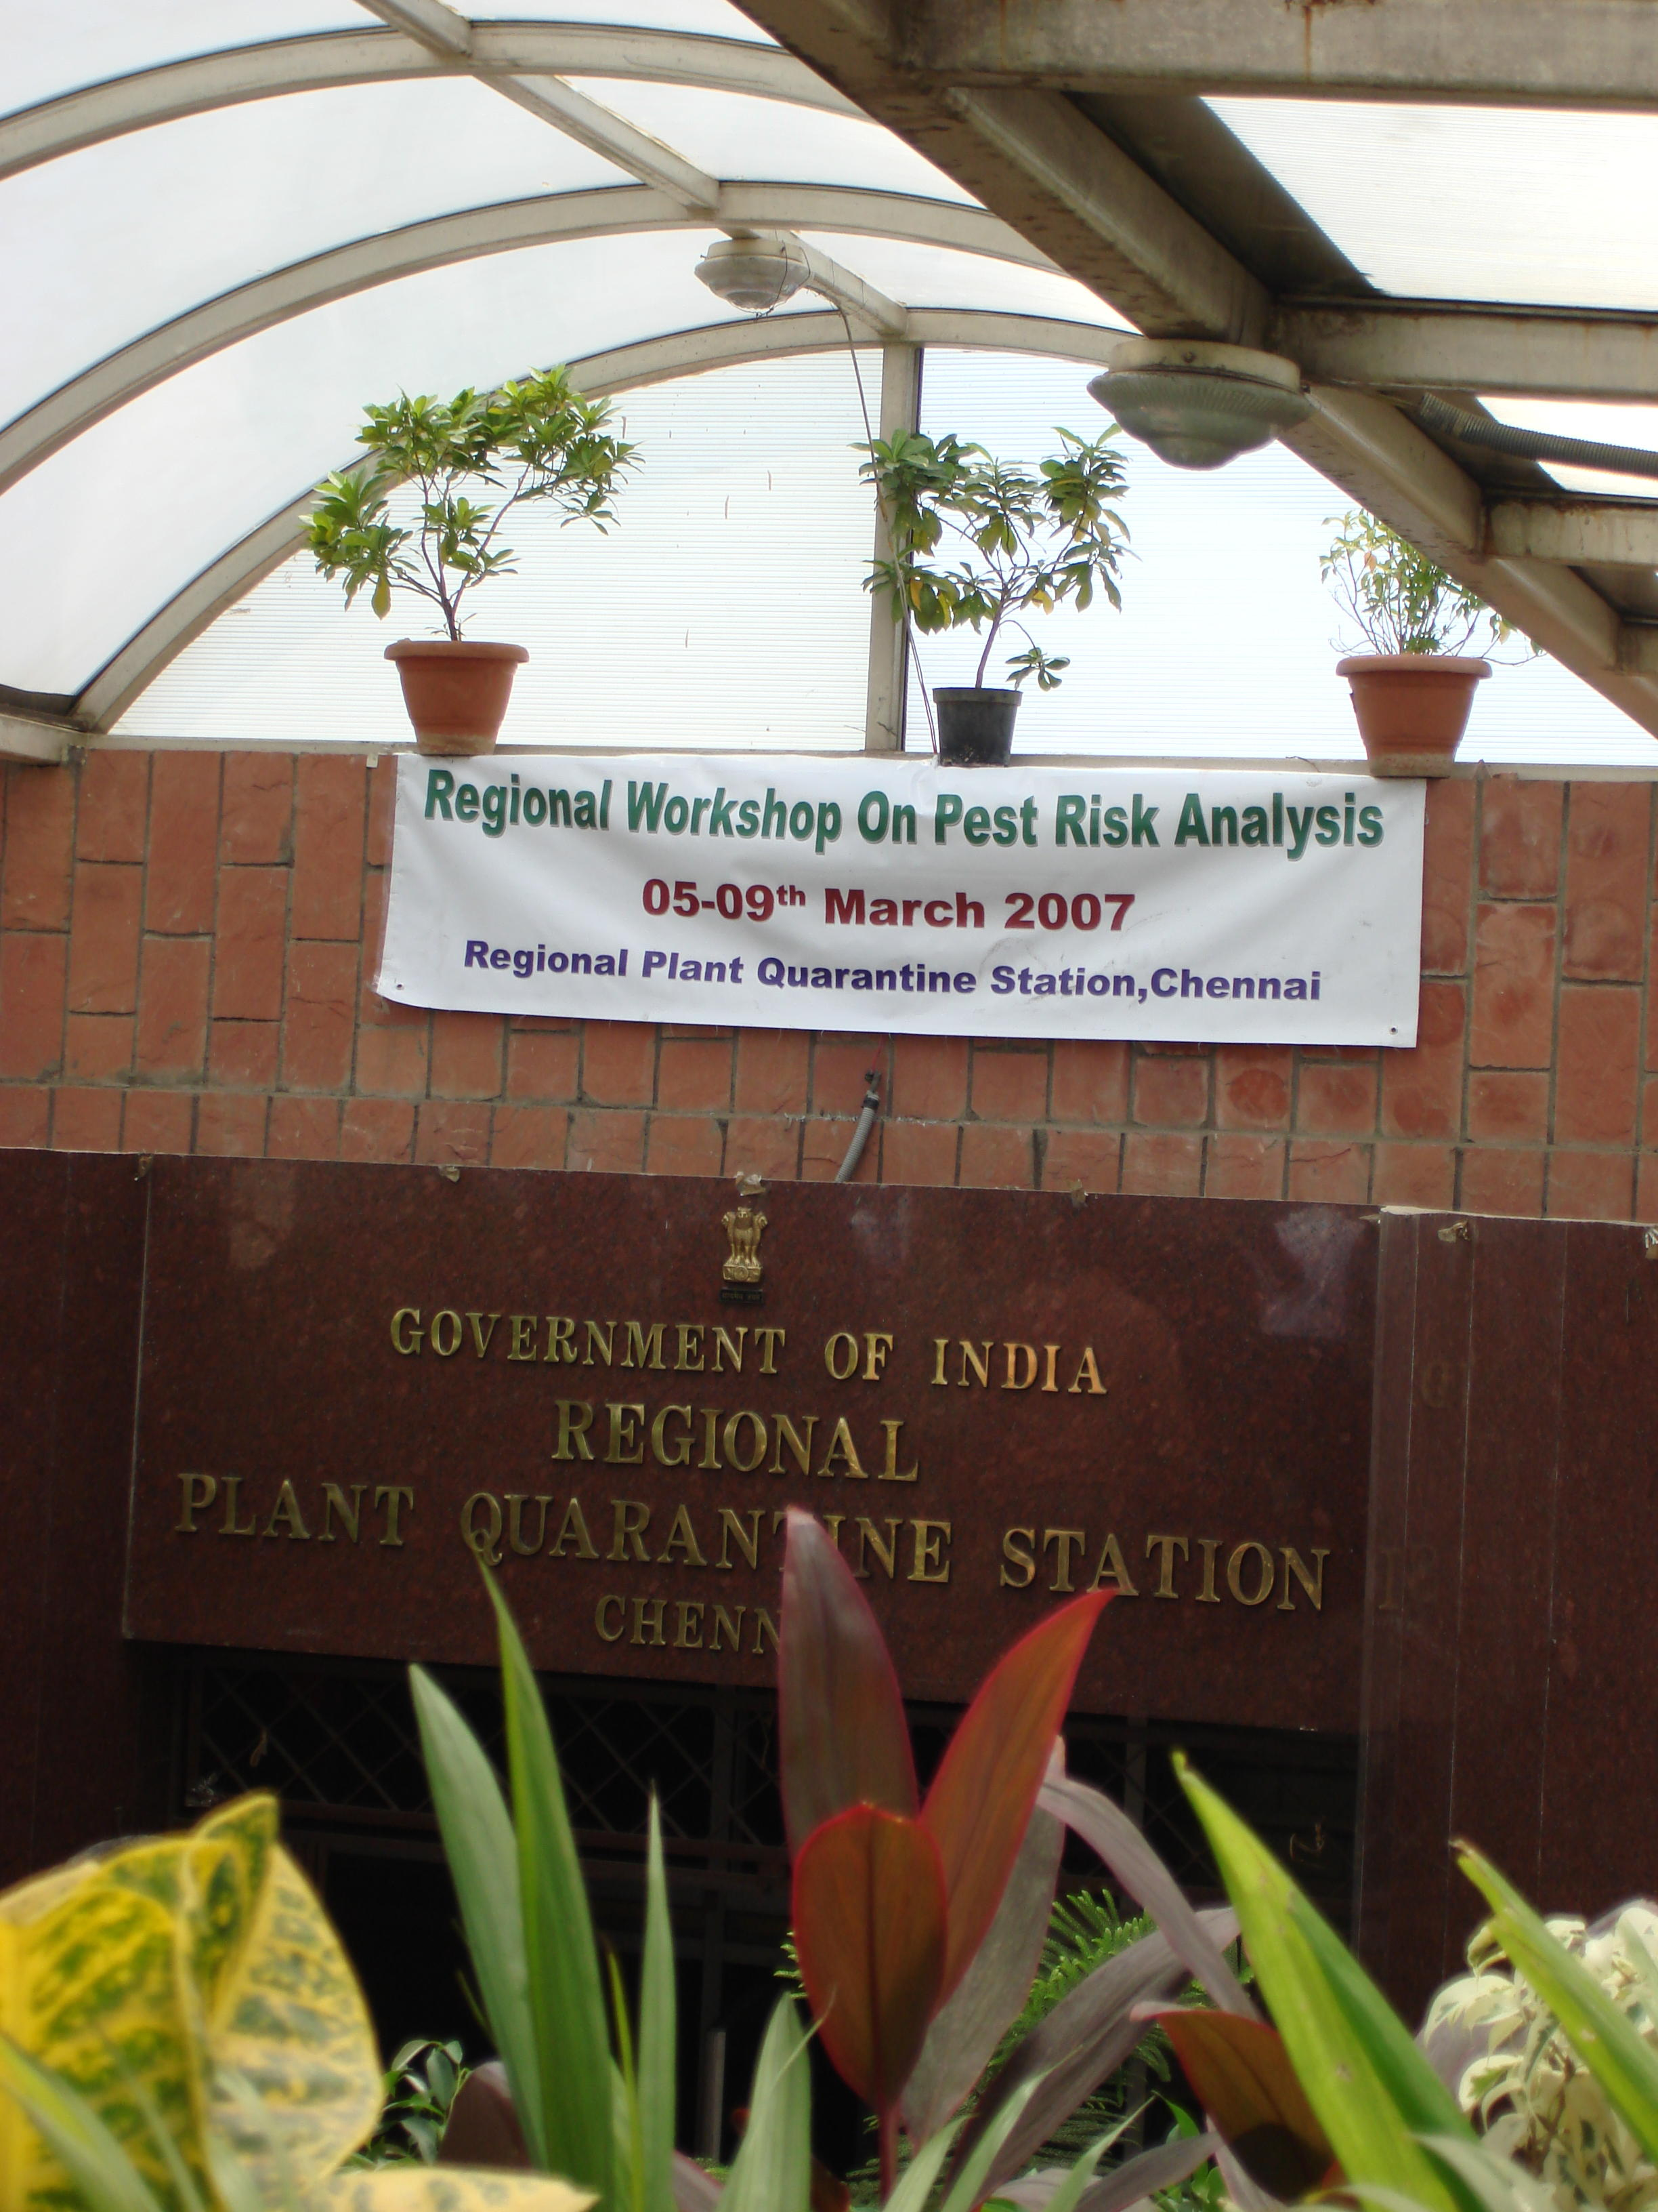
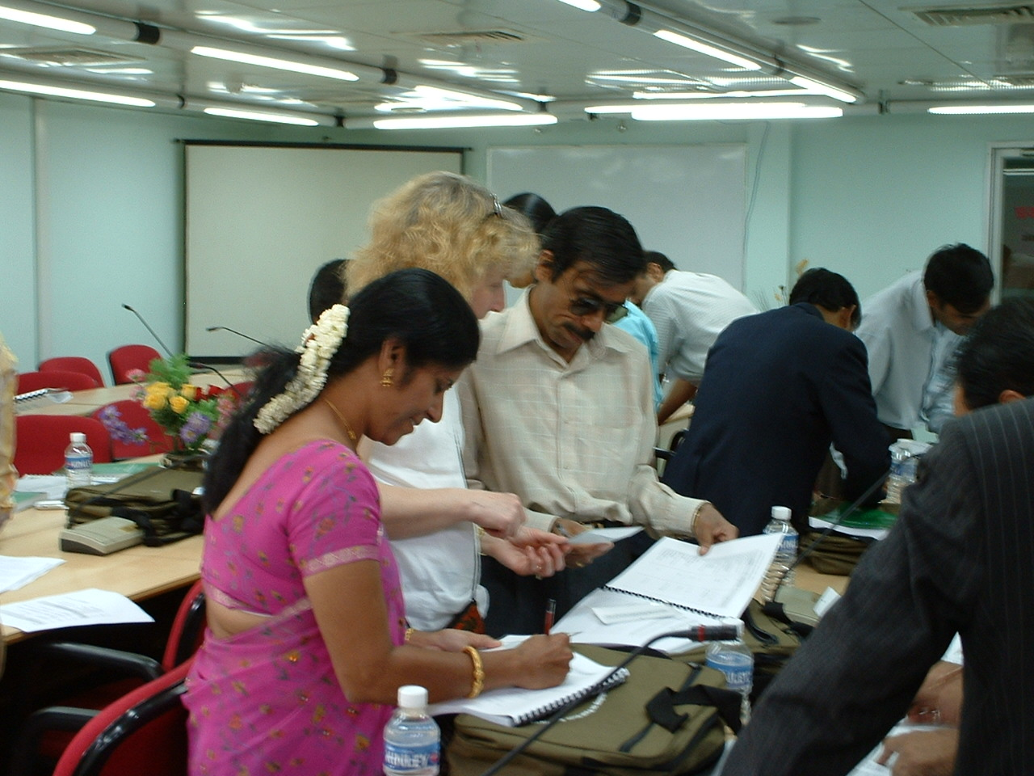
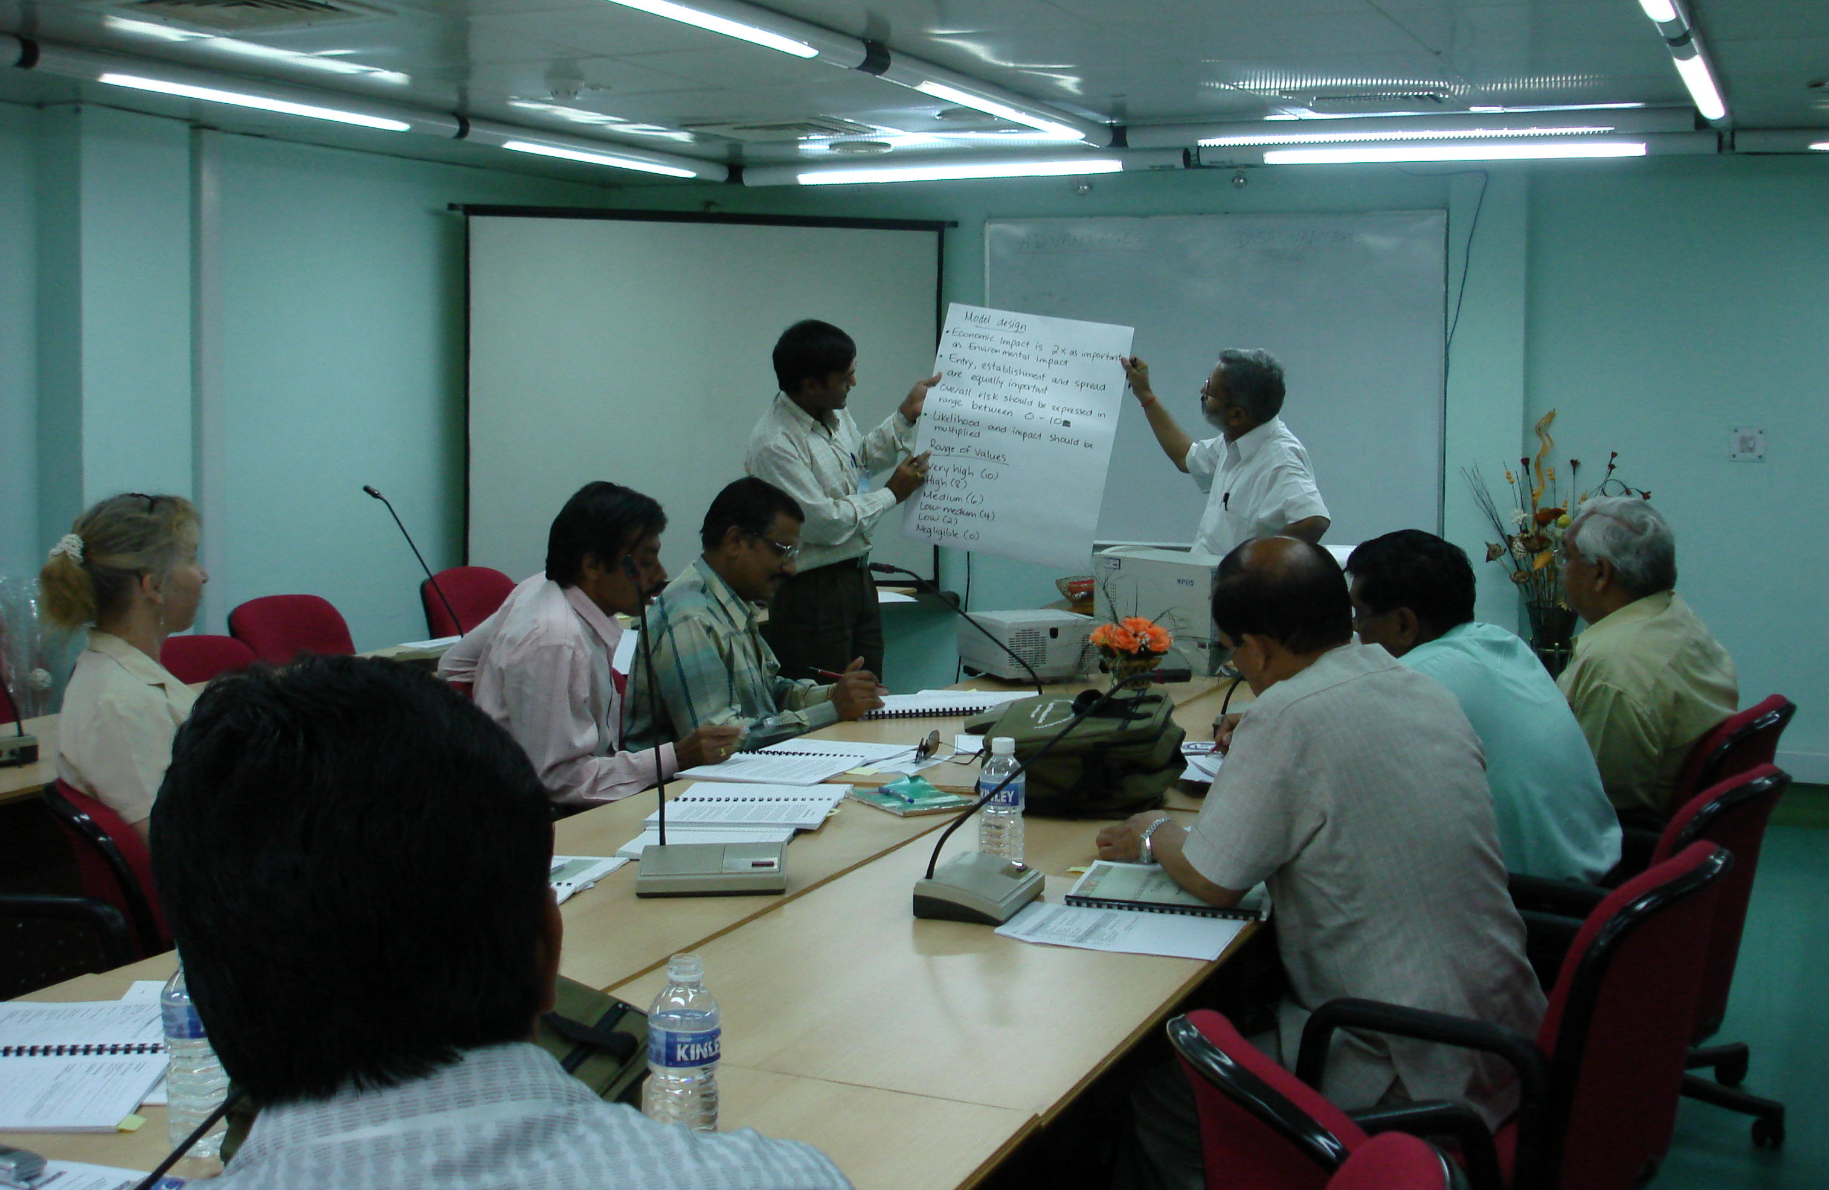
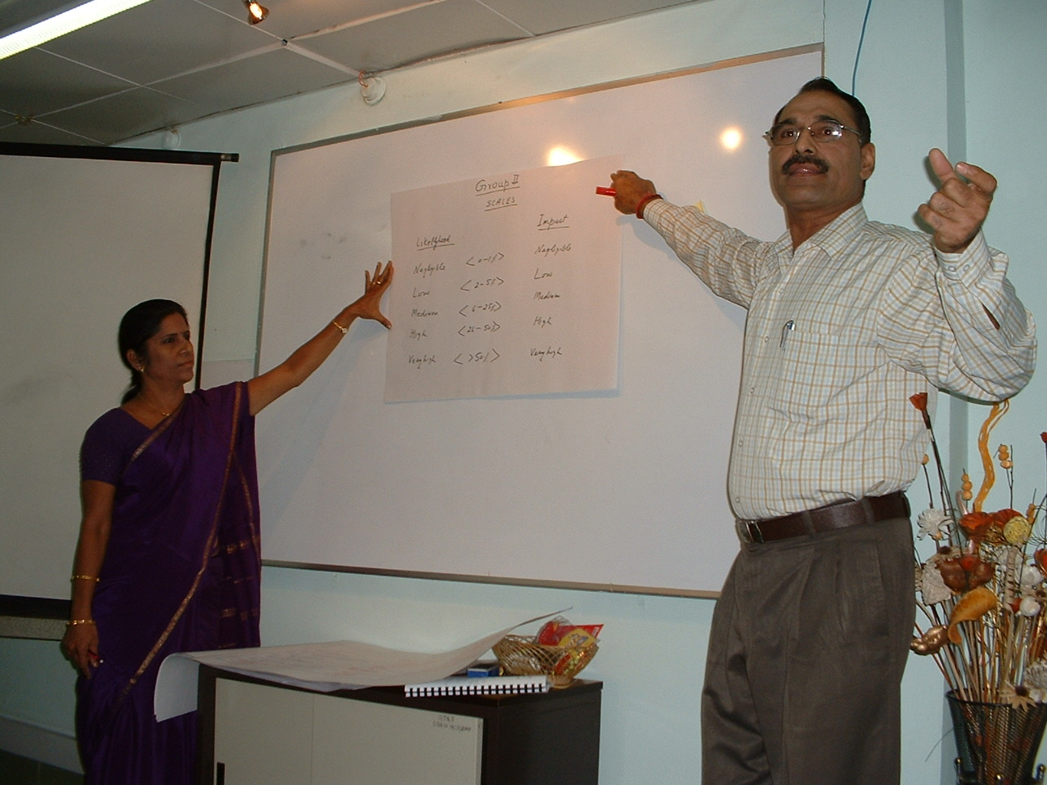
Delivering PRA training (March 2007)

Slide 8
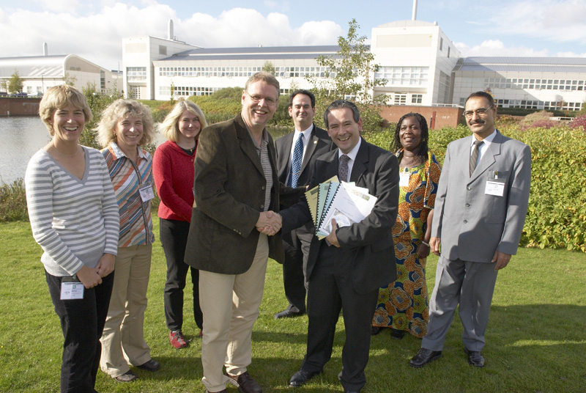
How did people in IPRRG get involved supporting IPPC with PRA?
2007: After training in India all materials reviewed, edited and converted into a training package
slides (with full speakers notes)
breakout activities with supporting information
student activity handbook & course manual
guide for future trainers (train the trainer)
All placed on the IPPC phytosanitary resources page
Training materials formally passed to IPPC in October 2007
Group formally became IAGPRA
2010: used training materials in Botswana
https://standardsfacility.org/PG-089

Slide 9
Countries where PRA training has been delivered (could be more)

Slide 10
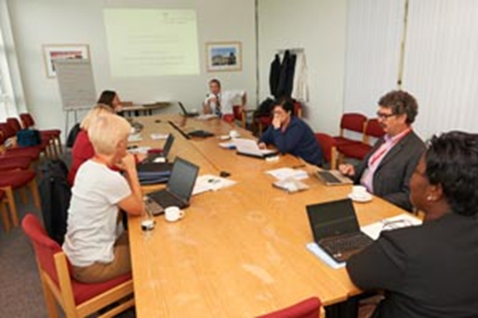
Review work by others supporting IPPC
2013: IAGPRA provided creative and editorial input to a US led project: Developing advocacy materials on the importance and utility of PRA
Work by Stephanie Bloem, Alison Neeley & Ashley Jackson Franklin (USDA APHIS PPQ Center for Plant Health Science and Technology)
Aim to provide material to promote the need for pest risk analysis / urge NPPOs to conduct PRAs
Target senior leaders & those controlling budgets of NPPOs
Outputs include glossy handouts and short YouTube videos
YouTube videos
What is PRA: https://www.youtube.com/watch?v=mHlGRiaiso8
Why PRA is important for …
trade https://www.youtube.com/watch?v=-jP4Xf_9rkg
domestic agriculture https://www.youtube.com/watch?v=DjFSXr7wLEU
the environment: https://www.youtube.com/watch?v=_pytV7GJt5s
technical justification https://www.youtube.com/watch?v=wUkb4wgFs_I

Slide 11
Wikipedia page

Slide 12
Guide for pest risk communication
2017-2019: Drafted IPPC Guide to pest risk communication for NPPOs
74 pages
Four chapters
What is pest risk communication, and why is it important?
Principles of good pest risk communication
Key factors to consider before communicating about pest risk
Putting pest risk communication into action
15 case studies from around the world
Appendices
Checklist for communicating about pest risks
Assessment of capacity for risk communication
Risk perception tool
Accessible writing
https://www.fao.org/3/ca3997en/CA3997EN.pdf

Slide 13
Relationship with IPPC
IPPC recognizes the importance of strong links with organizations that share common interests
creates synergy towards achieving common goals
IAGPRA had provided expert advice and support on PRA related issues to the IPPC Secretariat, the CPM & its subsidiary bodies, and to contracting parties, in particular with respect to building capacity for PRA
IAGPRA was recognised as an external partner – annual reports to CPM
IAGPRA merged with IPRRG in 2019 and IPRRG is now recognized by IPPC as an external partner (Agenda item 14.3 from CPM 14 refers*)
Contact point for IPRRG within IPPC Secretariat is Mr Juan RULL GABAYET
IPRRG now has a role to support IPPC
* https://assets.ippc.int/static/media/files/publication/en/2019/02/INF_10_CPM_2019_IAGPRA_Report-2019-02-15.pdf

Slide 14
Thank you for your attention

