Slide 1
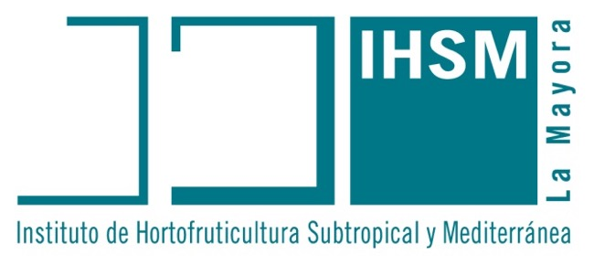
Malaga, Spain 2024 (5)? Eduardo de la Peña, CSIC

Slide 2
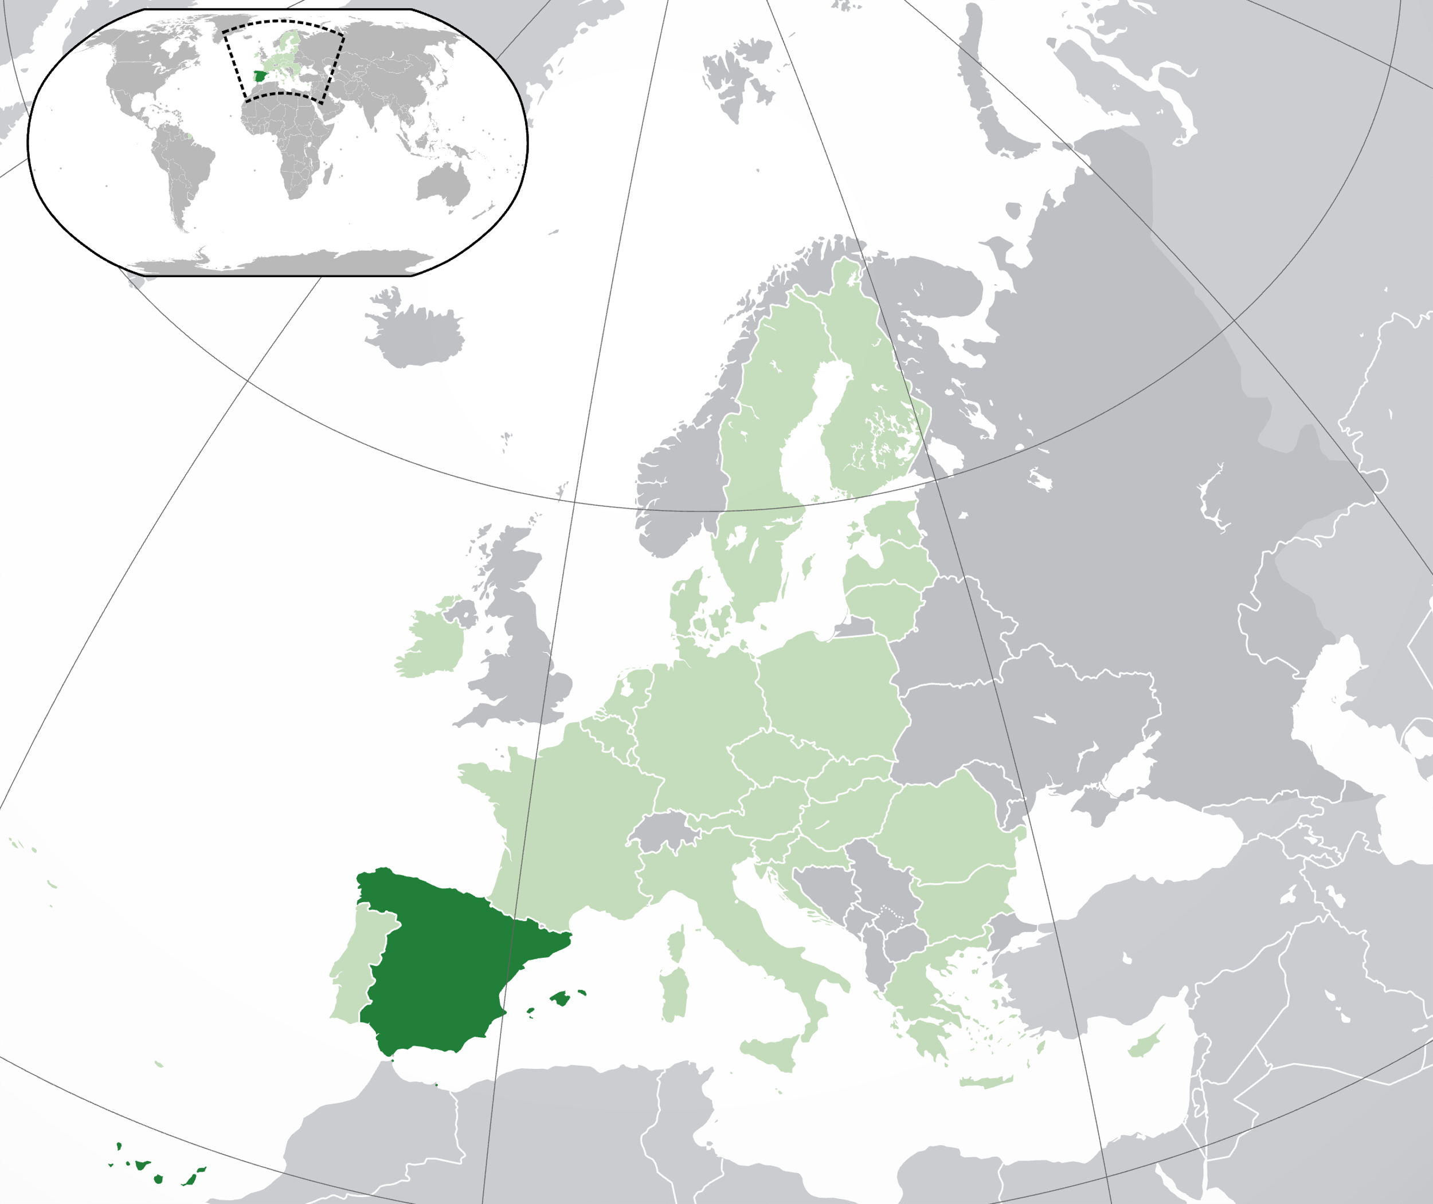

Slide 3
The institution
Spanish National Research Council (CSIC)
2nd largest scientific organization in Europe after CNRS
120 institutes across Spain (and in Brussels and Rome) covering all disciplines of science and technology
Institute for Subtropical and Mediterranean Horticulture (IHSM)
Malaga

Slide 4
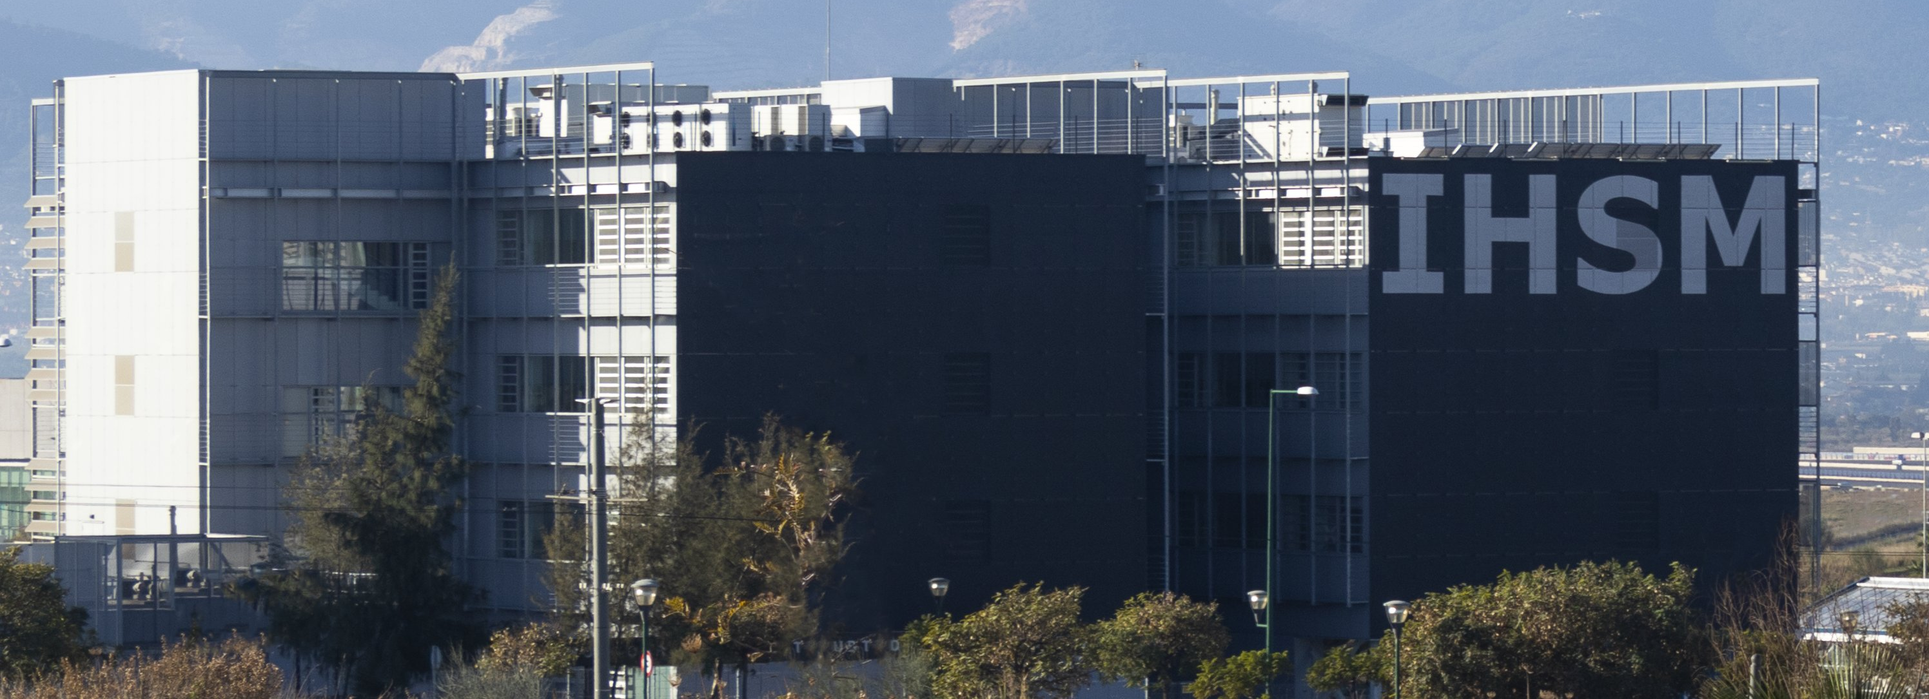
IHSM-UMA-CSIC
2021: Hybryd research center CSIC and University of Malaga
Focused on plant science
(Molecular) characterization of crops, pests and diseases
Crop physiology
Breeding
Crop protection

Slide 5
Experimental station
Algarrobo
30 km east of Malaga city
Field research station (CSIC)
55 ha of experimental fields
Oriented towards commercial production
Agronomy and cultivation tehcnologies
Subtropical and Mediterranean crops

Slide 6
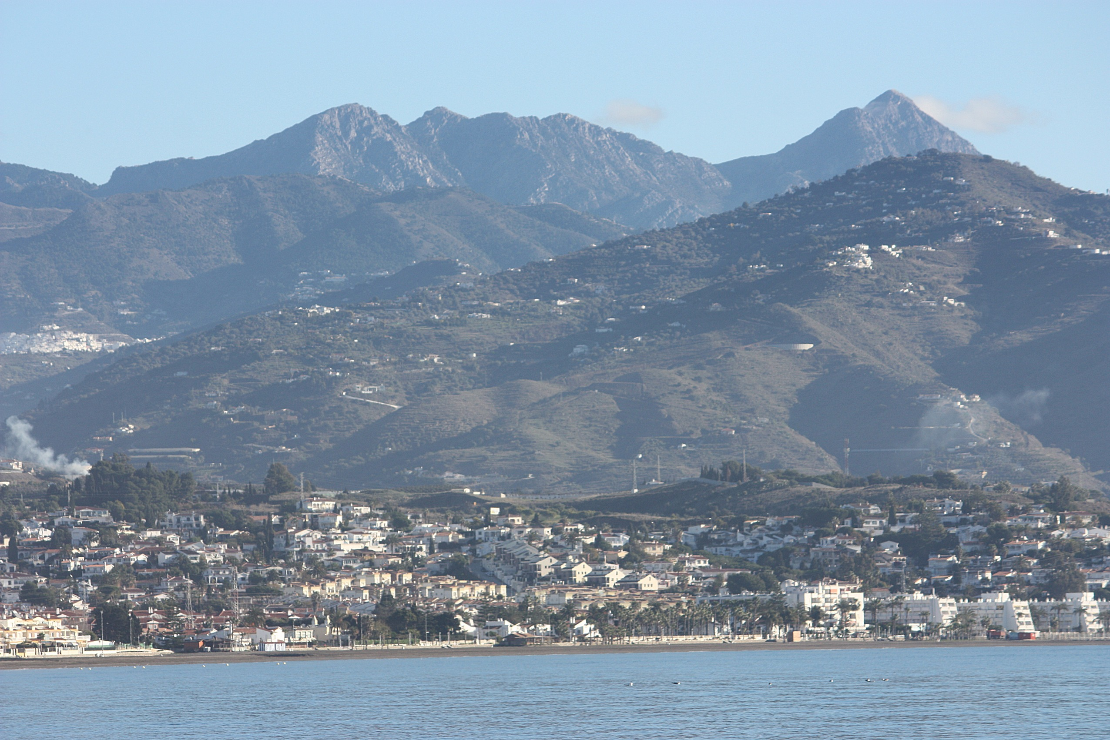

Slide 7
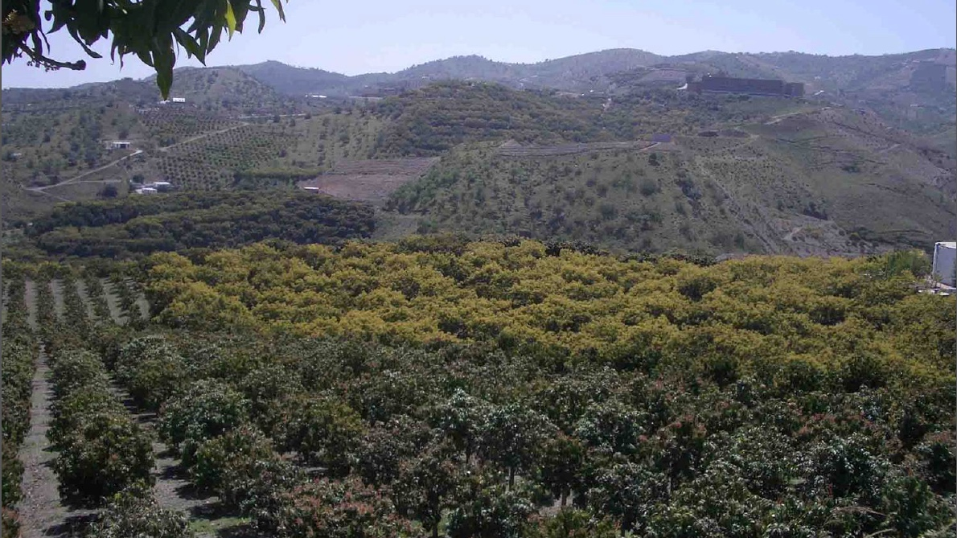
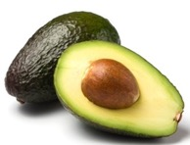
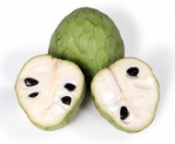
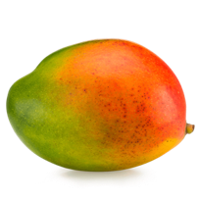
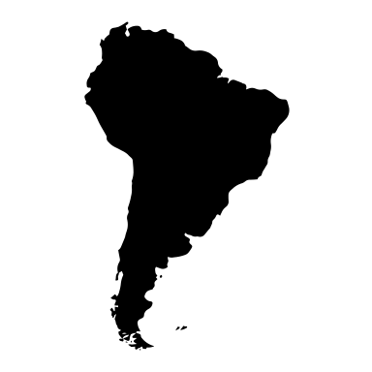

Slide 8
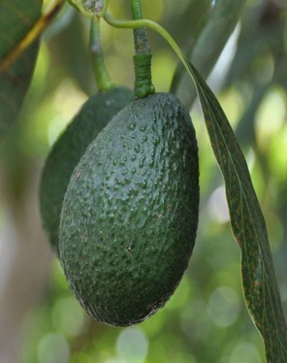
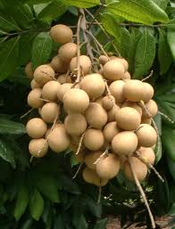
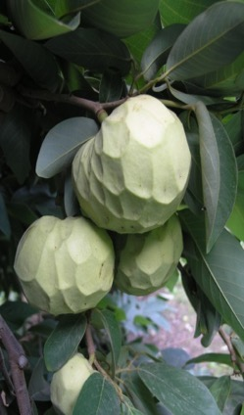
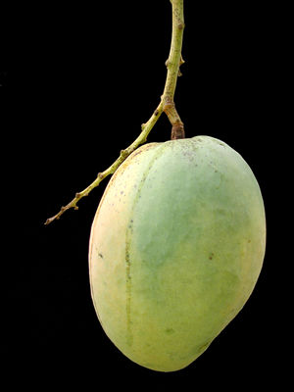
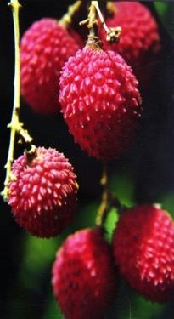
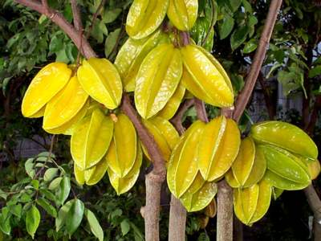
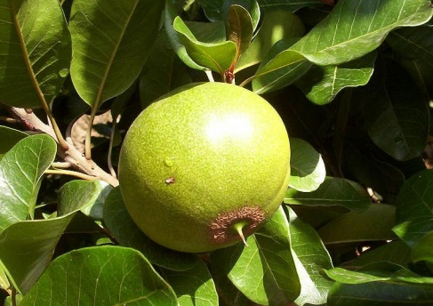
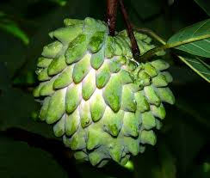
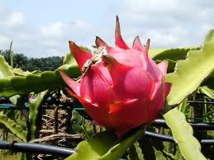
DUS (Different, Uniform and Stable)
Tropical fruits
Mango /Avocado
Cherimoya/Papaya
Collections (living):
Mango: 70
Avocado: 80
Cherimoya: 350
Lychee: 25
Starfruit: 15
Loquat: 20
Experimental production and breeding
Pitaya
Papaya
Cacao (under shelter)
Coffee (under shelter)

Slide 9
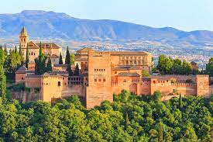
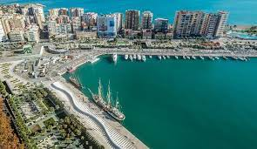
Malaga City

Slide 10
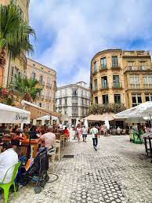
Malaga city
Lively city in the Mediterranean
Touristic destination
Interesting cultural life
Picasso Museum Malaga
Carmen Thyssen Museum
Malaga Roman Theatre
Pompidou Centre Malaga

Slide 12
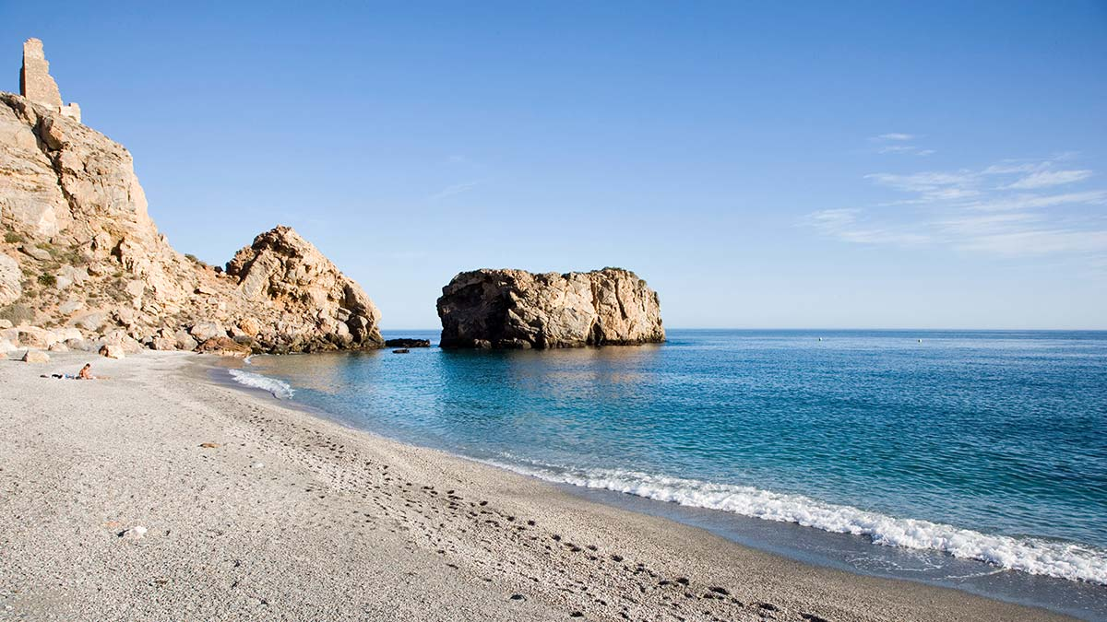

Slide 13
Málaga

Slide 14
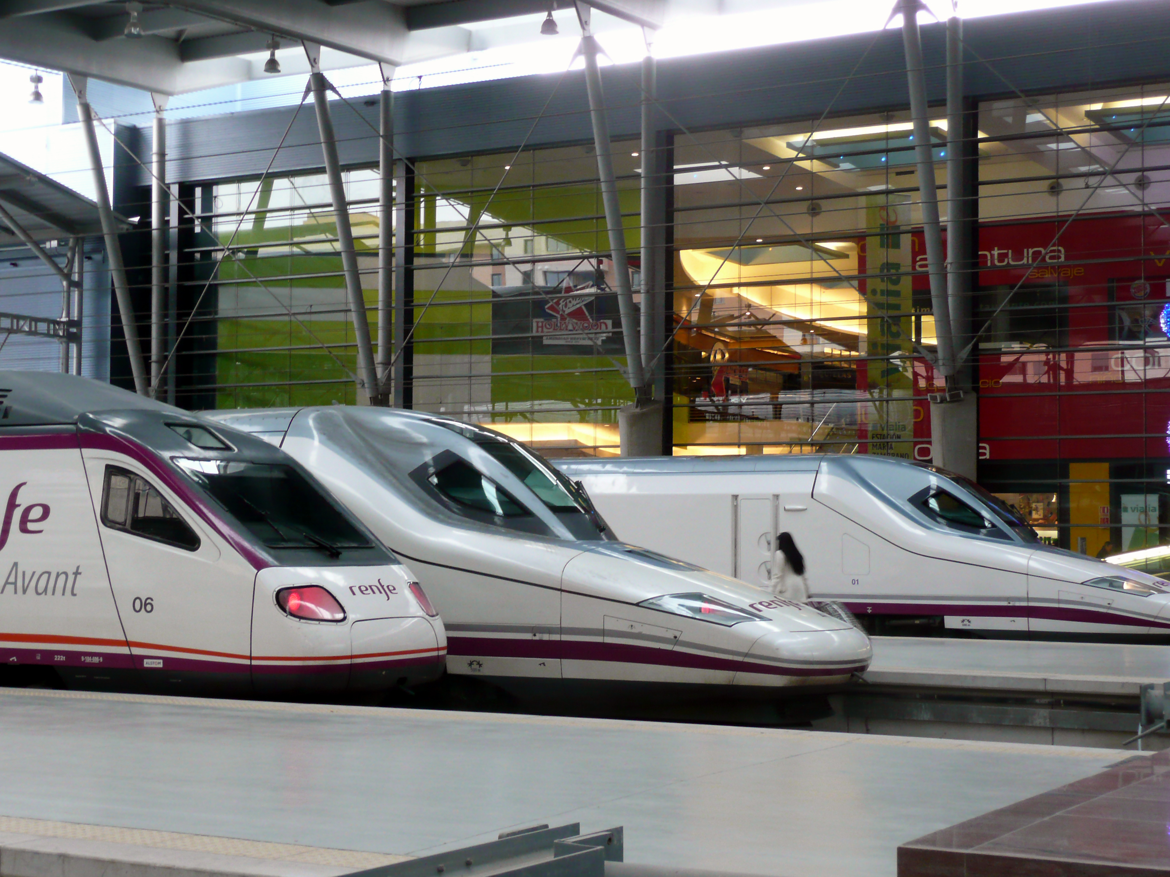
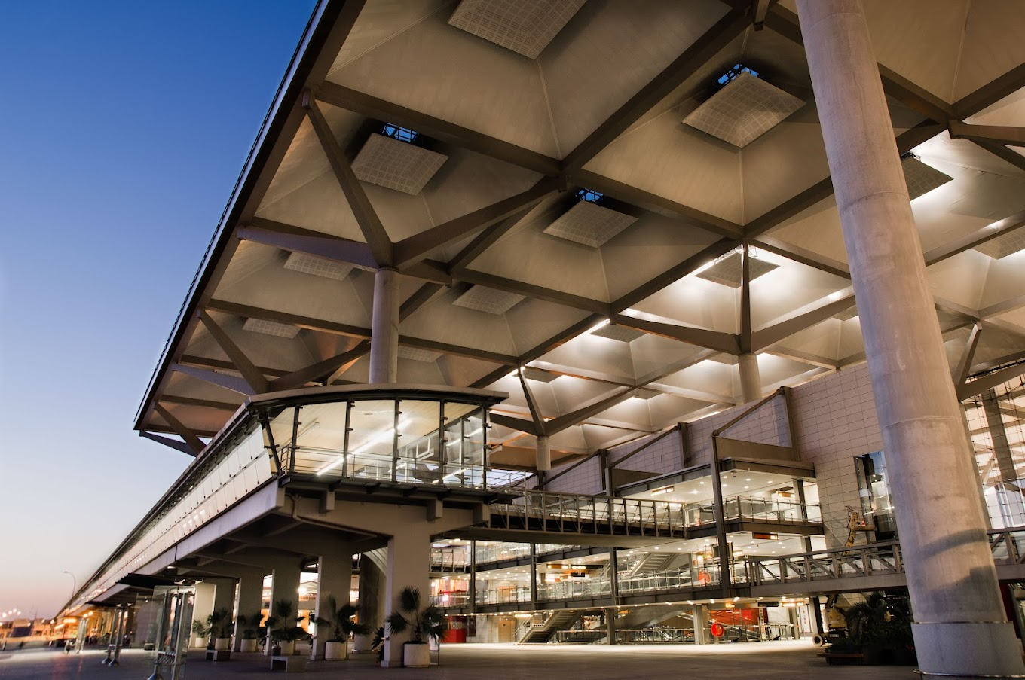
Logistics
Benign weather all year-round
Best moments 2nd half of september-December, April-June
Off season
Plenty of accommodation and facilitites for all budget types
2nd largest international airport in Spain
Connection with all major cities in Europe, UK, Africa (North Africa) and also direct flights to the USA
High speed connection to Madrid, Sevilla and Granada

Slide 15
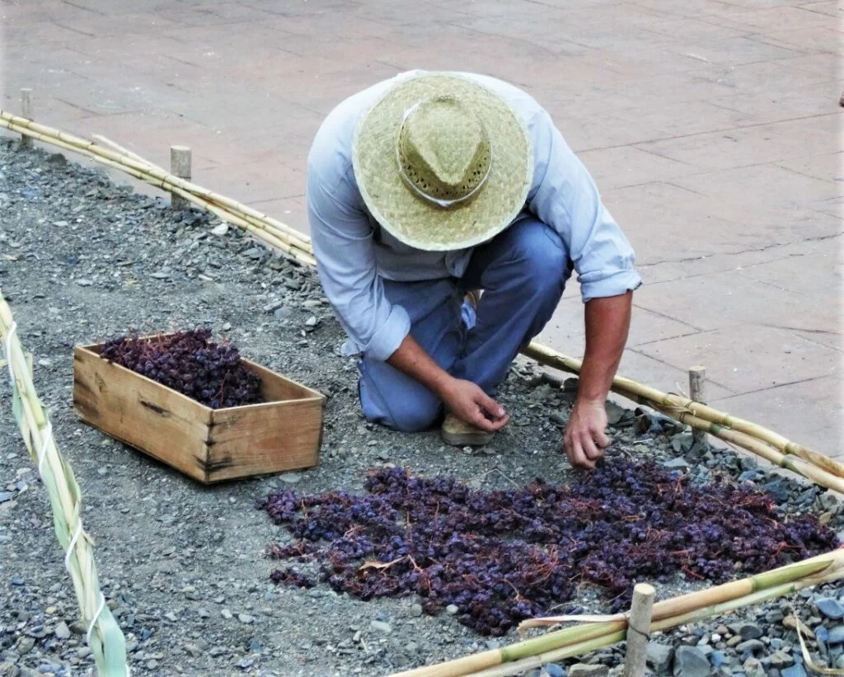
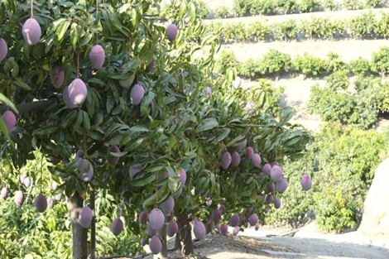
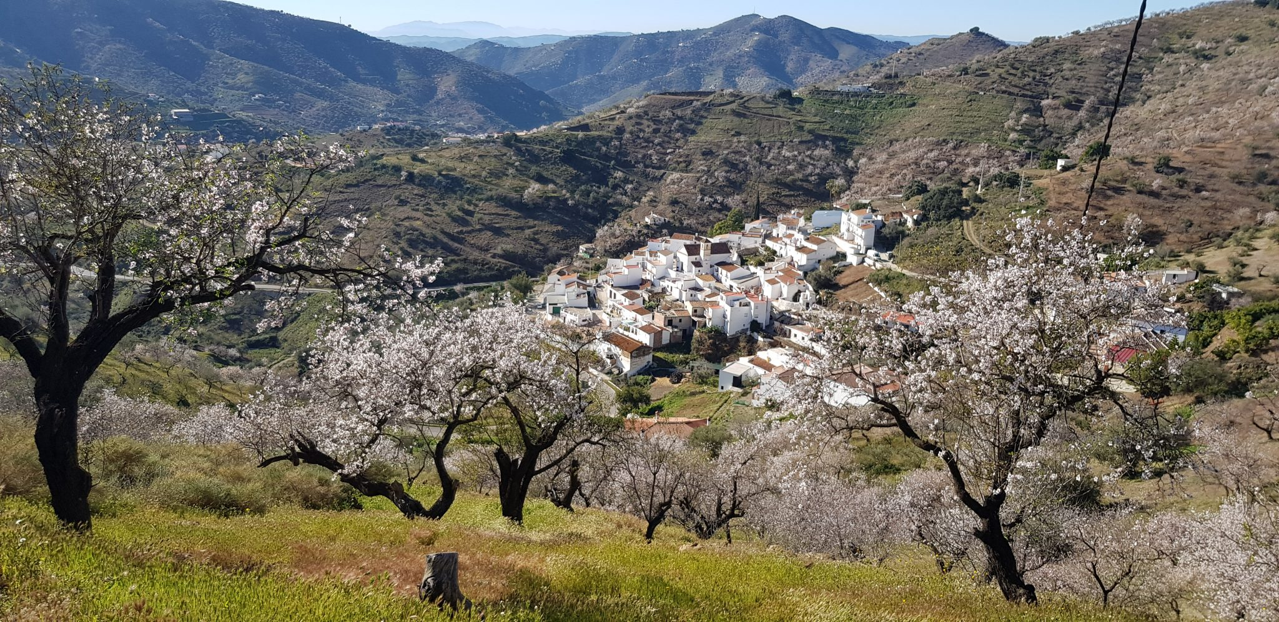
Visits

Slide 16
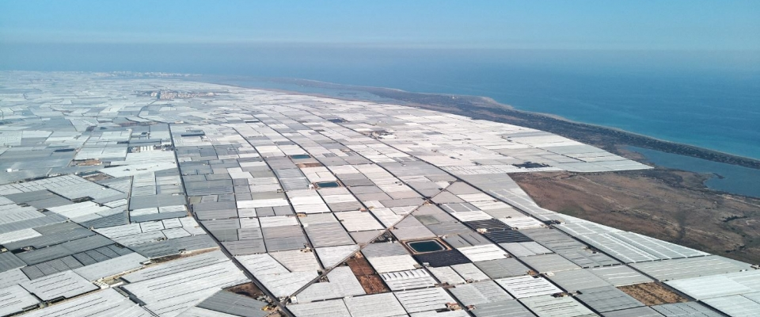
Visits

Slide 17
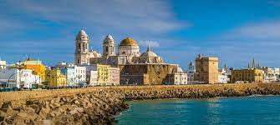
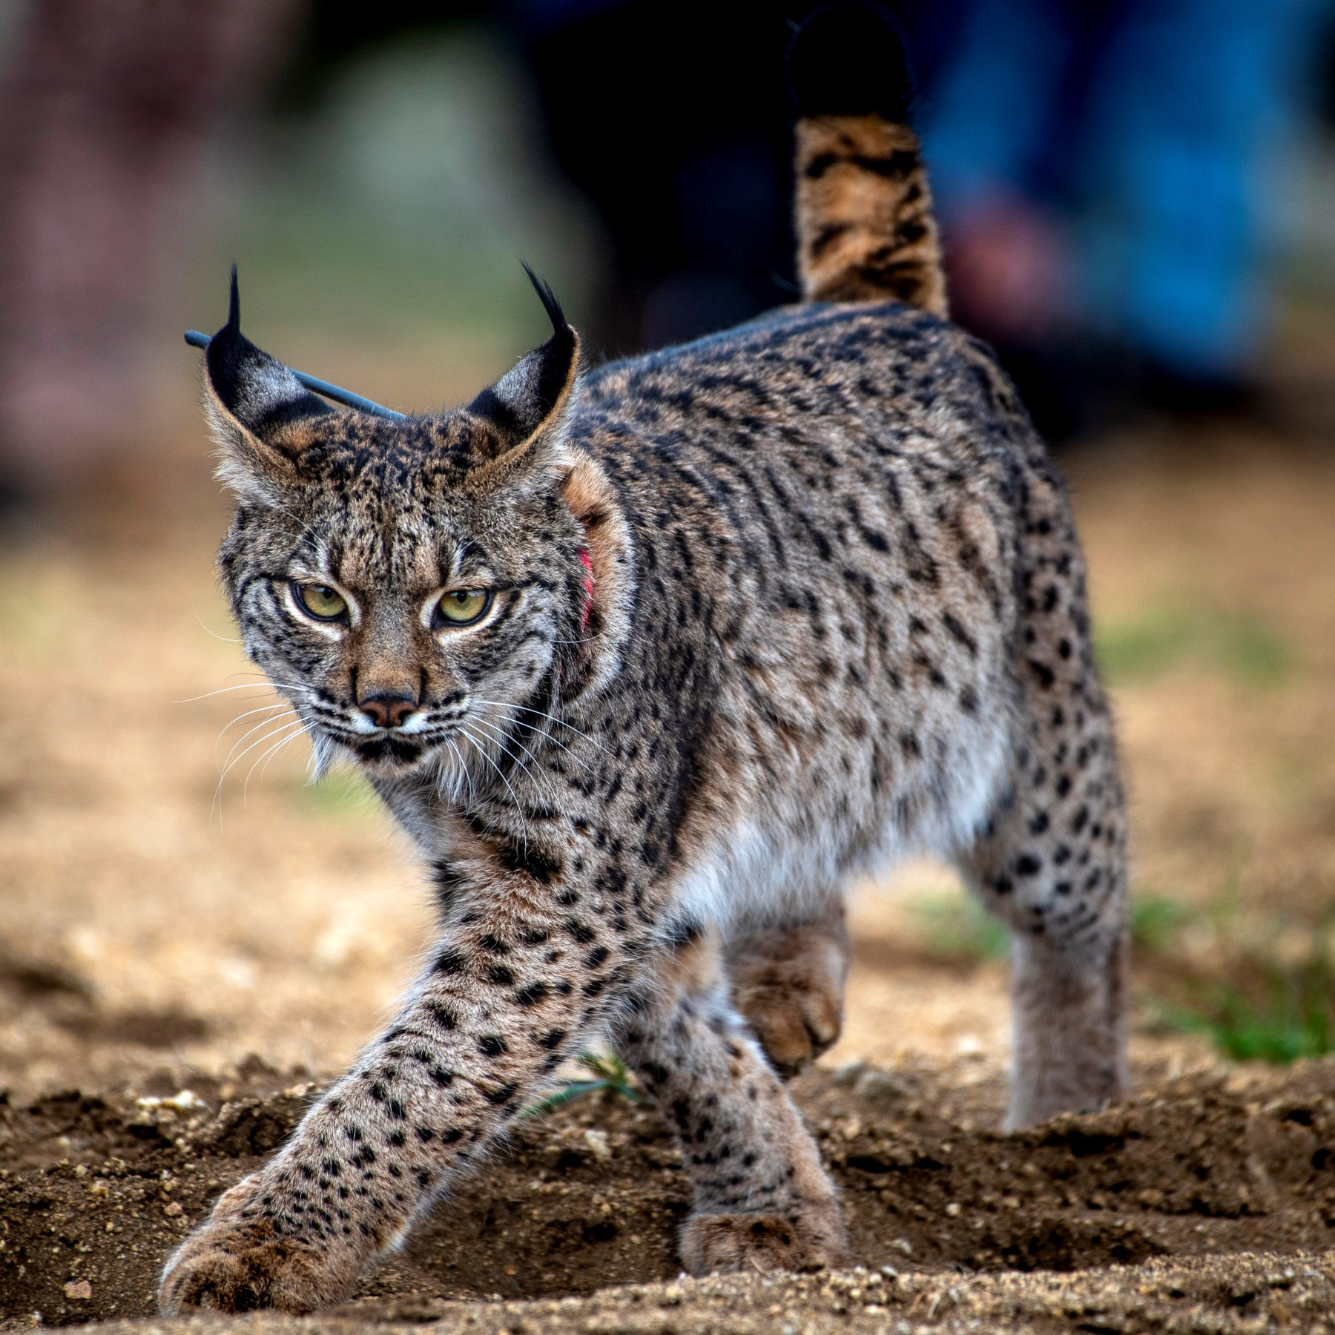
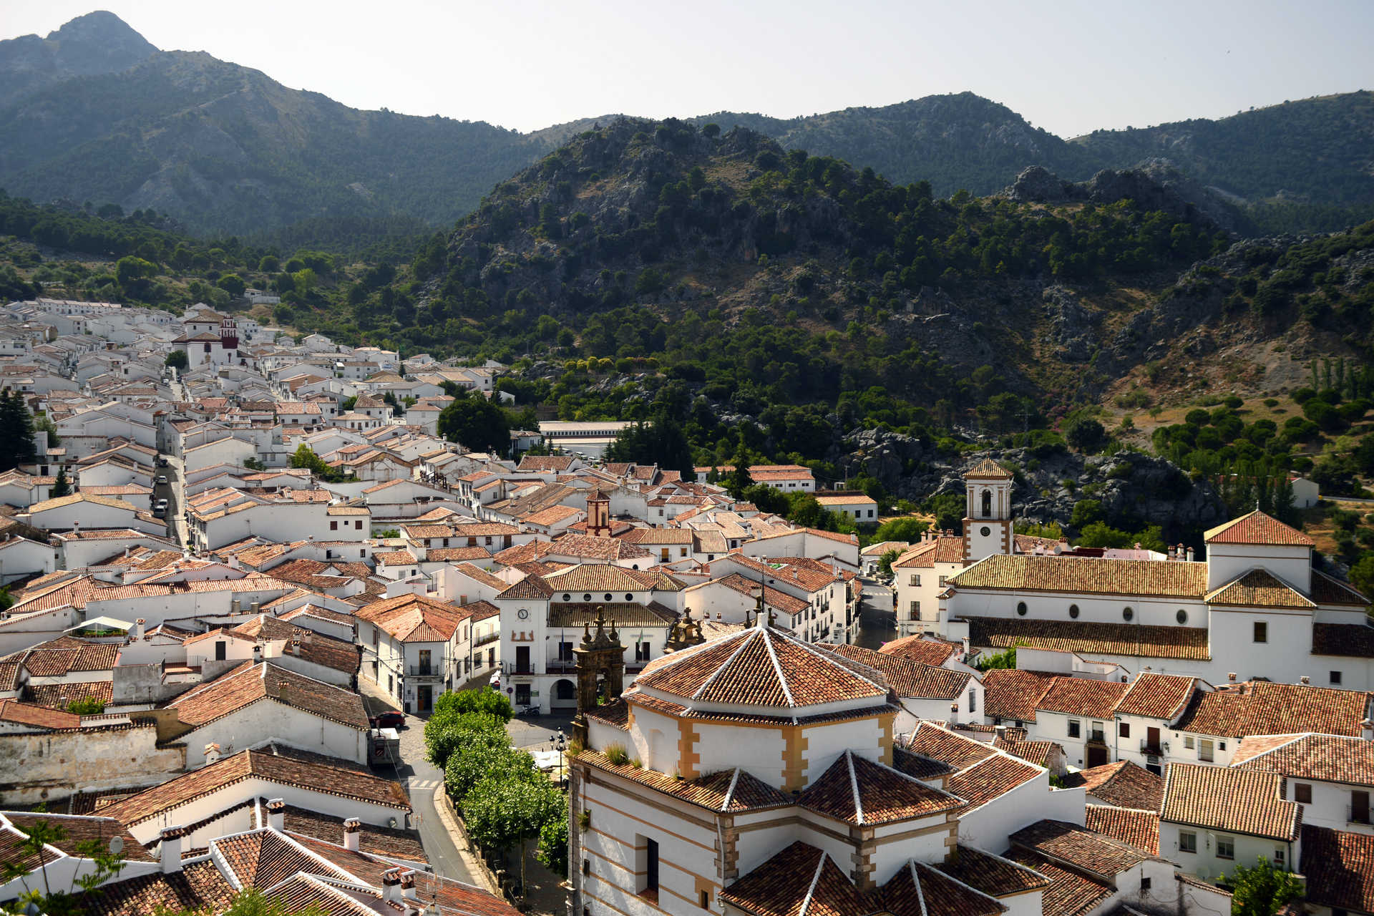
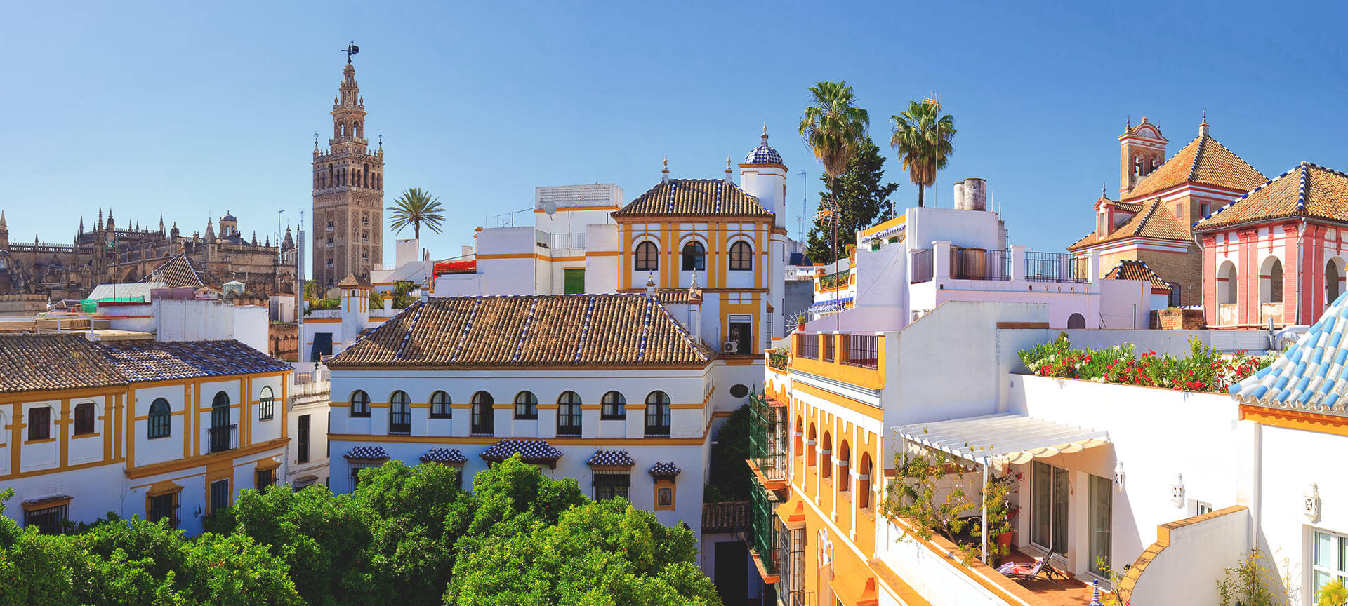
Explore nature and culture of Andalusia

Slide 18
Looking forward to meeting you in Spain!

