Slide 1
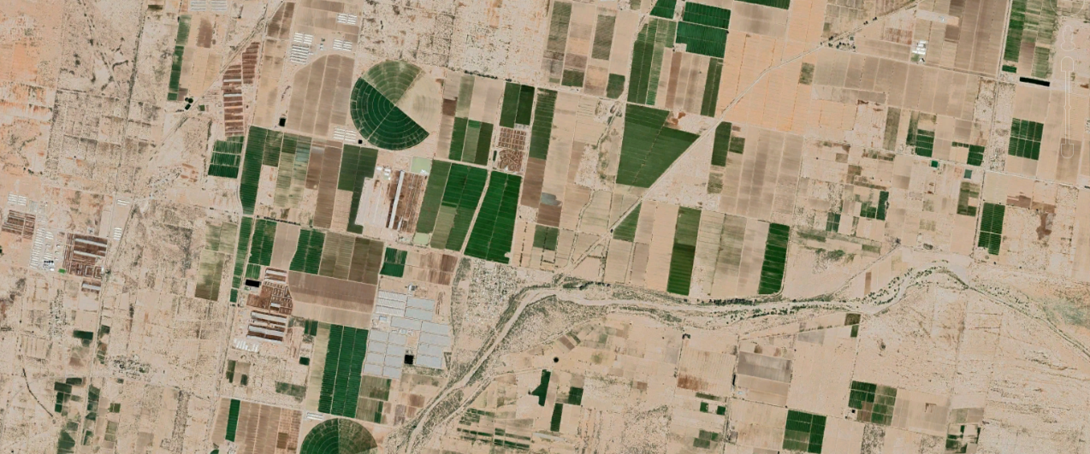
Using earth observation data to improve climate-modifying habitat datasets for pest risk modelling
Tim Beale (CABI), Pascale Bodevin (CABI), Steve Edgington (CABI), Libertad Sanchez Presa (CABI), Bryony Taylor (CABI), Alex Cornelius (Assimila), Gerardo Lopez Saldana (Assimila), Jon Styles (Assimila), Darren J. Kriticos (Cervantes Agritech)
Presented by Tim Beale at IPRRG Annual Meeting, Nairobi, Kenya. September 2023

Slide 2
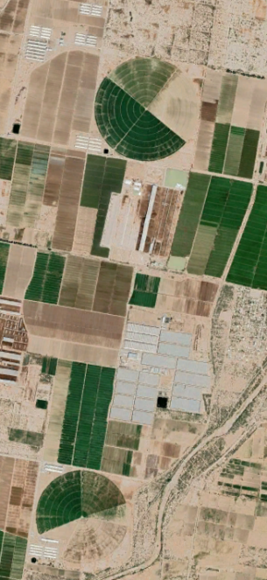
Using earth observation data to improve climate-modifying habitat datasets for pest risk modelling
Introduction
Timeline of the project(s)
Irrigated areas
Protected agriculture (PA)
Canopy temperature
Goals and next steps
Notes:
CABI – International not-for- profit organisation – providing information and applying scientific expertise to tackle agricultural and environmental problems
Assimila – Earth Observation experts – systems and tools for turning EO data into applications
Cervantes – Darren’s company - Pest modelling expert - Australian Partner
Identified the need to improve information on agricultural practices to better understand pest problems

Slide 3
Timeline
Global irrigation data product
Protected agriculture datasets (UK & Australia)
Canopy temperature datasets (UK & Australia)
Demonstrator pest models showcasing new datasets
Papers publishing methods
EO4AgroClimate
Prototype irrigation method
IPRRG 22
IPRRG 23
Phase 1
Jan 22
Mar 22
Oct 22
Phase 2
Apr 23
Sept 23
Mar 25
Notes:
Phase 1:
The UK's Science & Technology Facilities Council (STFC) – aiming to establish a bilateral UK/Australia (EO4AgroClimate).
Improve upon existing irrigation data
Phase 2:
Build on irrigation work to publish a global dataset
Work on producing a PA dataset - aim for UK and Australia
Canopy temperature dataset
Demo pest models
Papers publishing methods

Slide 4
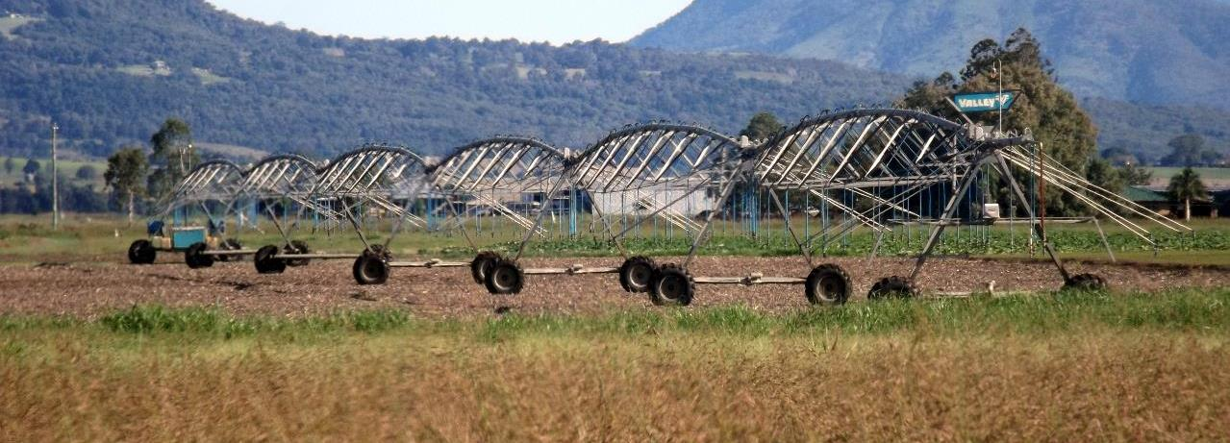
Irrigation
Notes:
Un-natural habitat, enabling the growth of crops in otherwise unsuitable areas.

Slide 5
Irrigation
Year | Global irrigated area (million hectares)
1961 | 139
2009 | 301
2050 | 337
(FAO, 2011a), (Alesandratos and Bruinsma, 2012).
Notes:
Irrigated area more than doubled between 1961 and 2009
FAO estimate the rate of increase will slow to of less than 0.1% per year but in a changing climate it is not easy to predict how agricultural systems will adapt

Slide 6
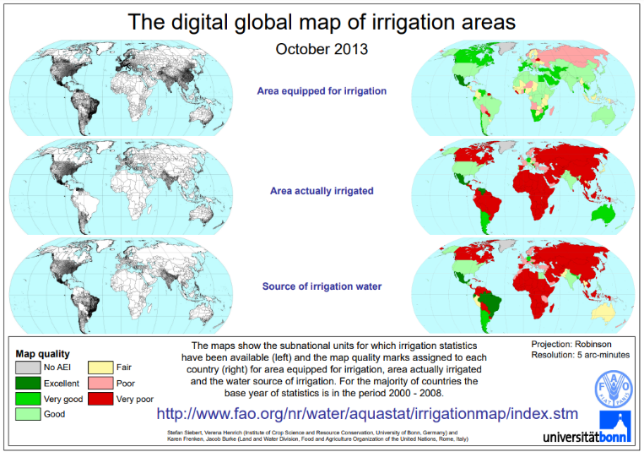
Global Map of Irrigated Areas (GMIA)
Latest version (v5) 2013
Areas equipped for irrigation around the year 2005
Resolution 5 arc mins (~10km)
Stefan Siebert, Verena Henrich, Karen Frenken and Jacob Burke (2013). Global Map of Irrigation Areas version 5. Rheinische Friedrich-Wilhelms-University, Bonn, Germany / Food and Agriculture Organization of the United Nations, Rome, Italy
Notes:
For global species distribution models – most commonly used dataset is the GMIA - Global Map of Irrigated Areas
Taking a closer look at the dataset we can understand the challenges of monitoring irrigation
Version 5 – 2013
Irrigation “around the year 2005” (18 years ago)
Resolution = 5 arc minutes
Area Equipped for Irrigation
Information on irrigated areas and activities is collected through national statistical offices. In some cases this is combined with remote sensed data. However this data is collected at different reporting levels and is slow to collate, harmonise and goes out of date quickly.
Data for areas equipped for irrigation is estimated to have a quality of quite good (top ‘green’ map)

Slide 7
Irrigation data challenges
EO Studies:
Global Irrigated Area Map (GIAM) (Thenkabail et al, 2009)
Identified 43% more irrigated areas than reported in official FAO statistics
A study published in 2018 using SPOT data (1999-2012) found big differences EO vs reported irrigation:
“The results globally show a 18 % larger irrigated area than existing approaches based on statistical data” (Meier, Zabel & Mauser, 2018)
GMIA
Based on regional data
Data is now old
Based on equipment – rather than actual
Funding reduced - plans for a 2015 version
Notes:
EO Solutions:
EO has potential to provide us with better data, more timely – in turn will allow us to more accurately model pest distributions under changing climate scenarios
For example, sanitary and phytosanitary (SPS) organisations may want to understand irrigation patterns for the previous year or season to understand locations at risk of particular pests and diseases and to guide survey and monitoring activities.
Our POC showed potential to identify areas affected by wildfire. EO derived vegetation indices over time clearly show areas which have a consistent pattern of either natural vegetation or agricultural growth and then contracting periods of vegetation absence. Whilst other systems exist to predict and monitor wildfire risk, this POC may have potential to monitor the longer term impacts of wildfire on land use and habitats for pests and diseases

Slide 8
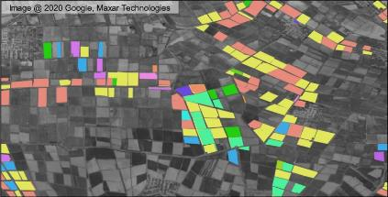
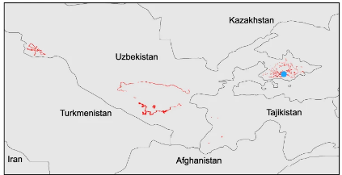
Irrigation: Search for (ground) data
Census-type data available from government sources as used in GMIA
Projects which use EO methods to spatially allocate irrigation stats (from sources above) to agricultural areas
A handful of published datasets providing the centerpoint of pivot fields
A handful of published datasets with land cover / crop classification which also recorded some irrigation information
A crop type dataset for consistent land cover classification in Central Asia (Remelgado et al. 2020)
Notes:
Lack of high resolution ground truthing data
Suspect local-farm level data exists within more advance closed precision ag systems

Slide 9
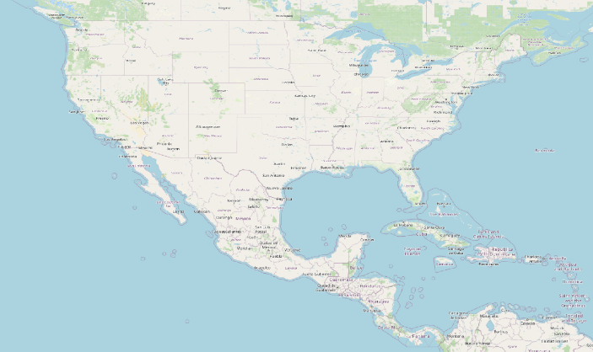
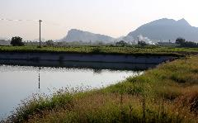
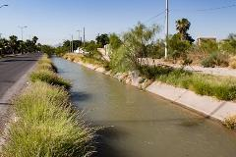
Irrigation: EO Approach
Input data:
MODIS/Terra Enhanced Vegetation Index (EVI) 16-Day L3 Global 250m.
ERA5 total precipitation climate dataset
Use precipitation data to drive CLIMEX soil moisture model
Time series comparison of ‘peak vegetation’ events and ‘peak moisture’ events
Identify irrigation events over selected time period to create an irrigation mask
Durango and Coahuila, Mexico
Irrigation Map

Slide 10
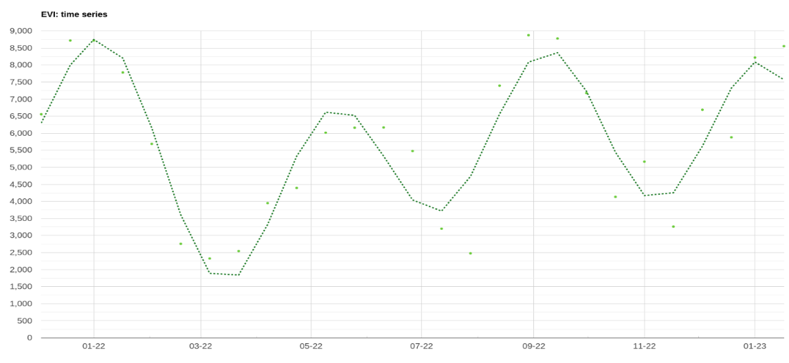
EVI time series
Notes:
Step 1: EVI observations a fitted to harmonic model to eliminate outliers and obtain a smoothed curve that can be used to characterise vegetation phenology
Step 2: All peaks on the EVI time series are identified and the dates are kept for further processing

Slide 11
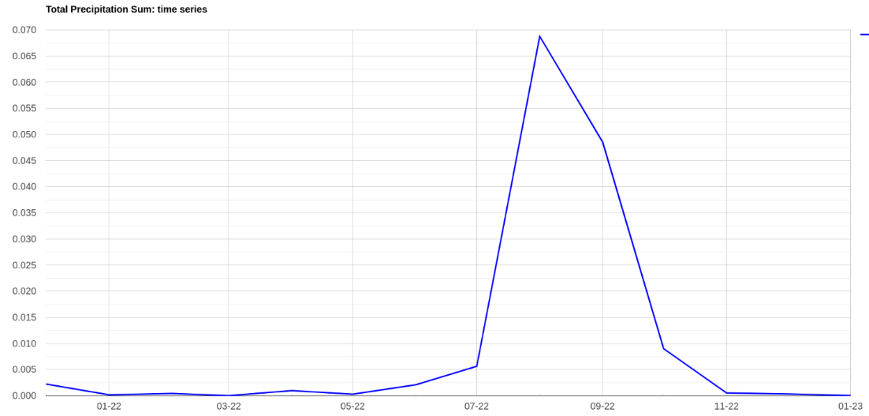
Precipitation/soil moisture time series
Notes:
Step 3: The peak of the ERA5 total precipitation is identified and the date of the peak is kept

Slide 12
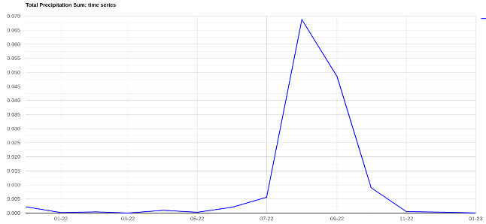
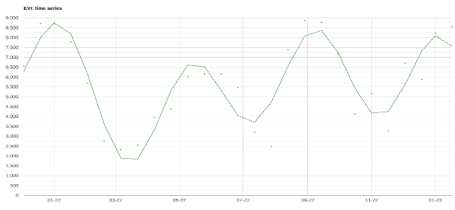
Irrigation classification
Notes:
Step 4: All peaks in the EVI that are further away from a certain threshold (in weeks) are flagged as potential areas of irrigation

Slide 13
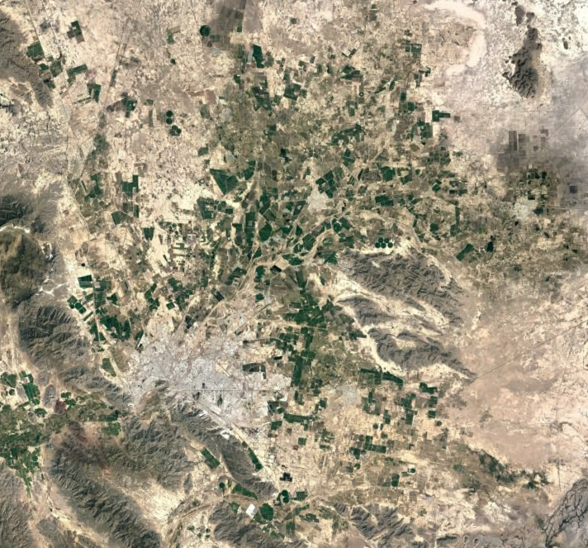
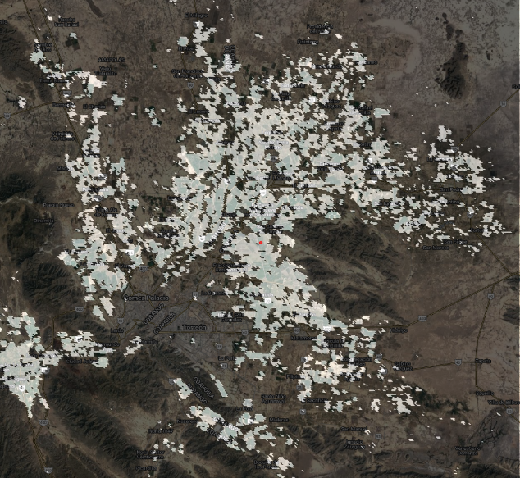

Slide 14
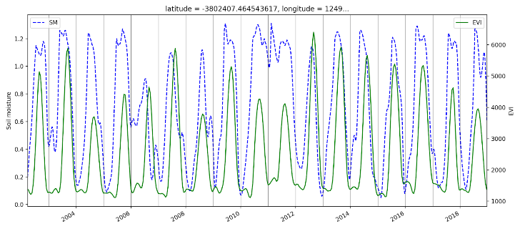
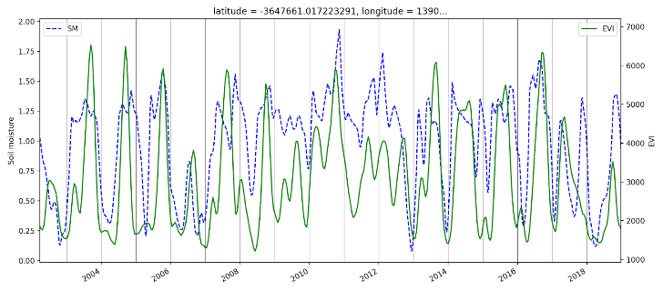
Multi-year comparison
ERA5 data was used to populate the CLIMEX soil moisture model (blue) and compared with the EVI vegetation model (green)
EVI identified rainfed cropland
→
EVI identified irrigated cropland
→
Notes:
20 years of data
Selected 2 locations in Australia focussing on 2010 vegetation conditions
Top graph - shows the unimodal rainfed pattern (matching quite well) consistent year to year.
The bottom graph – more of a mixed picture but in 2009 and 2010 with 2 peaks of vegetation. The soil moisture stayed fairly stable but peaked in the second half of the year as expected

Slide 15
Comparison with GMIA in SE Australia
EO derived irrigated area. Using 20-year timeseries analysis method
GMIA irrigated area map. Irrigation volume data taken from a particularly wet season (2005/06)
Notes:
Promising results
Ground truthing data to test more thoroughly

Slide 16
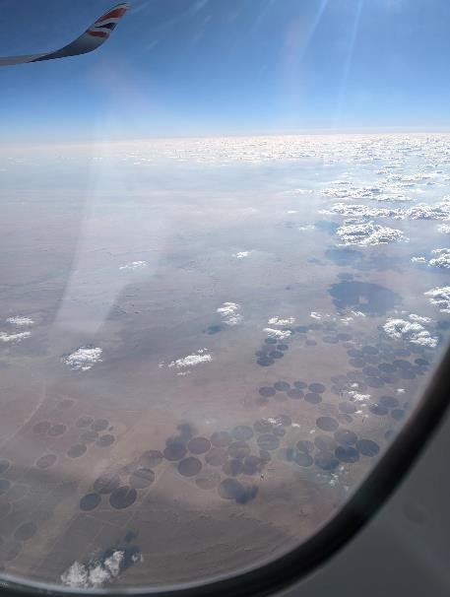
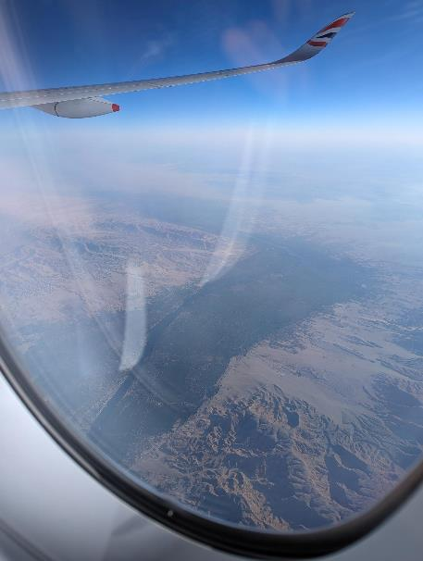

Slide 17
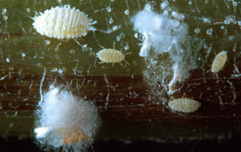
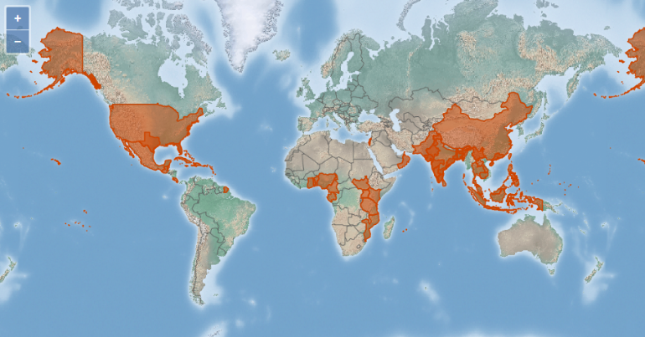
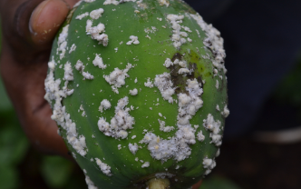
Irrigation and pest distribution
Example: Papaya mealybug (Paracoccus marginatus)
Notes:
The papaya mealybug, is a highly polyphagous invasive pest that affects more than 200 plants inc. Cassava, avocado, citrus
Native to Mexico and Central America - First reported - Africa in 2009 (Ghana)
Can cause losses of up to 91%
2015 study in Bangladesh led to an average economic loss of approximately US$700 per hectare per year

Slide 18
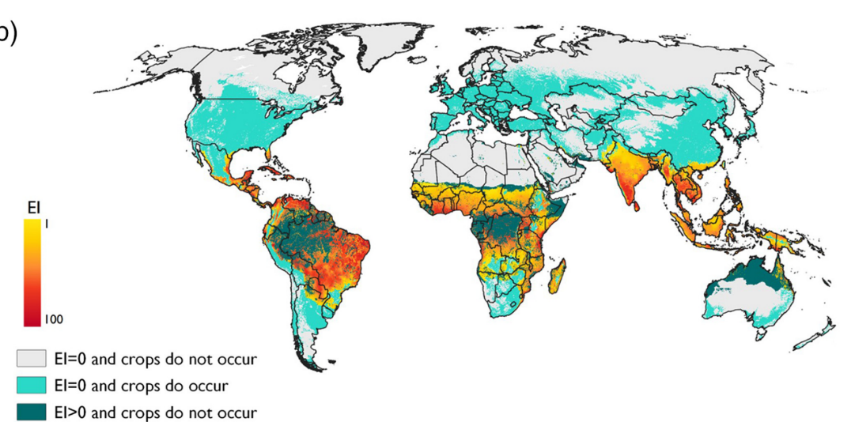
The potential global distribution of the papaya mealybug, Paracoccus marginatus, a polyphagous pest (Finch et al. 2020)
Notes:
Potential distribution of P. marginatus using CLIMEX climate-based niche model.

Slide 19
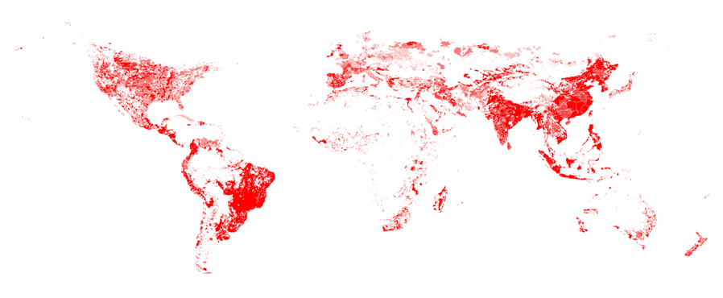
The potential global distribution of the papaya mealybug, Paracoccus marginatus, a polyphagous pest (Finch et al. 2020)
GMIA - Area Actually Irrigated
Notes:
We combined this model with spatial data on irrigation and cropping patterns to increase the real-world applicability of the model.
GMIA Irrigation data on the area actually irrigated was used to identify irrigated areas
top-up irrigation scenario of 2.5 mm day−1 throughout the year

Slide 20
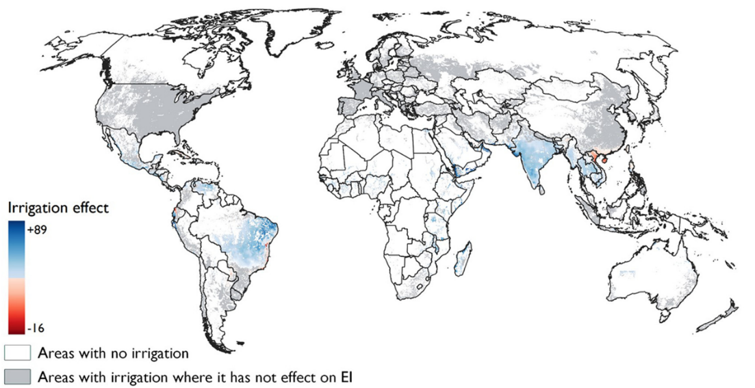
Impact of irrigation on Environmental Suitability
Notes:
Impact of irrigation on Environmental Suitability (EI Index)
The biggest effect of irrigation was seen in Brazil ( central and eastern) and in Asia (India and Southeast Asia)

Slide 21
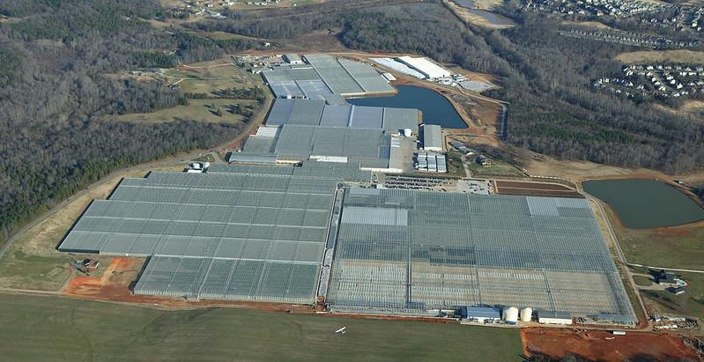
Protected agriculture
Notes:
Un-natural habitat, greenhouse/glasshouse/plastic structure polytunnel.
Provides warmer conditions, warmer minimum temperatures to allow persistent populations

Slide 22
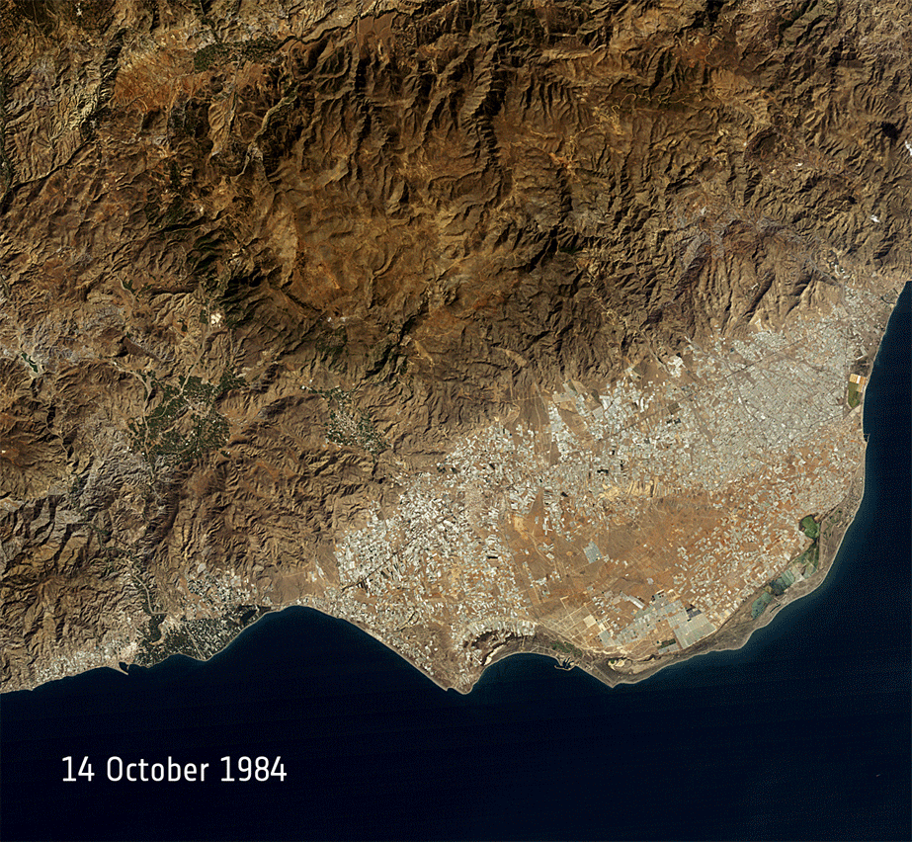
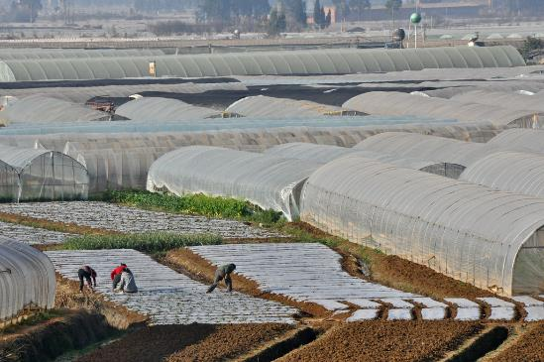
Protected agriculture
China:
3% of farmland under plastic covering (4m ha)
35% of vegetables produced under cover
‘Mar de plastico’ (sea of plastic)
Almeria, Spain (USGS/ESA)
Hot house production, Yunnan, China
(Asian Development Bank)
Notes:
40,000 hectares of greenhouses - largest concentration in the world
China’s current 5-year agricultural plan includes “Accelerating the development of protected agriculture”
Growing automation in glasshouses - vertical agriculture practices

Slide 23
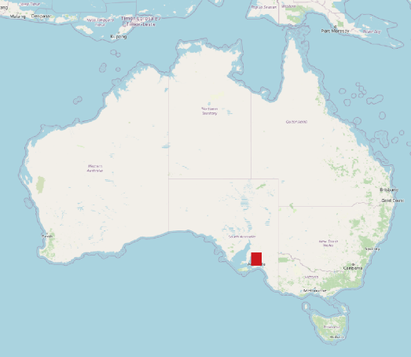
Protected Agriculture - EO approach
Input data: Sentinel 2 multispectral (10m)
(Annual multitemporal composites)
Advanced Plastic Greenhouse Index (APGI)
Normalized difference enhanced sand index
Delineated PA/non-PA training data
XGBoost binary classification
Protected Agriculture Map
Notes:
Test area near Adelaide
<Info on slide>

Slide 24
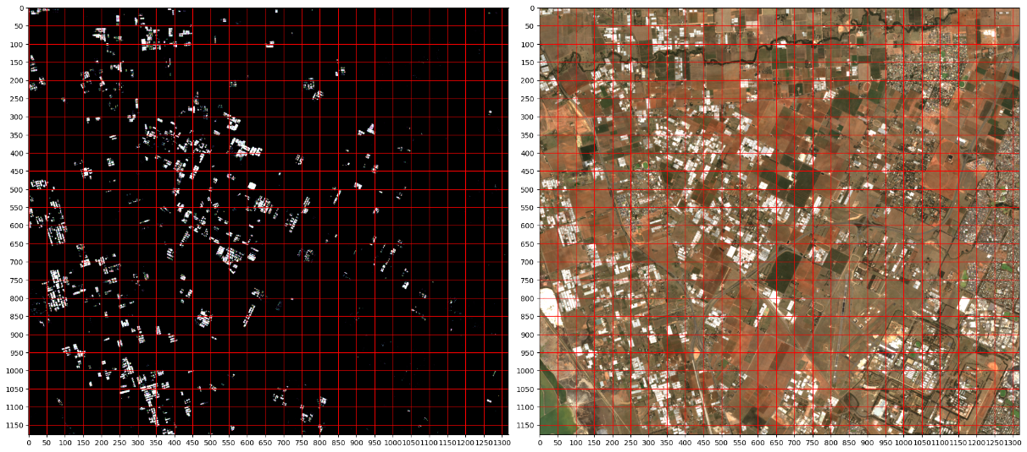
Protected Areas - EO approach
Notes:
Right - RGB image - 500m grid
Left - Output PA map

Slide 25
Protected Areas - EO approach
Notes:
Blue - Good definition between white buildings and PAs
Pink - Salt flats area of white sand - highly reflective - No dirt roads
99% accuracy - but very small area / significant input data / consistent practices
Challenges to scale up -
Different PA types - netting and glass
Performed on downloaded datasets
Scaling up via Google Earth Engine

Slide 26
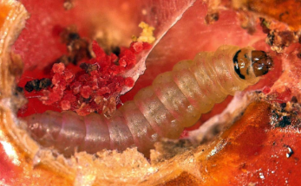
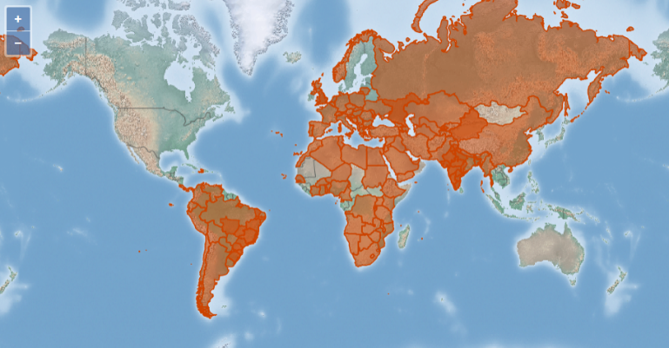
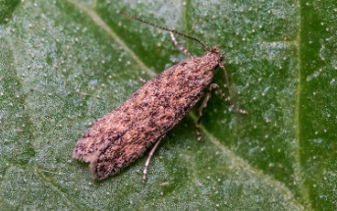
Protected agriculture and pest distribution
Example: Tomato leafminer
Tomato leafminer (Tuta absoluta / Phthorimaea absoluta)
Notes:
Native to S America – reported in Spain in 2006 – spread S and E
Difficult to manage - v significant losses – up to 100%

Slide 27
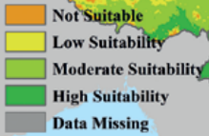
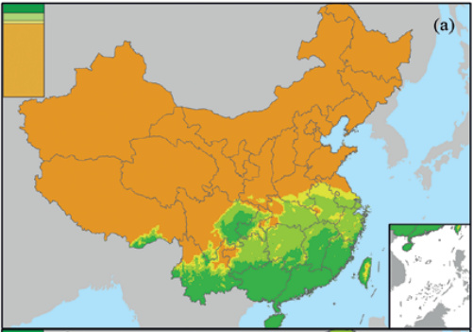
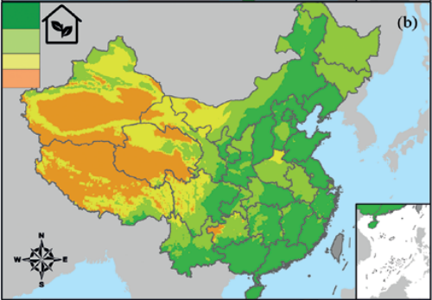
Protected agriculture matters: Year-round persistence of Tuta absoluta in China where it should not (Liu et al. 2023.)
Ecoclimatic Index (EI)
Current climate scenario (no PAs)
Ecoclimatic Index (EI)
Current climate scenario with PAs
Notes:
China – reached in 2017
Data
- Average area of PA 2008-2018 in each province in China National Bureau of Statistics 2019
Model - adjust cold stress in the CLIMEX model
Findings - T. absoluta to survive the harsh winters in northern China because PAs offer thermal buffering and prolong the pest’s development window and provide overwintering refuge
Explaining why subtropical and tropical pests like Tuta can successfully invade colder areas and establish year-round populations in temperate zones worldwide, such as Tajikistan, Kazakhstan, Kyrgyzstan, Uzbekistan and Russia

Slide 28
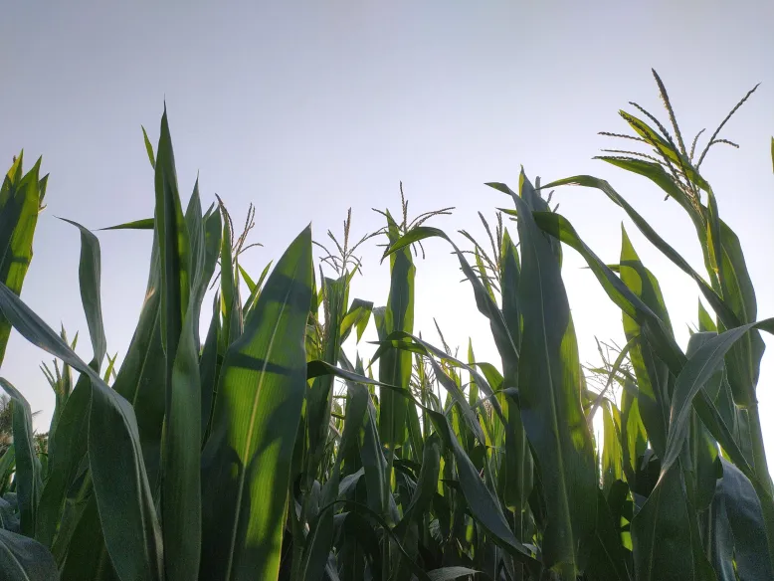
Canopy Temperature
Notes:
Issue when trying to model crops
And pests depending on their lifecycle stage and position

Slide 29
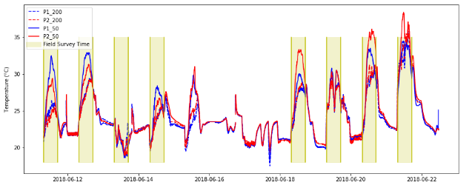
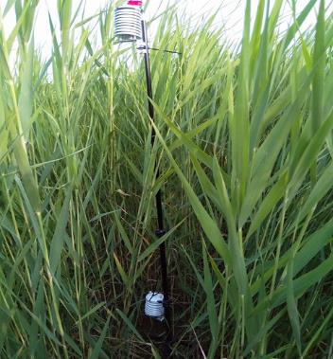
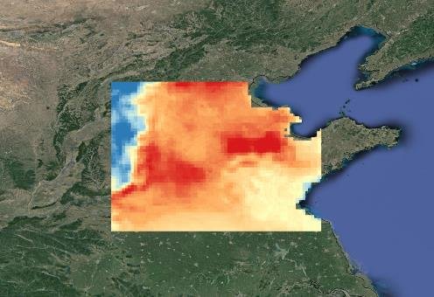
Analysing and ground truthing existing EO temperature products
2m
0.5m
Notes:
Current EO products surface/ground temperature or 2m air temperature.
Canopies store heat – alter air flows – not perfect measures for in-canopy conditions
Using both – can we estimate the canopy temperature

Slide 30
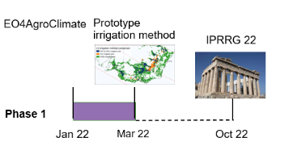
Timeline
Global irrigation data product
Protected agriculture datasets (UK & Australia)
Canopy temperature datasets (UK & Australia)
Demonstrator pest models showcasing new datasets
Papers publishing methods
Gather user feedback
IPRRG 23
Ground truthing
Refine algorithms
Validation
Pest models
Apr 23
Sept 23
Mar 25

Slide 31
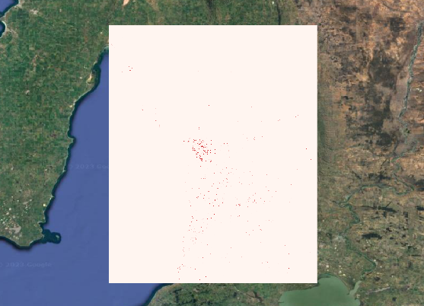
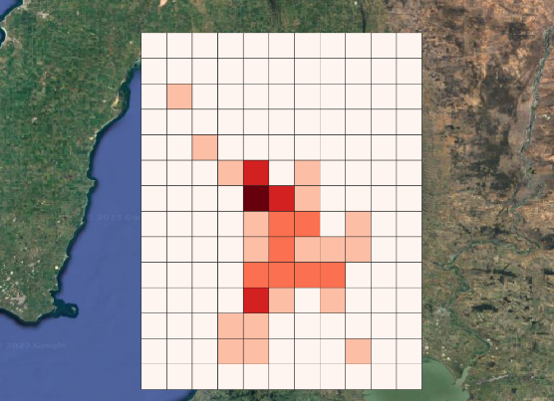
Improved datasets for pest risk modelling
Binary irrigation / PA results
High resolution (250m / 10m)
Pest modelling datasets
Transformed to regional/global scale
(e.g. a 10km grid)
Area (or % area) of irrigation / PAs
Notes:
Design for pest risk modelling – not all EO experts
Transforming datasets to make them useful for pest distribution and risk modelling

Slide 32
Uses: Identifying errors in occurrence data
Occurrence data:
Of the “Human Observation” type records (attempting to discount specimen records):
54,788 “greenhouse” records
201,535 “irrigation” records
??? unlabelled…
Notes:
First use: Identifying anomalous raw data
Cleaning model input data
There is a danger of assuming that an organism can exist in these areas ‘naturally’ - this then projects this assumption into geographies where the pest can’t survive overestimating the potential range
misdirecting resource allocation for preparedness activities, and undermining the reputation of pest risk assessment

Slide 33
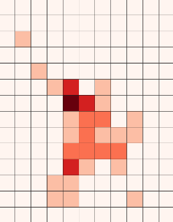
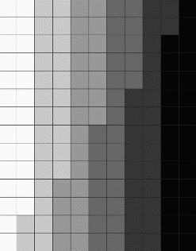
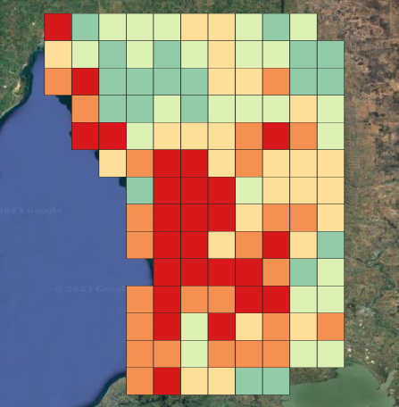
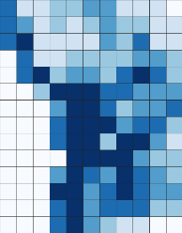
Uses: Improved risk factors
Protected agriculture
Environmental variables
Temperature
Canopy temperature
Precipitation
Koppen-Geiger zones
Climate change scenarios
Pest Risk Models
Irrigated areas
Notes:
Aim to publish datasets at the end of the project in 2025
Integration with CLIMEX for easier irrigation scenario workflow
ultimately better data = better models = make better decisions

Slide 34
Questions & Feedback
Current uses / challenges around irrigation and protected agriculture in pest risk modelling?
Are there particular pests where you have experienced problems with these agricultural systems?
Requirements for the new irrigation, protected agriculture or canopy temperature data products - what should the end products look like?

Slide 35
References
Araújo Soares, M., & Ribeiro Campos, M. (2022). Phthorimaea absoluta (tomato leafminer) [dataset]. In CABI Compendium. CABI Publishing. https://doi.org/10.1079/cabicompendium.49260
Finch, E. A., Beale, T., Chellappan, M., Goergen, G., Gadratagi, B. G., Khan, M. A. M., Rehman, A., Rwomushana, I., Sarma, A. K., Wyckhuys, K. A., & Kriticos, D. J. (2020). The potential global distribution of the papaya mealybug, Paracoccus marginatus, a polyphagous pest. In Pest Management Science (Vol. 77, Issue 3, pp. 1361–1370). Wiley. https://doi.org/10.1002/ps.6151
Liu, X., Yang, M., Arnó, J., Kriticos, D. J., Desneux, N., Zalucki, M. P., & Lu, Z. (2023). Protected agriculture matters: Year-round persistence of Tuta absoluta in China where it should not. In Entomologia Generalis. Schweizerbart. https://doi.org/10.1127/entomologia/2023/1784
Tonnang, H. E. Z., Mohamed, S. F., Khamis, F., & Ekesi, S. (2015). Identification and Risk Assessment for Worldwide Invasion and Spread of Tuta absoluta with a Focus on Sub-Saharan Africa: Implications for Phytosanitary Measures and Management. In R. N. C. Guedes (Ed.), PLOS ONE (Vol. 10, Issue 8, p. e0135283). Public Library of Science (PLoS). https://doi.org/10.1371/journal.pone.0135283
Watson, G. (2022). Paracoccus marginatus (papaya mealybug) [dataset]. In CABI Compendium. CABI Publishing. https://doi.org/10.1079/cabicompendium.39201

Slide 37
Abstract
Non-climatic habitat factors can have a significant effect on species ranges, allowing them to persist well beyond their natural ranges. Irrigation and protected agricultural structures such as glasshouses are used specifically to allow crop species to be grown successfully in locations where the climate is otherwise inhospitable. The same conditions that allow the crops to be grown in hostile climates allows pest species to persist beyond their natural limits. Species distribution databases such as GBIF and iSCAN do not distinguish between species distribution records collected from natural habitat situations and those from artificial habitat. Bioclimatic models that ignore the role of these artificial habitat modifications routinely make egregious errors, incorrectly projecting habitat suitability into inclement climates. Methodically overestimating the pest risk area in this manner can have important effects on biosecurity risk management, misdirecting resource allocation for preparedness activities, and undermining the reputation of pest risk assessment.
Advances in Earth Observation (EO) technology have opened up new possibilities for addressing agricultural challenges in the face of climate change. The EO4AgroClimate project is using EO-derived data to enhance three critical modelling datasets: irrigation, protected agriculture, and canopy temperature. These datasets will help to contextualise species distribution data from repositories, as well as improve the performance of environmental niche models (ENM) leading to more accurate, high-resolution, and timely information for pest risk assessment.

