Slide 1
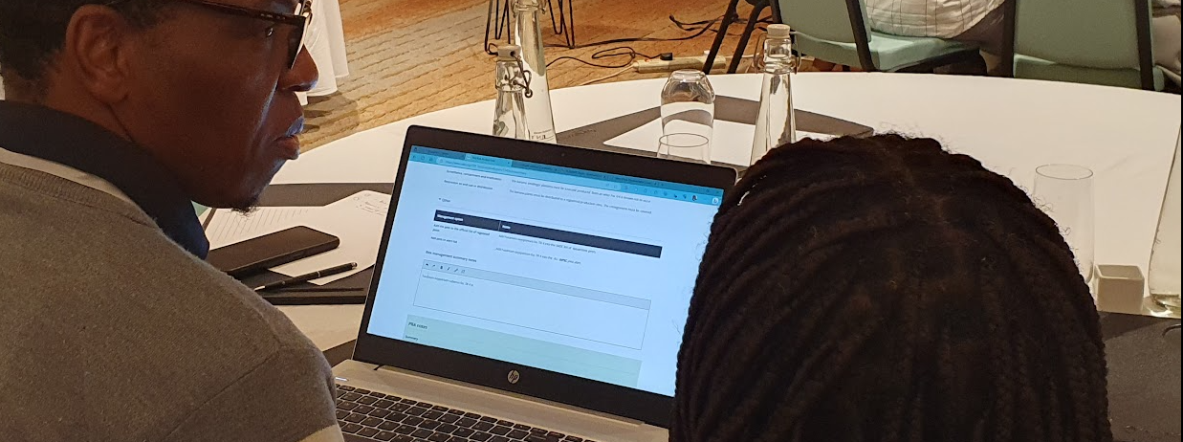
Development of the CABI Pest Risk Analysis Tool
Current status and future plans to support PRA capacity building
Lucinda Charles, Marc Kenis, Norbert Maczey, MaryLucy Oronje, Gareth Richards
IPRRG 2023, Nairobi

Slide 2
Motivation to build the PRA Tool
Provide a workflow for PRA
Increase access to information
Assist NPPOs with a challenging task
Help with documentation
Produce and share PRA reports
Improve decision support

Slide 3
2018-2020 Development stages
2018
User requirements workshops
2019
*Launched tool*
2020
Better handling of commodity pest lists
Expert consultation
Beta version of pathway-initiated PRA
PRA ‘By Pathway’ or ‘By Pest’
Edit commodity pest list
Create online teams
Offline workflow
Build a regulated pest list
Overrule CABI pest status

Slide 4
2021-2023
2021
Import data from datasheets
2022
Linkage to new CABI Compendium
2023
Added PRA ‘For Live Import’
Added regions
English and French reports
Batch exclude pests
French interface
Report formats
Login
UX review
Better pest lookup
Fixed saving
Offline French

Slide 5
Demo of main features
Type ‘CABI PRA Tool’ into browser
www.cabi.org/PRA-Tool
Or access from
CABI Digital Library
www.cabidigitallibrary.org

Slide 6
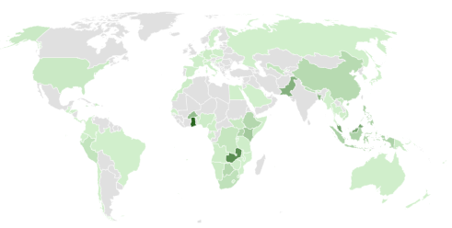
Access, usage and sustainability
Paying subscribers
Gratis subscriptions for 117 NPPOs
CABI Compendium
Premium Horizon Scanning Tool
PRA Tool
Development and outreach funded by international partners, currently through PlantwisePlus

Slide 7
Using the PRA Tool to support PRA training
Benefits
Close alignment to ISPMs
Linkage to CABI Compendium
Platform for online and offline team working
English and French
Training programme
Purpose and overview of PRA
Simple lead-in using Horizon Scanning Tool
Stage-by-stage theory followed by group work
Draft PRAs prioritised by participants
Training partnerships
COLEAD
FAO
GB NNSS
Continuing development

Slide 8
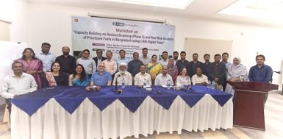
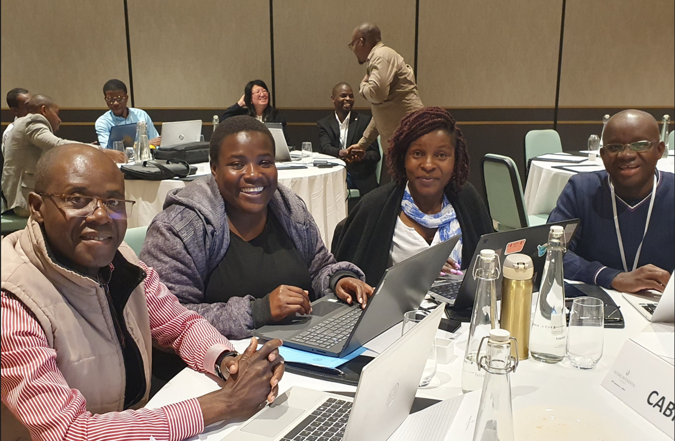
Recent PRA capacity building workshops
Horizon scanning for pest prioritization
Kenya, Ghana, Zambia, Burkina Faso, Bangladesh, Pakistan, Burundi
PRA training
Regional: East Africa, SADC, ECOWAS, ECCAS, Caribbean, UK overseas territories
PRA training partnership with COLEAD: Caribbean, Africa
National: Kenya, Ghana, Pakistan, Ethiopia, Uganda, Nepal, Bangladesh, Pakistan, Burkina Faso
Webinars: various
PRA writeshops
Kenya, Ghana, Saint Helena, Nepal, Bangladesh, Burkina Faso
Workshops to explore a regional approach for PRA
SADC (EAC and ECOWAS planned for 2023)

Slide 9
PRA capacity building workshops 2021-23
Countries : participants
70 : >400
South Asia HS and PRA
PW+, FAO, CABI: 3:84
Caribbean PRA
CABI, GB NNSS: 14:43
COLEAD virtual: 10:19
Fiji PRA
COLEAD virtual 1:3
St Helena PRA
GB NNSS: 1:6
Africa HS, PRA
PW+, FAO, CABI: 44:>250
COLEAD virtual: 7:8

Slide 10
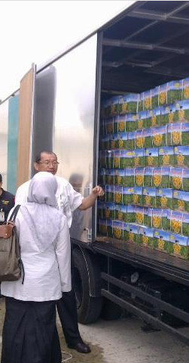
Examples of follow-on activities
Wider national training
Development of ToR for PRA Team
PRAs for more effective import control
PRAs to improve market access outcomes
Publication of PRAs on national websites
Updating of regulated pest lists
Development of national PRA protocol
Increased usage of CABI resources
Feedback to CABI to improve tools and Compendium data
Notes:
Examples from the list?

Slide 11
Planning PRA Tool improvements
General usability and efficiency
PRA learning support
Publishing/sharing PRAs
Data enhancements
Decision support
To achieve consistency and transparency in PRA
To use best risk assessment methodology and data
To link to other digital tools and data
To develop regional PRA (REC or RPPO)
Users
Trainers
Wider community of experts

Slide 12
How can we improve decision support?
Grouping and prioritising pests in a pathway PRA
For long pest lists
How to include pests that are not host-specific
Assistance with the 4 risk assessment steps
Methods and data
Climate change factors
Summarising overall risk
Risk scoring
Acceptable level of risk and appropriate level of protection
Handling uncertainty
Selection of risk management measures
Options available
Systems Approach – Beyond Compliance tools
Summarising import conditions

Slide 13
Workshop access is available to workshop participants
www.cabi.org/PRA-Tool
PRA Tool help page: www.cabi.org/PRA-Tool/help
Contact: PRA@cabi.org
Feedback: https://forms.office.com/e/372xSm3ymy
We would be very pleased to receive comments on the tool!

