Slide 1
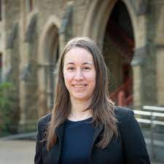
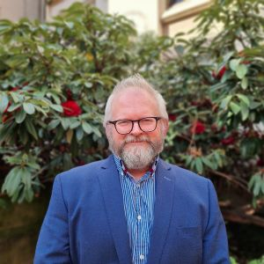
A guide to optimising investment into pest risk controls at the border a methodological perspective Anca Hanea Edith Arndt, Thao P. (TK) Le, Chris Baker, John Baumgartner, Andrew Robinson

Slide 2
Acknowledgement of Country
I'd like to acknowledge the Traditional Owners of the unceded land on which I work, learn and live, the Wurundjeri people of the Kulin Nation.
I would like to pay respect to the Elders past, present and emerging.

Slide 3
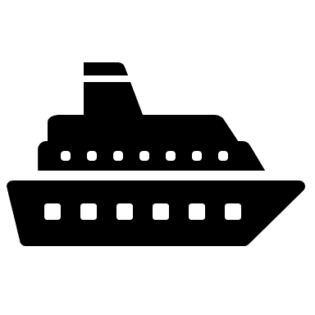
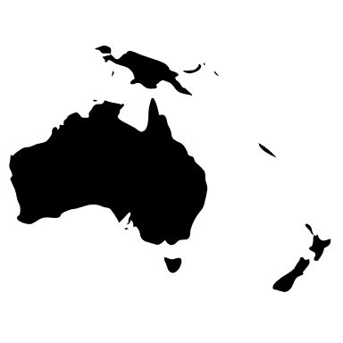
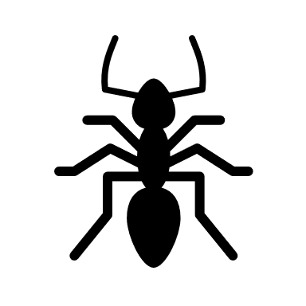
Background
Arrival rate
Leakage rate
Interventions

Slide 4
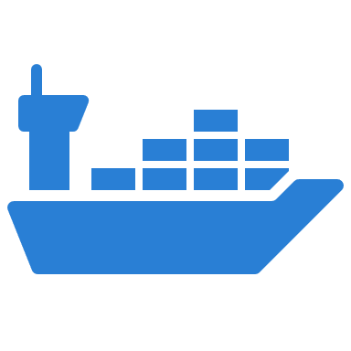
Context
Optimise border interventions with respect to a fixed set of threats arriving on the container pathway and damaging a fixed set assets/values

Slide 5
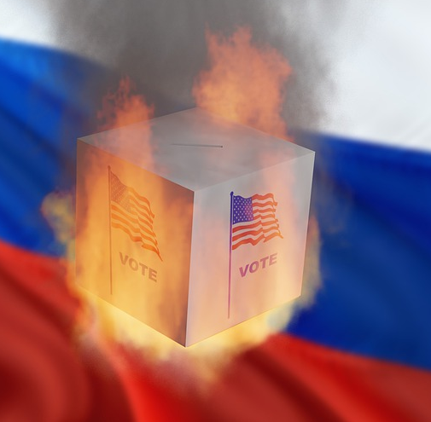
Decision Making Methodology
What can happen?
How likely is it to happen?
What are the consequences?
How do you feel about it?

Slide 6
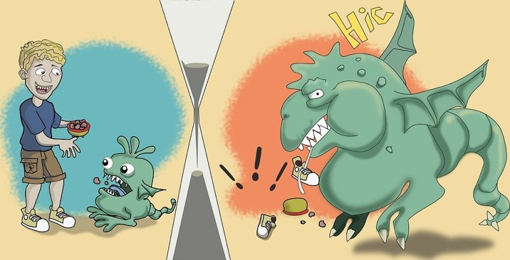
Rational Decision Making
State of world is uncertain
Outcomes/consequences of acts are uncertain
The value of an act (decision) varies with the circumstances
Utility (act/decision) = ∑ Utility (consequence)
×
Probability {state leading to that consequence}

Slide 7
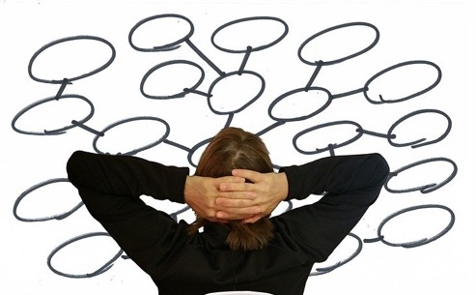
Quantitative & Qualitative
What can happen?
How likely is it to happen (i.e., what is the probability)?
What are the consequences?
How do you feel about it (i.e., what is the value/utility)?

Slide 8
Quantitative & Qualitative
Pest arrival, leakage, spread, damage
Arrival rates, leakage rates, establishment rates
Damages to assets
How much does it cost?

Slide 9
Qualitative
Conceptual Draft Model
Formal Draft Model
Arrival/pathway model
Leakage model
Spread model
Damages/Consequence model

Slide 10
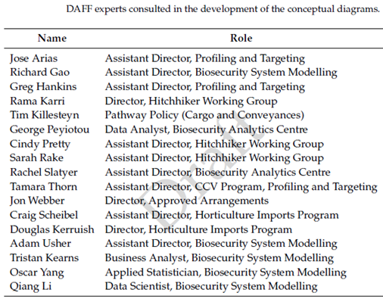
Container Pathway in Australia
Conceptual model of the container pathway
Statistical/Probabilistic/Simulation model
Expected leakage
Conceptual Draft Model
Formal Draft Model

Slide 11
Quantitative
Flickr/Creator: Brett Jordan
Covariates explaining arrival rates, leakage rates
Values of assets that may be affected, costs of interventions
Data and expert judgement

Slide 12
Container #111
High risk origin: TRUE
Offshore treatment: NO
Rural destination: FALSE
Empty container: FALSE
Container #452
High risk origin: FALSE
Offshore treatment: TRUE
Rural destination: FALSE
Empty container: FALSE
Containers have different properties = covariates explaining arrival rates

Slide 13
TREATMENT
CONTAINER PROPERTIES
INSPECTION
NO INSPECTION

Slide 14
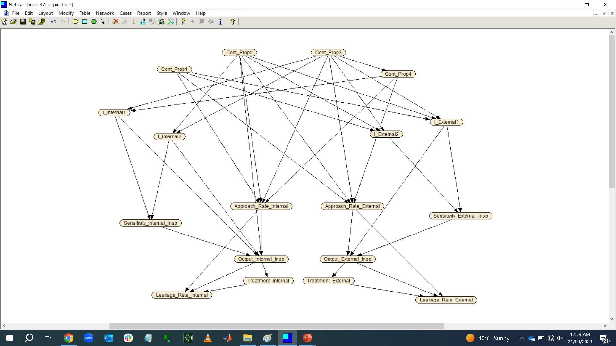
top level correlated contained properties
true contamination
detected contamination
leaked contamination

Slide 15
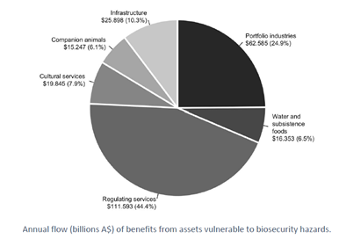
Spread / Damage Model
Dodd et al. (2020) Final report for CEBRA project 170713, The University of Melbourne,
https://cebra.unimelb.edu.au/__data/assets/pdf_file/0020/3535013/CEBRA_Value_Docs_KeyResultSummary_v0.6_Endorsed.pdf

Slide 16
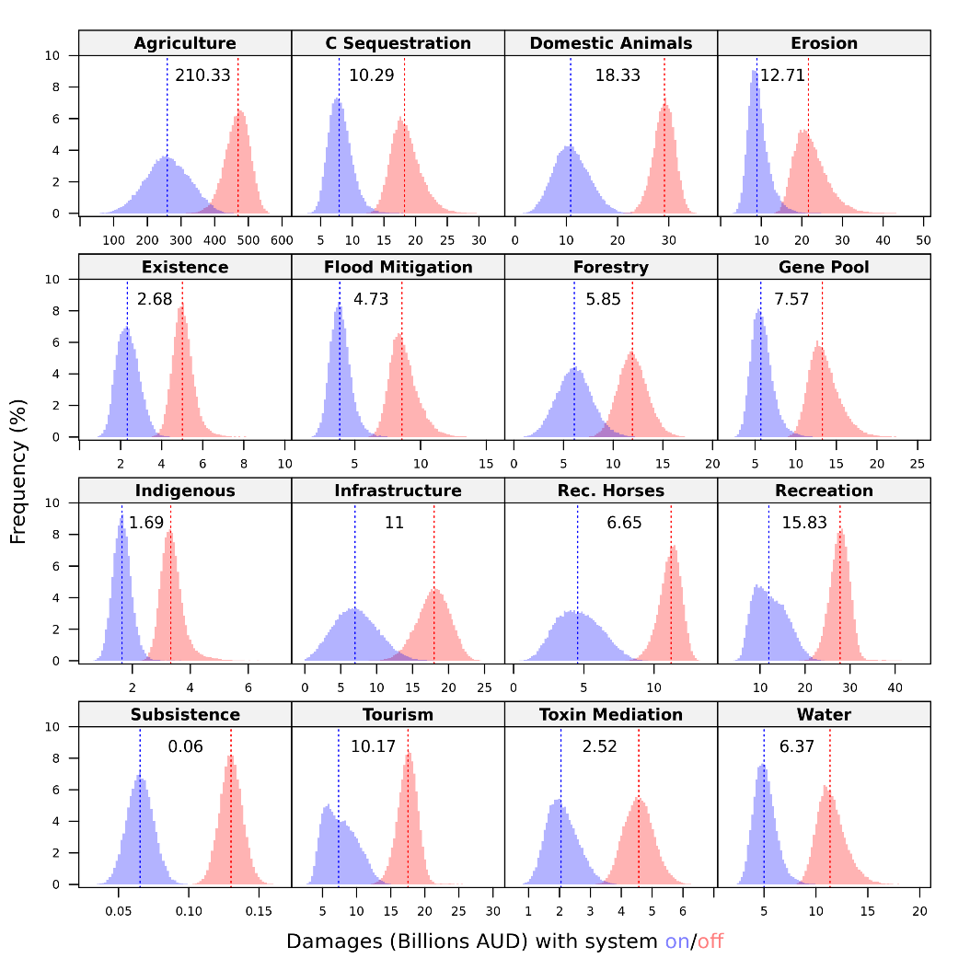
The Value Model
Parameter | Setting
Spatial resolution | AUS, 2500m x 2500m (1.3M pixels)
Assets at risk | 16
Biological hazards | 40 functional groups
Temporal resolution | 50 years, 1-year intervals
Iterations | 50,000 of each state (on/off)
Discount rates | 5% financial, 3% environmental
Dodd et al. (2020) Final report for CEBRA project 170713, The University of Melbourne,
https://cebra.unimelb.edu.au/__data/assets/pdf_file/0020/3535013/CEBRA_Value_Docs_KeyResultSummary_v0.6_Endorsed.pdf

Slide 17
The Value Added Model
Adjust policy, boarder inspection regime
Fine tune border inspection policies to achieve particular risk mitigation objectives

Slide 18
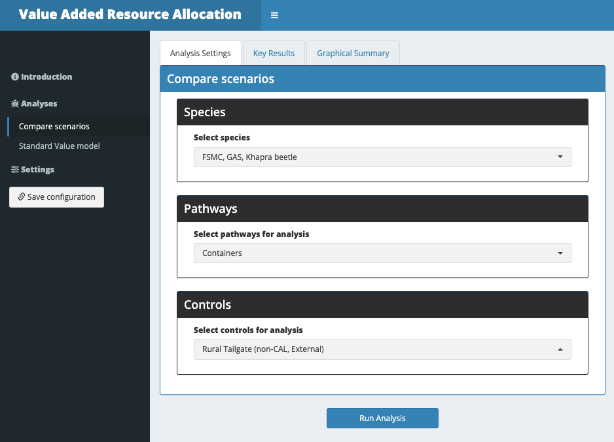

Slide 19
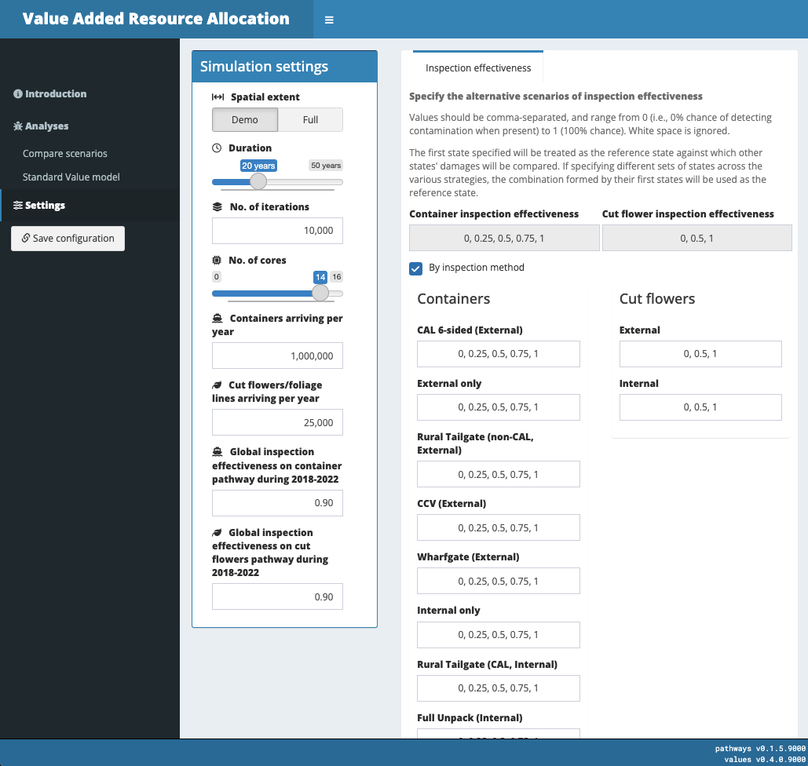

Slide 20
Asante sana
anca.hanea@unimelb.edu.au

Slide 21
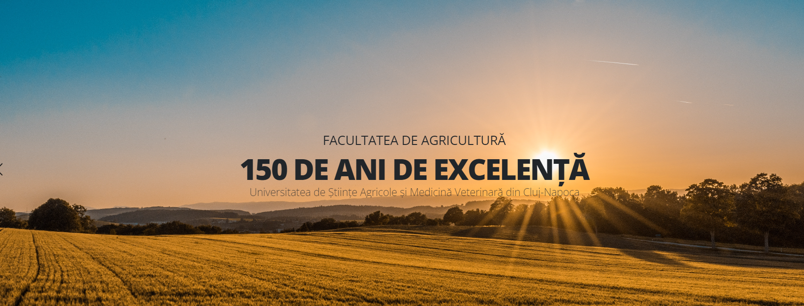
https://www.youtube.com/watch?v=-eVarZPuYCk

