Slide 1
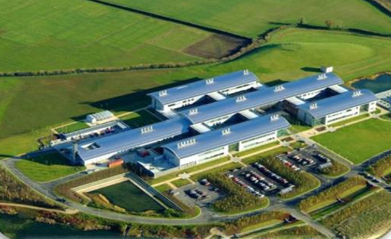
Pest Risk Analysis - DAFM
Department of Agriculture Food and the Marine
Pest Risk Analysis Unit (PRAU)

Slide 2
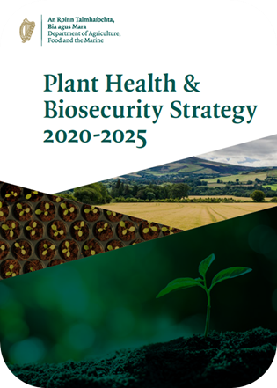
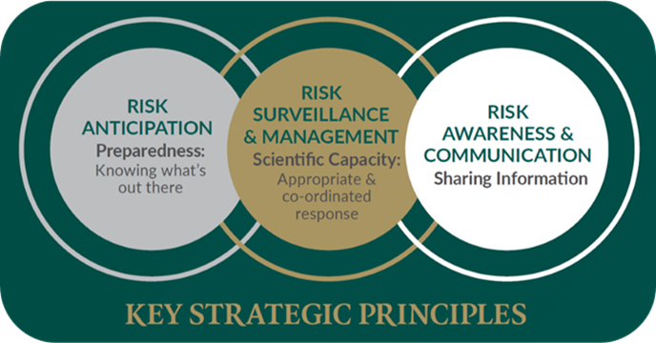
PRAU – Strategy driven
DAFM published its Plant Health & Biosecurity Strategy in November 2019: PDF
It set out policy between 2020-2025
Outlining 3 key strategic principles linked to risk
Risk Anticipation recommendations to develop Horizon scanning and pest risk analysis
Led to creation of the Pest Risk Analysis Unit (PRAU)

Slide 3
PRAU
PRAU created in 2020 as part of the Plant Sciences Division
This separates the risk evaluation process from the risk mangers in stakeholder DAFM Divisions (FID, HPHD, ICOPS and CECD)
The PRAU’s current duties are:
Horizon scanning for emerging biosecurity threats
Risk evaluation
Risk communication
Research
Plant Health Sub-Committee Projects
Conor McGee (AI)
Andy Bourke (AAI)
Notes:
The PRAU was set up in 2020 largely as a result of the PH&BSs recommendations for enhancing capacity in the area of risk assessment and anticipation of emerging threats to Irish biosecurity
…..

Slide 4
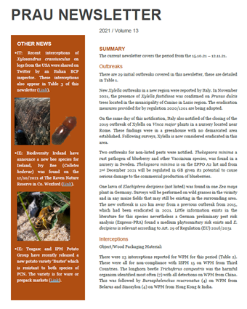
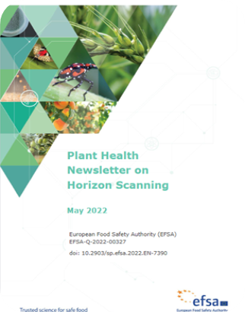
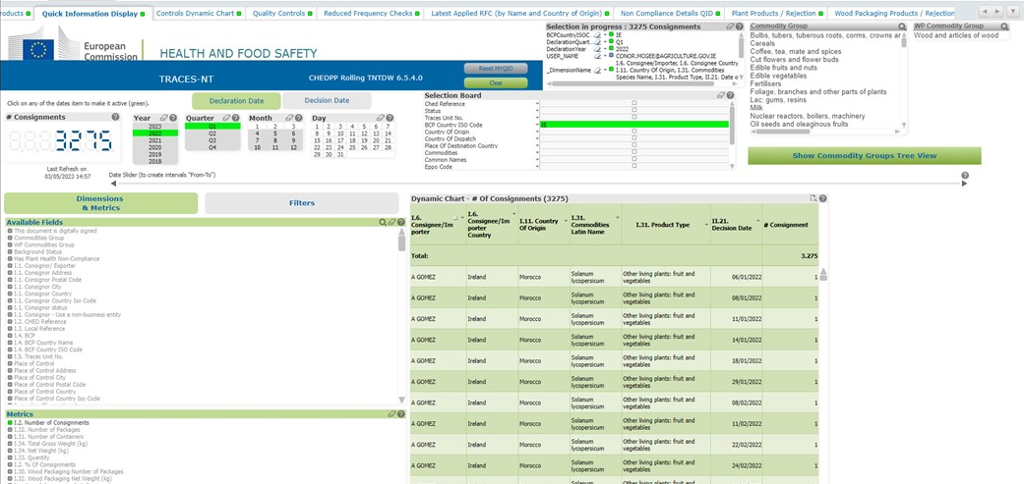
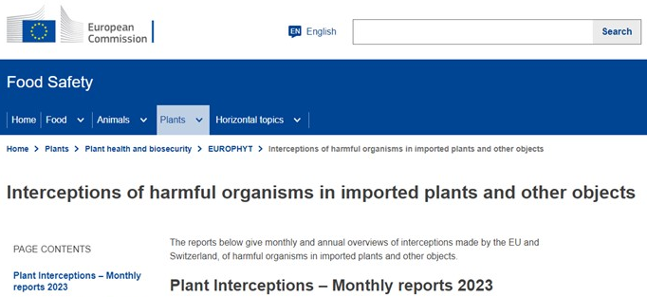
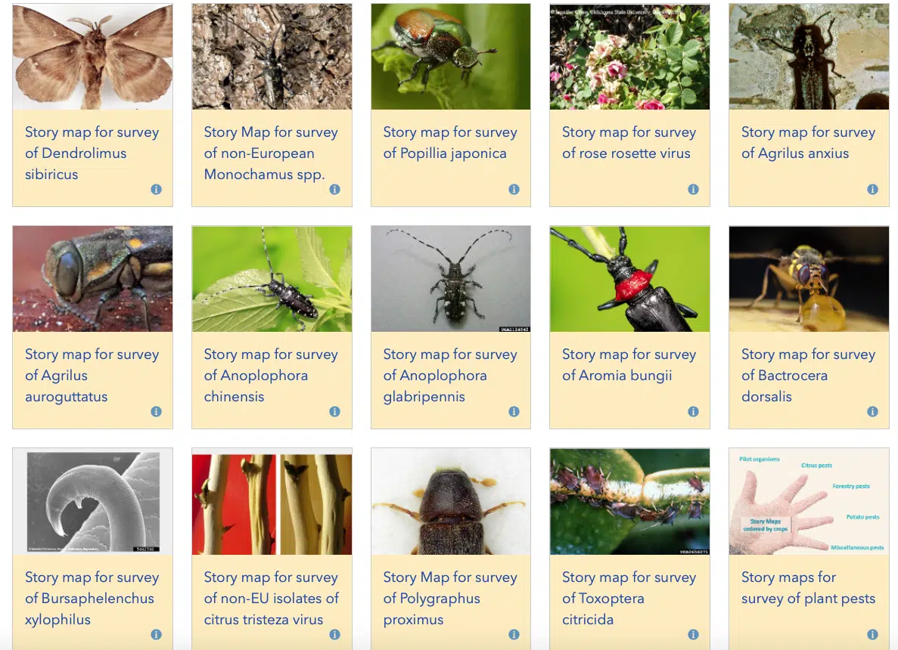
Horizon Scanning - IE
Structured Monitoring Undertaken monthly
Literature
(Scan & EFSA WG)
Citizen Science
IE Trade data
(TRACES)
Interceptions (EU - TRACES & UK – Alert list)
EU Outbreaks
(Europhyt)
Interceptions (EU & UK)

Slide 5
DEPPR - Work Prioritisation
PRAU coordinate the DAFM Emerging Plant Pest Review (DEPPR) Sub-committee
DEPPR consists of representatives from FID, HPHD, CECD, ICOPS and PSD
DEPPR serves several purposes:
Update stakeholder divisions on progress in PRAU risk assessments and projects
Sign off on final versions of PRAs and factsheets
Review recent notable developments in plant health
Select Risk Assessment prioritisation for the coming quarter

Slide 6
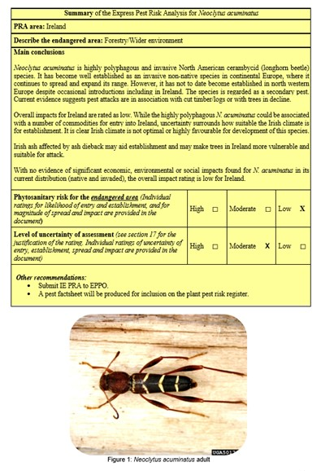
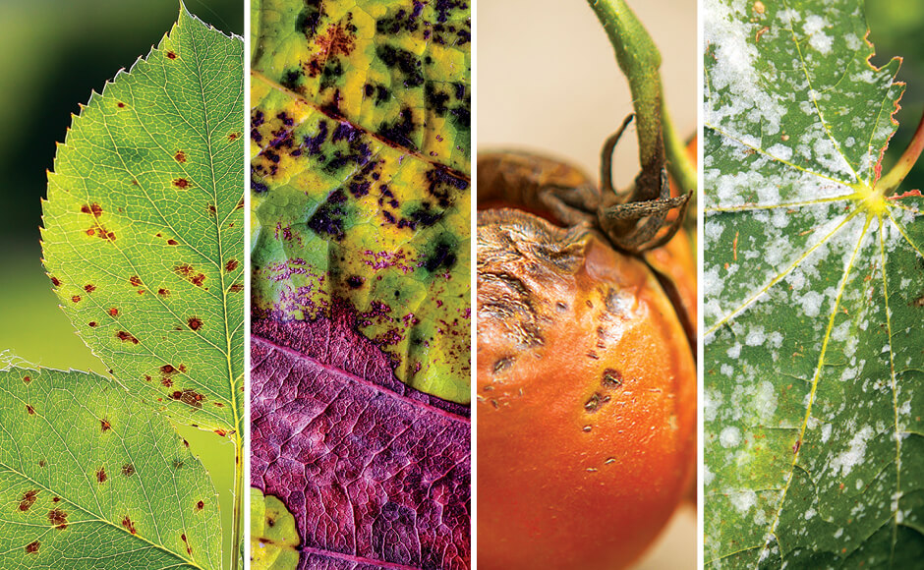
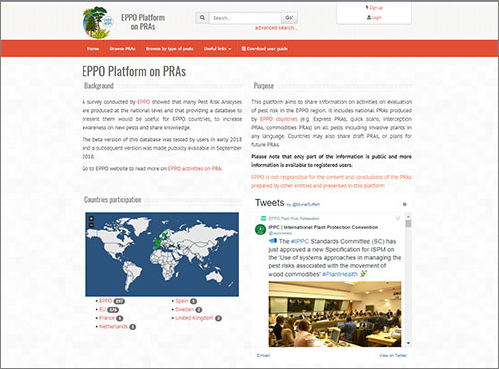
Pest Risk Assessment - IE
IE PRA
Process
Structure
PRAU draft
EPPO PRA Structure
(PM 5)
Pest or pathway topic
Prioritisation – DEPPR
Peer review
Peer Review
Public
Plant Science Division
Specialists

Slide 7
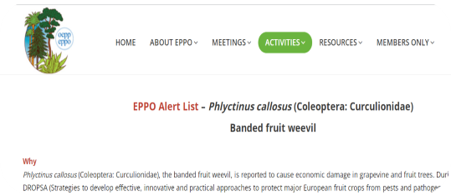
Pest Risk Assessment
IE PRA Model:
Several PRA process were explored (NL, UK, DE, FR). Current approach suits IE resources and needs.
Milestones to date include:
>20 IE PRAs complete
Several non-regulated pests added to IE surveillance (Toumeyella parvicornis, Beech leaf disease)
1 PRA already on EPPO platform, 4 pests identified for full peer review process and subsequent EPPO submission in 2023.
Bilateral meeting with DE led to creation of informal EU PRA network with Gritta Schrader
Nomination to EPPO PRA Development WG – Involvement in several PRAs, networking

Slide 8
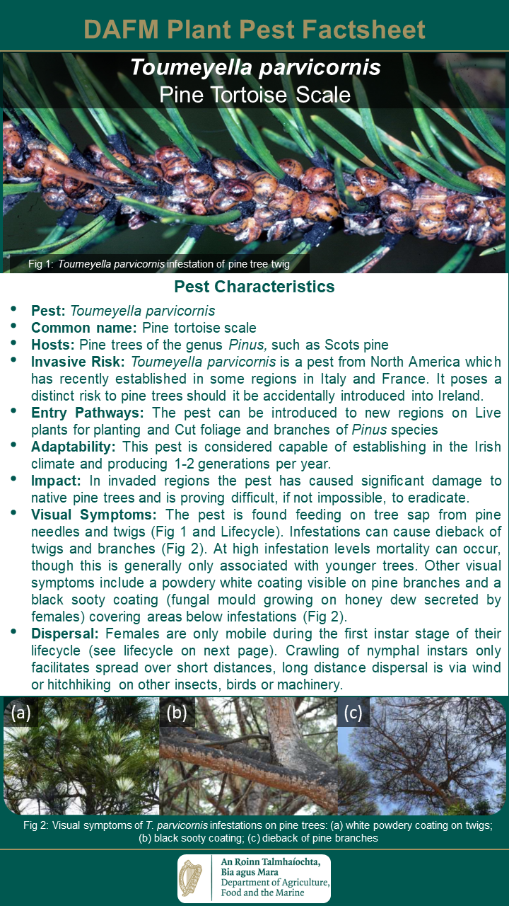
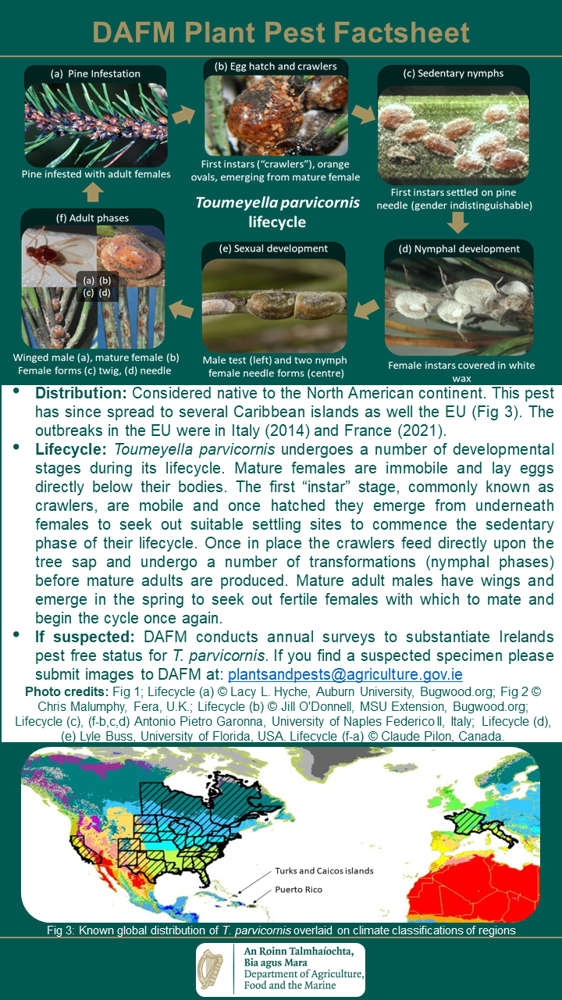
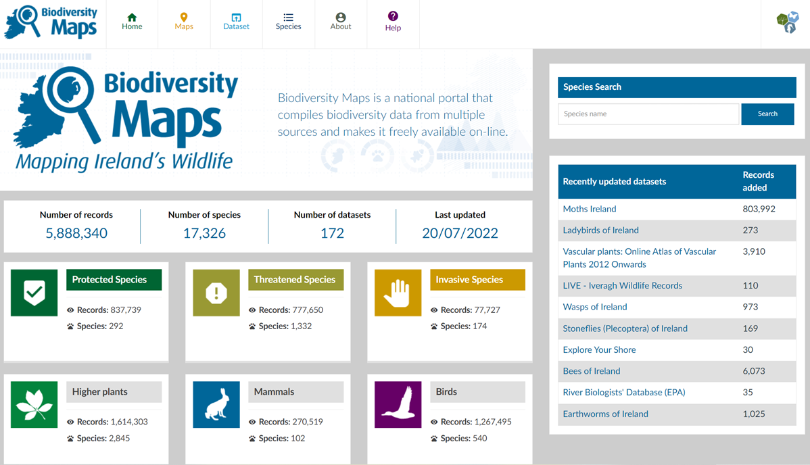
Risk Communication
DAFM Plant Pest Information:
Factsheet Website launched for EU High Priority, IE Protected zone and IE PRA pests.
Education resource for public events, citizen science, industry and third level.
Citizen science:
EU HP and IE PZ pests now listed on NBDC biodiversity database alert system.
The PRAU will receive an alert which will be disseminated to the relevant division inspector. Early warning - proof of concept already demonstrated
NBDC Biodiversity magazine articles from 2023
Plantpestreport@agriculture.gov.ie set up for non-DAFM notification of potential new pests identified in IE. Several reports to date
Notes:
There are 4 main initiatives we have progressed this year the first of which was the creation of the …..
This is a webpage launched in October of this year which consists of …
These serve as a…..
The second is our leadership in the creation of the….
We proposed an ….
The collective purpose of these 4 initiatives is to raise awareness of threats to Irish biosecurity across multiple sectors: such as third level students entering the workforce and engaged citizen scientists with the aim of enhancing surveillance capacity by raising interest in the area, while also building bridges with our peers in other departments north and south to to have a more joined up approach in the future in the areas of invasives species.

Slide 9
Research & Development
DAFM Funded Projects
Adaptfores Ph.D candidate - HS and PRA work on specific Irish forestry tree species
Online Pest Risk Analysis Modelling (OPRAM) – PSSRC funding
Proposed -Survey of Agri/forestry sectors and aid to crop prioritisation, plus impact scheme
EUPHRESCO Projects
Eclipse – Ips bark beetle project
Preparedness in Invertebrate Biological Control
Harmonisation between PPP authorisation and Popillia japonica contingency planning
Early Career Development
Support final year BSc & MSc projects
Support internships from MSc students
Third Level Engagement
Lectures given to UCD Horticulture
Exploring recorded lecture series

Slide 10
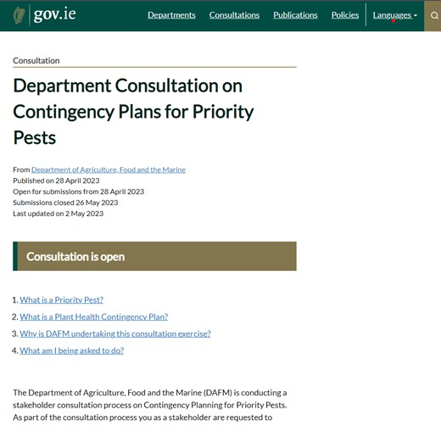
PH Committee Projects
Contingency Planning
Developed 15 HP Factsheets
Developed pest specific plans for 11 HP Pests
Surveillance
Aiding development of the Irish Multiannual surveillance plan
Building steps towards IE National Plant Pest Risk Register
Emerging Plant Pest Review - WG
IE Risk Assessment Network for Invasive species: Established network of risk assessors for invasive species from across the island DAFM / AFBI / NBDC / NPWS
Aim: Increase awareness, cooperation, research, communication and foster a joined up thinking
Met first in 2022 in Backweston, to become an annual event

Slide 11
Summary
The PRAU aims to deliver a public service that is:
Structured – All stakeholders understand the process and roles
Robust – Follows recognised international practice and is peer reviewed
Transparent – PRAs submitted to EPPO, factsheets publicly available
Inclusive – Invasive species network, Citizen science, Third level engagement
Internationally Recognised - EPPO, EFSA, Scientific publications, conferences

Slide 12
Thank you
Department of Agriculture Food and the Marine
Pest Risk Analysis Unit (PRAU)

